Slide 1
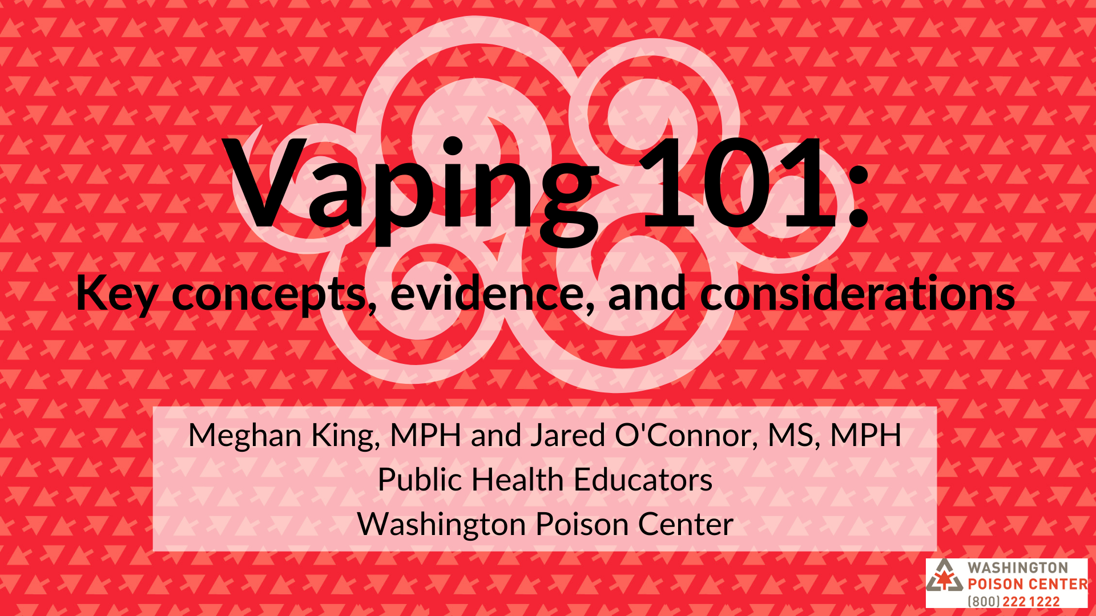
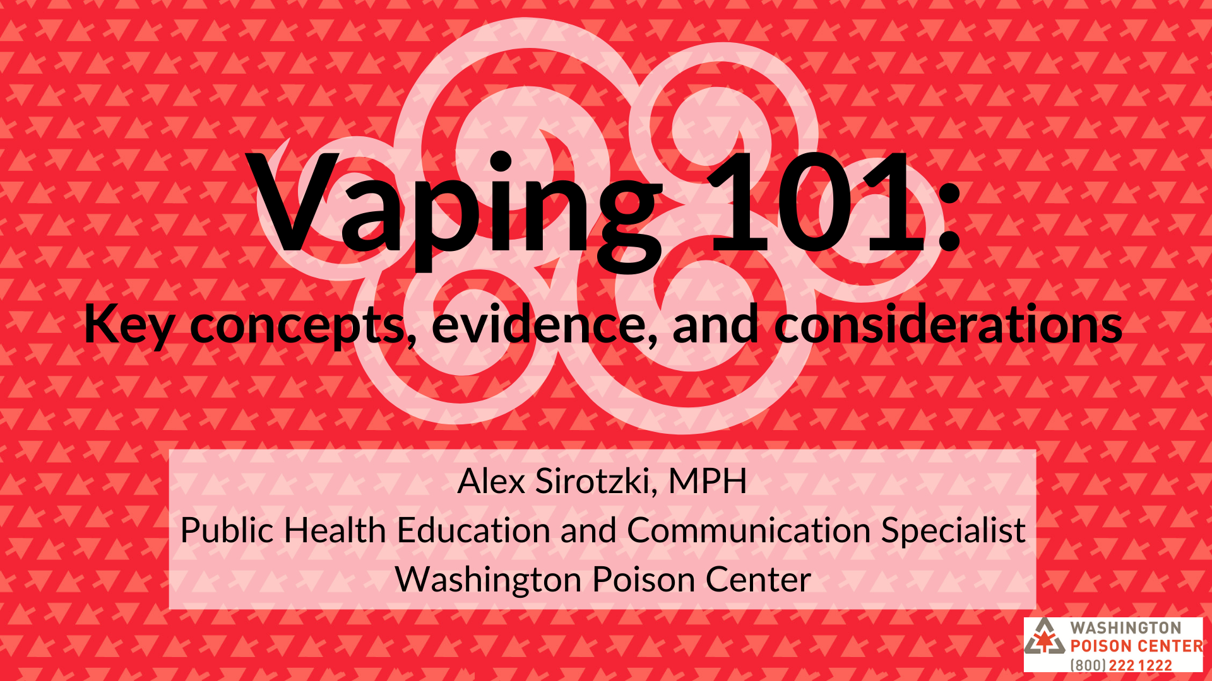
Notes:
MEGHAN

Slide 2

Housekeeping
Webinar is being recorded!
Please remain muted
Ask questions in the chat box anytime
Notes:
Explain where the chat box is located – upper right corner, select the chat icon, and type your comment/question in the box. You can send to everyone or to specific participants

Slide 3

Today’s discussion topics
The Washington Poison Center
Vaping basics
Nicotine overview
Communication
Public Health Issues
Notes:
A LOT of information, could talk for hours. Going to stick to the basics, but there’s still a lot. Please feel free to interrupt me with any burning questions, but let’s try to hold as many as possible to the end so that we cover everything I have for you.

Slide 4

Notes:
MEGHAN

Slide 5





A poison is…
Any product or substance that can be harmful if it is used the wrong way, by the wrong person, or in the wrong amount

Slide 6
Washington Poison Center services
Our Mission: To prevent and reduce harm from poisoning through expertise, collaboration, and education
We have done this for over 60 years!

Slide 7

(800) 222-1222
24/7/365
Free
Confidential
260+ Languages

Slide 8
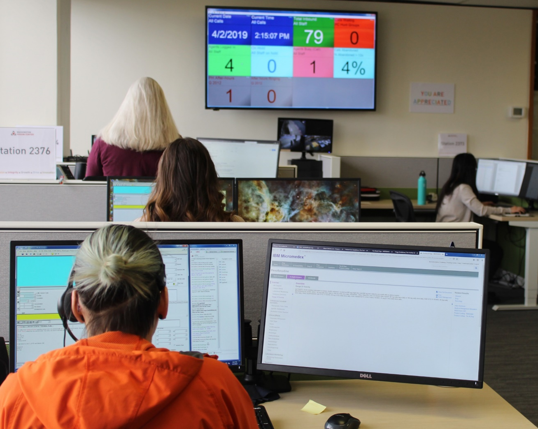
Washington Poison Center staff
Specialists in Poison Information (SPIs): expert-level nurses, pharmacists, and poison information providers
On-call Board Certified Medical Toxicologists

Slide 9

Notes:
JARED

Slide 10

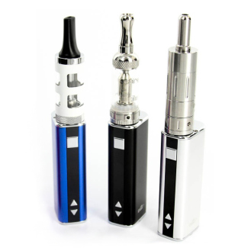

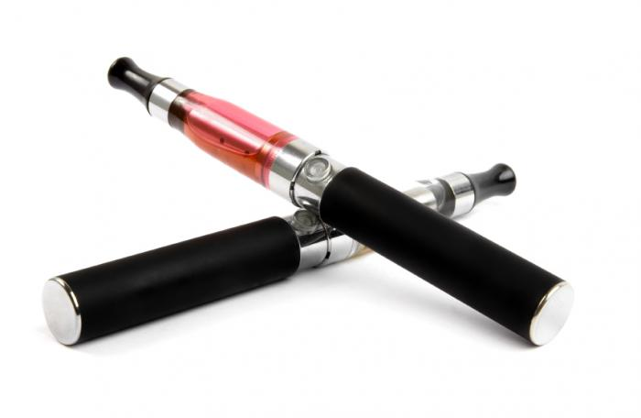
What are vaping devices?
Battery operated devices that heat a substance to create a vapor aerosol, which users then inhale
Goal = heat as close to combustion temperature as possible WITHOUT actually combusting (burning)
Known as: e-cigarette, e-cig, e-hookah, vape, mod, vape pen, vaporizer, JUUL, electronic drug delivery system (EDDS), electronic nicotine delivery system (ENDS)
Notes:
Official term = ENDS; general public does not call them ENDS. Typically hear…
Engagement: what are names you have heard?

Slide 11
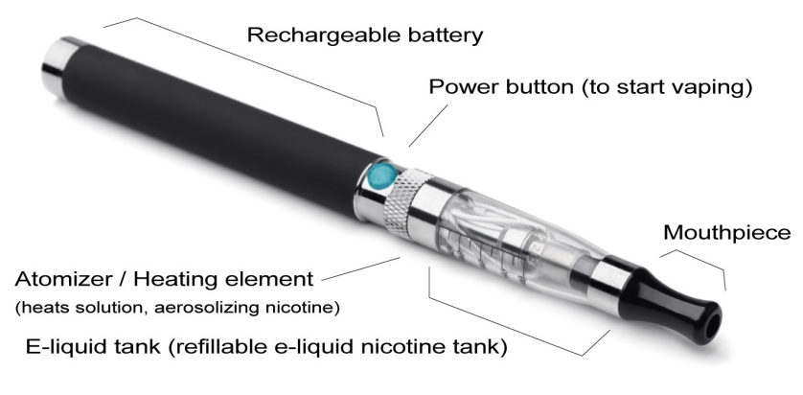
What are vaping devices?
3 Main Parts:
Battery
Heating element
Cartridge or tank
Image: https://www.kingcounty.gov/depts/health/tobacco/data/e-cigarettes.aspx
Notes:
All have a battery so that they can give power to the heating element. Atomizer heats up the liquid in the cartridge until it aersolizes, which you then inhale
Cartridge/reservoir where liquid is stored
[Pass around devices}
Battery → heats e-juice → released as an aerosol

Slide 12
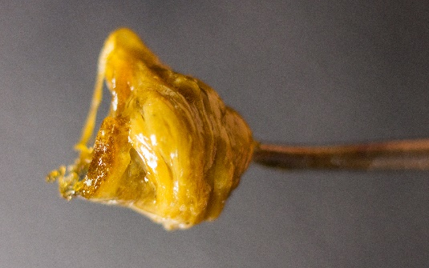
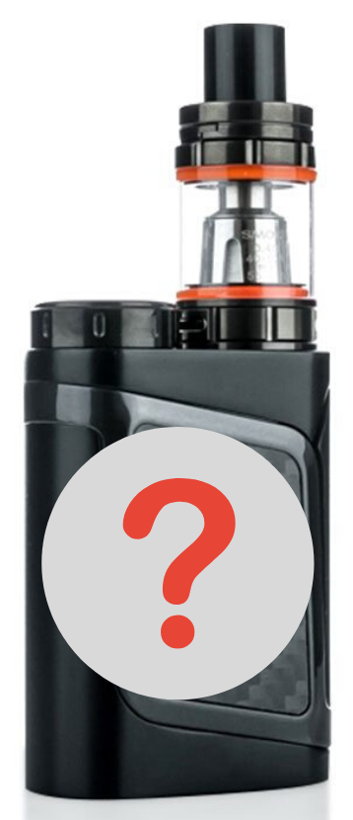
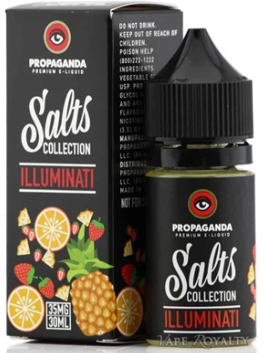
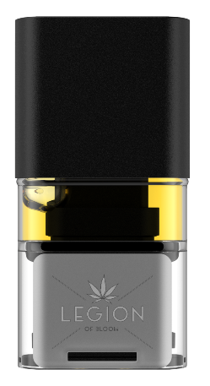
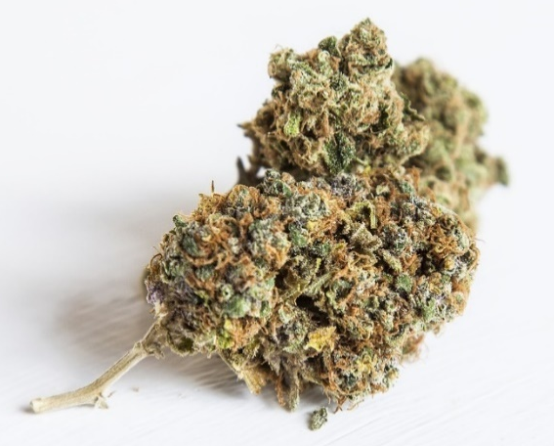
What do people vape?
Nicotine
E-juice
Just flavor?
Cannabis
Flower
Concentrate
Other substances

Slide 13
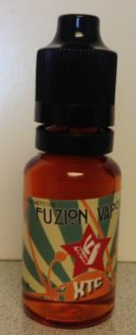
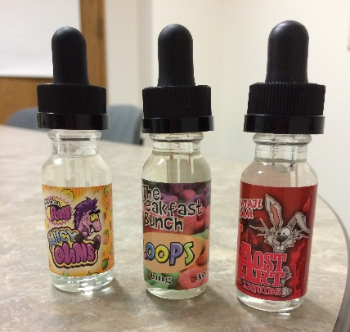
What is e-juice?
4 typical ingredients:
Liquid nicotine
Propylene glycol: helps aerosolize the nicotine
Vegetable glycerin: helps aerosolize the nicotine
Flavoring
Pre-made or self-mixed
Range of concentrations
Notes:
Lots of variation across devices. These are the basic ingredients.
Describe the ingredients in the e-liquids:
-Nicotine in liquid form
-Propylene glycol and vegetable glycerin are to help aerosolize the nicotine. Liquid nicotine is an oil-like substance. So we use vegetable glycerin to disperse the liquid nicotine throughout the substance, then add propylene glycol to thin it out (since otherwise it would be too viscous to vape)
-Flavoring: everything from fruit flavors to chocolate, essentially made up of a bunch of different chemicals. One study looked at the different chemicals in flavoring found 141 different chemicals in 1 sample

Slide 14
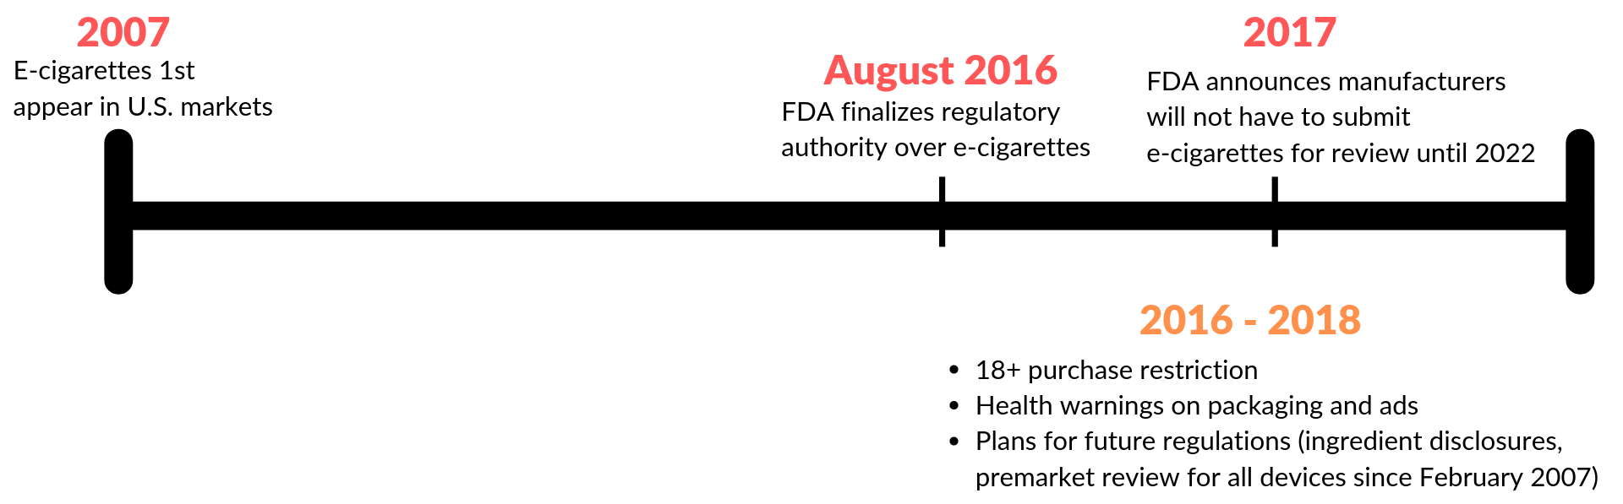
Vaping regulation (nicotine)
Notes:
Here is a simple timeline of some of the regulation around vaping:
2007: the first e-cigarettes enter the U.S. market, with no oversight
2016: The FDA finally establishes regulatory authority over e-cigarettes. Note the ~9 year gap between this and the devices introduction to the market.
2016-2018: FDA establishes a series of regulations around vape devices, including:
18+ age limit
Mandated health warnings on labels and ads
Plans for future regulations (ingredient disclosures and premarket review)
2017: FDA announces that manufacturers of ALL vape products on the market from 2007 to that point will have to submit their product for safety review, BUT that they had until 2022 to do so
More detailed scripting and sources below, if trainer wants to linger (not necessary, though):
This is a very brief history of FDA’s authority over e-cigarettes – won’t go into detail here, but it’s important to know there is a long history of delay by our federal government to fully address and regulate these products. Currently, manufacturers don’t need disclose ingredients or even report that to the FDA, no regulations on flavors, minimal marketing regulations, etc.
We really saw most regulatory action start in 2015-2016 (roughly a decade after they hit the market). In 2016, FDA officially established their regulatory authority over vaping products – they then moved to restrict sales to 18+ years old. They also released plans for future regulations relating to things like ingredient disclosures, health warnings on packages, and pre-market review (all products since Feb 2007 must get approval).
In 2017, the FDA announced that manufacturers needed to submit products to them for review in 2022. Unfortunately, this meant that products could remain on the market until then.
------
https://www.publichealthlawcenter.org/topics/tobacco-control/fda-tobacco-action-center
http://www.fda.gov/TobaccoProducts/Labeling/RulesRegulationsGuidance/ucm388395.htm
https://changelabsolutions.org/does-fda-regulate-e-cigarettes

Slide 15
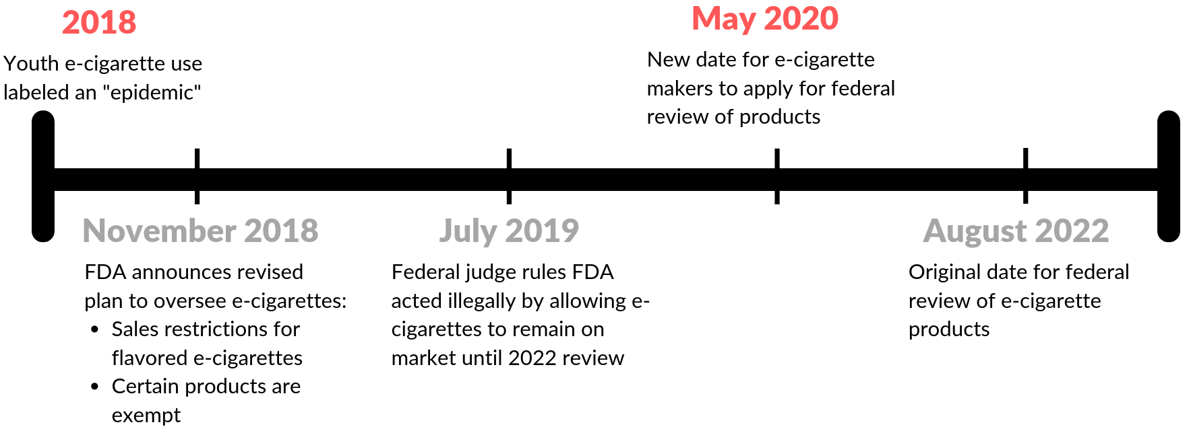
Vaping regulation (nicotine)
September 2020
January 2020
- Washington & Federal T21
- Federal flavor ban
Notes:
2018: Youth e-cigarette use declared an epidemic by FDA
November 2018: FDA alters oversight plan
Sales restriction for flavored e-cigs
This added restriction to where e-cigs could be legally sold/purchased → mainly making sure age related restrictions were in place
This banned flavors sold in spaces like convenience stores
Still could purchase other flavors online or in vape shops
Certain flavors exempt: tobacco, mint, and menthol
July 2019: Federal judge rules that the FDA acted illegally by letting devices remain on market until 2022 review
May 2020: New FDA review date
September 2020: NEW new FDA review date (pushed back due to COVID)
“To date, no ENDS product has received marketing authorization from the FDA and FDA has not issued a grandfathered status determination for an ENDS product.”
“Although we do not know how many applications will be submitted by the September deadline, we do know that there are over 400 million deemed products listed with FDA.”
January 2020
WA T21 and Federal T21
Federal flavor ban
More detailed scripting and sources below, if trainer wants to linger (not necessary, though):
In 2018, the FDA publicly announced that e-cigarette use among youth had reached the threshold to be considered an “epidemic.”
Scott Gottlieb: “Today, I’m directing the FDA’s Center for Tobacco Products (CTP) to revisit this compliance policy as it applies to deemed ENDS products that are flavored, including all flavors other than tobacco, mint and menthol. The changes I seek would protect kids by having all flavored ENDS products (other than tobacco, mint and menthol flavors or non-flavored products) sold in age-restricted, in-person locations and, if sold online, under heightened practices for age verification.”
https://www.fda.gov/news-events/press-announcements/statement-fda-commissioner-scott-gottlieb-md-proposed-new-steps-protect-youth-preventing-access
In November of that same year, they announced additional actions they would take to regulate these products. Specifically, they planned to move towards restricting sale of flavored e-cigarettes – mainly ensuring age-restrictions were in place and verified. What’s concerning is that certain flavors were exempt from this regulation: menthol, mint, and tobacco are exempt along with non-flavored products. This is despite data showing that mint is one of the most popular flavors among high school youth– in fact, over half (57.3%) of high school youth who use e-cigarettes use mint flavored products.
Step in the right direction, but provided criticism that sales restrictions were only a partial measure
Plus, folks thought the delay of federal review of e-cigarette products would only contribute to the epidemic
July 2019: federal judge ruled the FDA acted illegally when it allowed vapor products to remain on the market until 2022. E-Cigarette makers now must reapply by May 2020. FDA must then act within 1 year.
FDA evaluates a new tobacco product based on whether it is appropriate for the protection of the public health, among other things. Scientific evaluation considers the risks and benefits of the product for the whole population, including users and non-users. These data should show the increased or decreased likelihood that current tobacco users will stop using certain products, as well as the increased or decreased likelihood that non-users will start using the products.
https://www.fda.gov/downloads/TobaccoProducts/GuidanceComplianceRegulatoryInformation/UCM501016.pdf
https://www.fda.gov/news-events/fda-voices-perspectives-fda-leadership-and-experts/how-fda-regulating-e-cigarettes

Slide 16

Washington Tobacco & Vapor 21
Effective January 1, 2020
Illegal to sell tobacco and vapor products to anyone under 21
Penalties:
18-20 year olds will NOT face penalties for purchase, use, or possession
Youth under 18 may still face penalties (fine/community service)
Retail violation = gross misdemeanor (criminal charges, fines, or both)
Goal = closes off social circles
Notes:
A little bit of hope… lots more policy/regulations needed, but step in the right direction
Washington Tobacco and Vapor 21 was signed into law on April 5, 2019, and went into effect on January 1, 2020.
This bill made it illegal to sell tobacco or vapor products to anyone under 21. Enforcement is primarily focused on retailers, not consumers. Retailers caught selling to those under 21 will face criminal charges, fines, or both. 18-20 year olds won't face penalties for purchase, use, or possession, but youth under 18 may still face fines or community service.
Military bases and tribal lands can opt in to Washington's T21 but are not required to.
We are in a bit of a limbo state for 18-20 yo's; currently there are no penalties for purchase, use, or possession.
For WA T21, youth laws and penalties did not change (for youth under age 18).

Slide 17
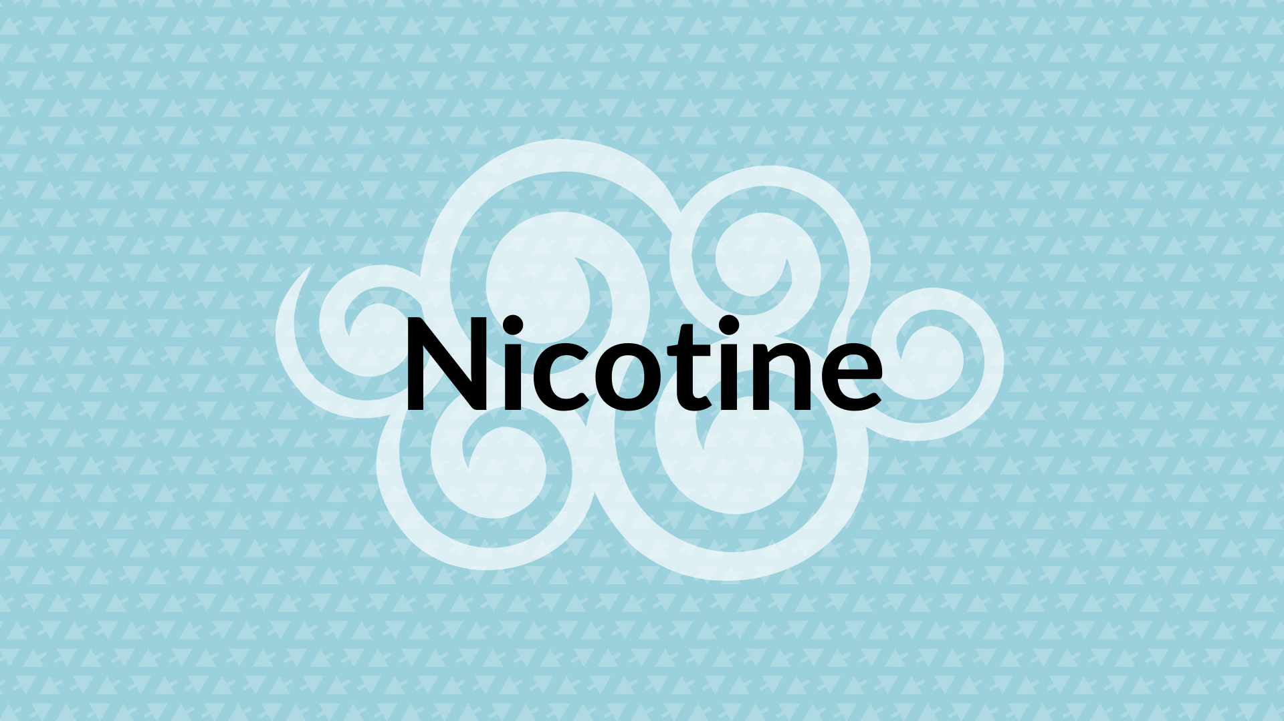
Notes:
JARED

Slide 18

What is nicotine?
Nicotine is a natural chemical found in the tobacco plant
Found in many different products
Pesticides
Smoking products (cigarettes, cigars, pipes, etc.)
Tobacco products (chew, snus, dry snuff, etc.)
Vaping products

Slide 19
Acute clinical effects of nicotine
Routes of exposure: inhalation, ingestion, absorption
Severity of effects dependent on exposure amount, concentration of product, and individual
Mild to Moderate | Severe
Upset stomach Nausea/vomiting Dizziness Headache Tremor Increased heart rate High blood pressure | Seizures Lethargy/weakness Confusion Decreased heart rate Low blood pressure Trouble breathing Death

Slide 20
(Physical) dependence & addiction
Physical (dependence) occurs when the body/brain begins to rely on an external substance to maintain normal function
Tolerance: needing ever-increasing doses to maintain normal function
With dependence, reducing/quitting the substance leads to withdrawal (range of symptoms)
Addiction: when dependence becomes disruptive to other aspects of life (dependence is a symptom of addiction)
Notes:
What does that mean? Well, dependence is [DEFINE DEPENDENCE]
Dependence is requires 2 factors:
Tolerance
Withdrawal symptoms
Addiction is similar but distinct from dependence
While it is possible to have a physical dependence but not an addiction, dependence runs the risk of developing into an addiction

Slide 21

Nicotine and the brain
Nicotine reaches the brain within seconds
Interacts with the brain’s reward system → releases dopamine
Trains the brain to repeat the action that caused it to “feel good”
“Positive” effects of nicotine:
Pleasure
Decreased stress/anxiety
Mood control
Improved concentration
Appetite suppressant
Notes:
https://www.drugabuse.gov/publications/research-reports/tobacco-nicotine-e-cigarettes/nicotine-addictive
For cigs, it’s 10 seconds

Slide 22

Nicotine and the brain
Nicotine is quickly broken down by the body → leads to craving more
Tobacco research:
# of brain receptors increases with continual exposure to nicotine → makes cravings more intense
Repeated exposure alters learning, stress, & self-control
Nicotine withdrawal symptoms:
Difficulty concentrating
Irritability
Depressed mood
Restlessness
Anxiety
Insomnia
Notes:
https://www.drugabuse.gov/publications/research-reports/tobacco-nicotine-e-cigarettes/nicotine-addictive

Slide 23
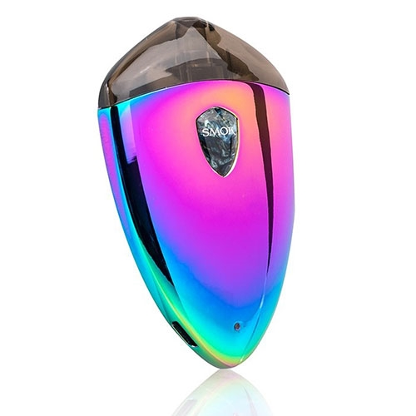
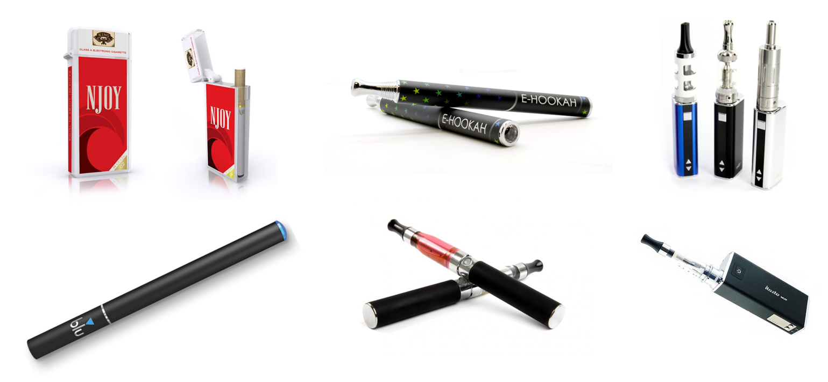
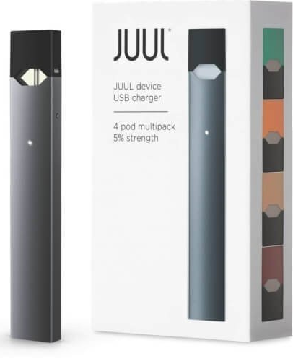

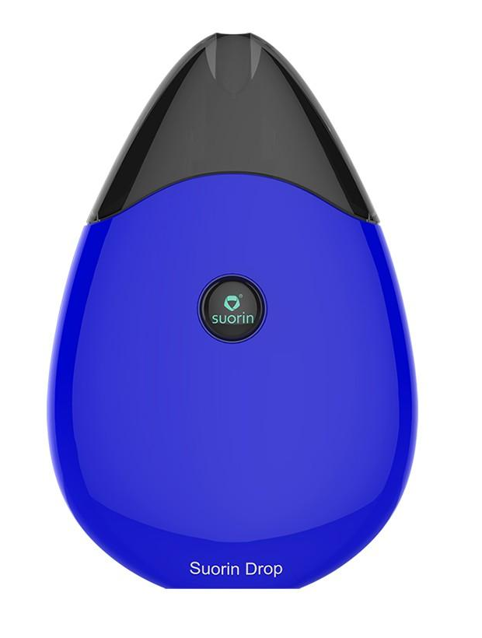
Evolution of vape devices
Disposable salt-based
Minis/Cigalikes
Vape Pen
Box Mod
JUUL
Pod Vapes
*Images are not to scale
Freebase nicotine
Salt-based nicotine
Notes:
MEGHAN WILL SHOW DEVICES WHILE JARED SPEAKS
Speaking Points
Since they were first introduced, e-cigarette devices have evolved over several “waves” similar to the way that cell phones have evolved from the basic flip phone to the iphone 11.
The first wave of E-cigarettes, Cigalikes or minis, are usually disposable and closely resemble traditional cigarettes.
The second wave is a larger device, the mid-size rechargeable vape pen.
The third wave is a much larger rechargeable device with a large battery, the box mod, and can often be customized with different parts.
The fourth wave of devices is where we are now, with smaller and sleeker salt-based devices that can be recharged and have pre-filled or refillable “pods.” Salt-based devices were introduced by JUUL, and now other companies are adapting to a similar pod vape model.
We will go into more detail next about each of these types of device. You’ll see just how these products have evolved since they were first introduced to the market around 2007-2008.
Step through each type, and show samples of the product as you go (if available).
Sources:
Truth Initiative. (2019, Nov 11). E-cigarettes: Facts, stats and regulations. Retrieved from https://truthinitiative.org/research-resources/emerging-tobacco-products/e-cigarettes-facts-stats-and-regulations.

Slide 24
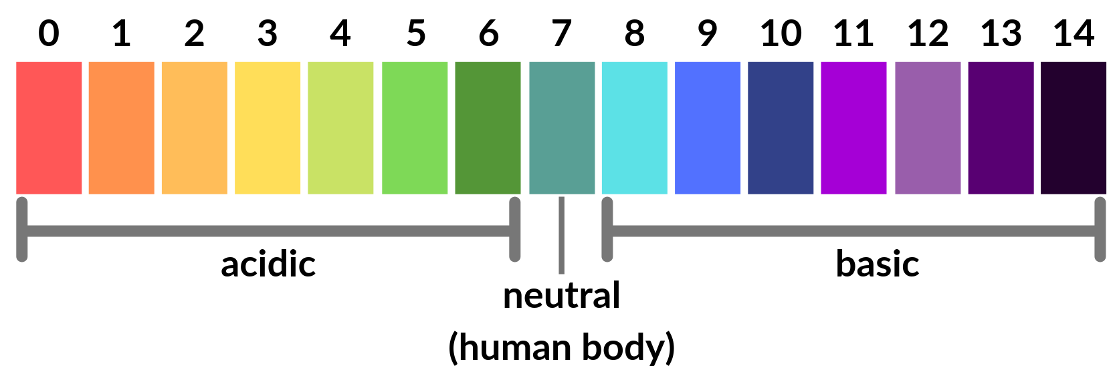
Salt-based nicotine is less harsh
Salt-based nicotine (<400°F)
Free-base nicotine (~420°F)
Notes:
We include this pH scale to highlight an important difference between free-base nicotine and salt-based nicotine:
Free-base
Freebase is nicotine directly extracted from tobacco; FB has high alkalinity, meaning it is basic – right here around at 8 to 8.5 on the pH scale.
This pH matters because of harshness – when something has a pH different from the human body, it feels harsh or irritating. (burn in the back of the throat)
Manufacturers used to cover the harshness of freebase w/ additives like menthol, which creates a cooling effect
Salt-based:
Nicotine has been treated with acids, which makes the pH of the nicotine solution more acidic, closer to that of the human body (which is 7). This means that you can have higher concentrations of nicotine, while having a smooth pull.
There’s a 2nd advantage to salt-based. Because you can have higher concentrated liquids, you don’t need to have as big of a reservoir to hold all the liquid. This then cascades down, because you don’t need to aerosolize as much liquid, you don’t need as big of heating elements. You don’t need as big of a heating element, you don’t need as powerful of a battery. This all adds up to the devices being smaller, all thanks to being higher concentrated liquid.
When JUUL first came out, teachers had no idea what they were.
Can’t vape in class- still produces a cloud
A lot of use is in the bathroom. But, kids are crafty! Don’t have an answer to what should be done

Slide 25
Synthetic nicotine and Puff Bar
Synthetic nicotine: a form of nicotine fully created in a lab rather than derived from tobacco
Health effects vs. tobacco-derived nicotine → uncertain
Puff Bar
Surged in popularity following the federal flavor ban
Legal loophole allowing flavors for disposal salt-based nicotine products
FDA ordered them to cease sales in July 2020
Spring of 2021, announced a return to the market with “tobacco-free nicotine” to sidestep earlier FDA ruling
Notes:
https://truthinitiative.org/research-resources/harmful-effects-tobacco/what-you-need-know-about-new-synthetic-nicotine-products
https://puffbar.com/collections/puff-bar

Slide 26
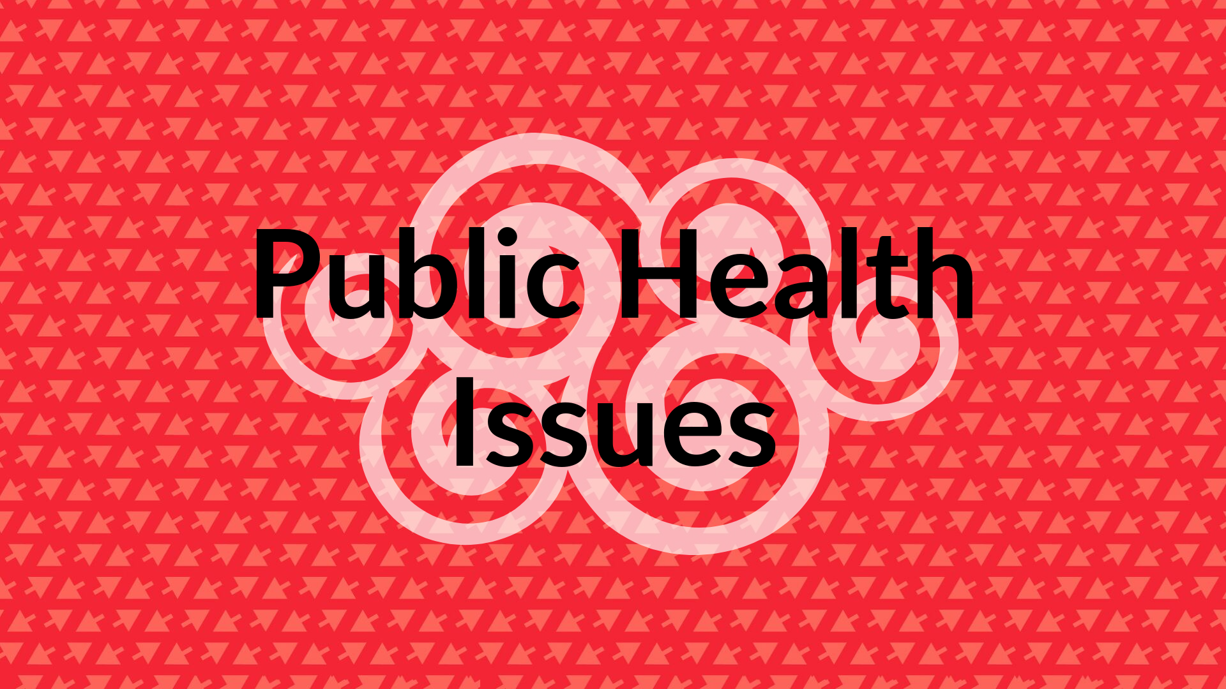
Notes:
JARED

Slide 27
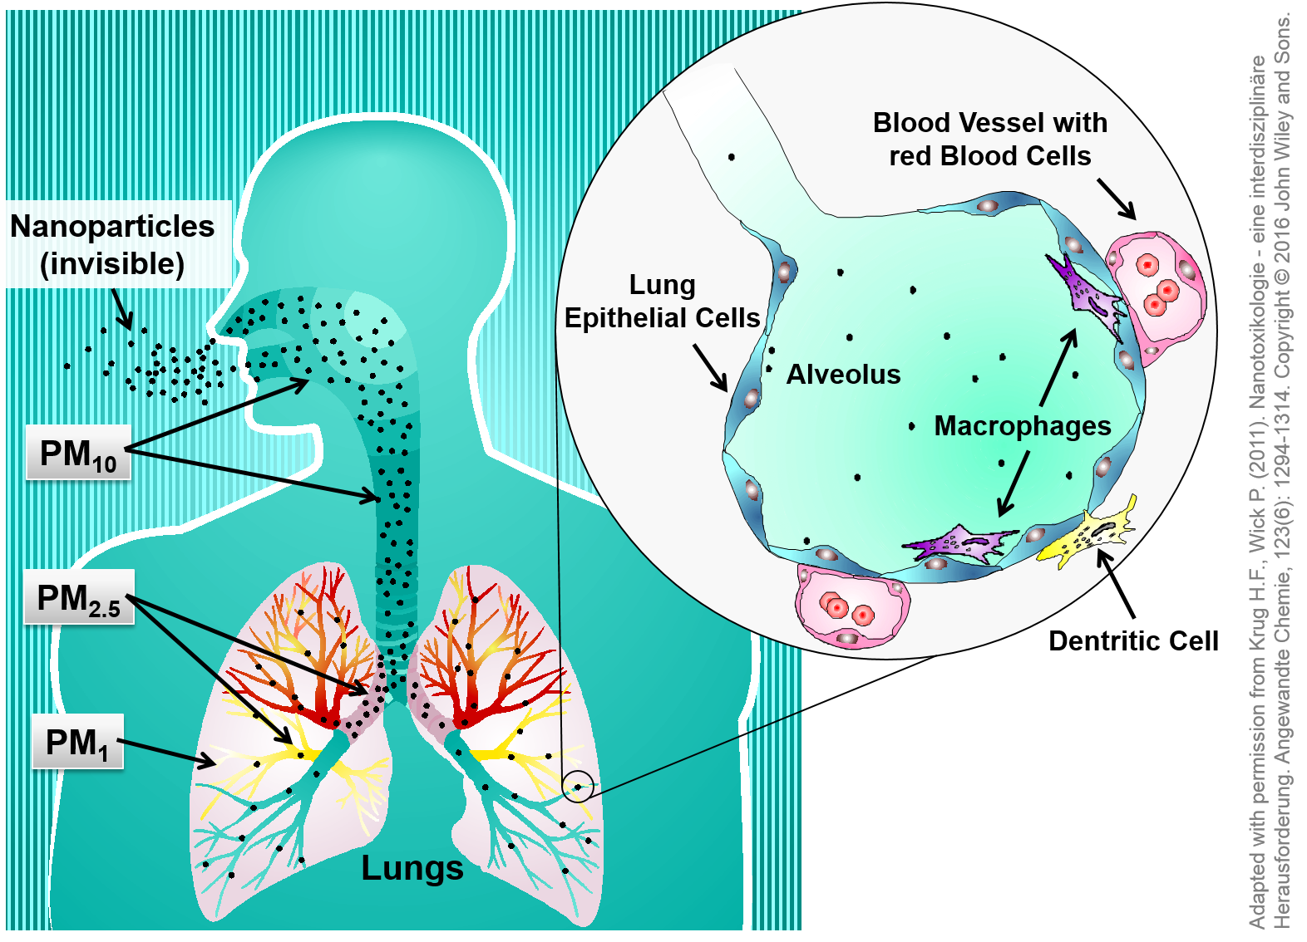
Aerosol dangers: ultra-fine particles
Vaping devices > combustible cigarettes
Travel deep into the lungs & bloodstream
Potential for greater absorption of attached chemicals (compared to particles in tobacco smoke)
Notes:
Size of particles in a vaping device’s aerosol
Aerosol from e-cigarettes have higher concentrations of Ultrafine Particles (UFP) than conventional cigarettes. UFP are particularly concerning because of they are so small, they can travel deep into the lungs, which may cause short-term and long-term respiratory and cardiovascular harm. And, research has shown that the chemicals from e-cigarettes that attach to the ultrafine particles can cause greater bodily harm than the chemicals attached to larger tobacco smoke particles.
They are small enough to travel to the alveoli (refer to image call-out of alveolus), the tiny air sacs at the end of our bronchial tubes where the gas exchange occurs – turning inhaled carbon dioxide into oxygen and sent to the bloodstream for distribution throughout our body (to our organs and heart).
-------------
http://www.onlinejacc.org/content/64/16/1740
Fuoco, F.C.; Buonanno, G.; Stabile, L.; Vigo, P., “Influential parameters on particle concentration and size distribution in the mainstream of e-cigarettes,” Environmental Pollution 184: 523-529, January 2014.
Manigrasso, M.; Buonanno, G.; Fuoco, F.C.; Stabile, L.; Avino, P., “Aerosol deposition doses in the human respiratory tree of electronic cigarette smokers,” Environmental Pollution 196: 257-267, January 2015.
Mikheev, V.B.; Brinkman, M.C.; Granville, C.A.; Gordon, S.M.; Clark, P.I., “Real-time measurement of electronic cigarette aerosol size distribution and metals content analysis,” Nicotine and Tobacco Research [Epub ahead of print], May 4, 2016.
Lerner CA, Sundar IK, Yao H, Gerloff J, Ossip DJ, McIntosh S, et al. (2015) Vapors Produced by Electronic Cigarettes and E-Juices with Flavorings Induce Toxicity, Oxidative Stress, and Inflammatory Response in Lung Epithelial Cells and in Mouse Lung. PLoS ONE 10(2): e0116732. https://doi.org/10.1371/journal.pone.0116732

Slide 28

Youth-specific concerns – nicotine
Nicotine can harm adolescent brain development
Repeated nicotine use in adolescence can harm the parts of the brain that control:
Attention
Learning
Mood
Impulse control
Notes:
Before we move on from nicotine, we wanted to dedicate one last slide to a youth specific concern beyond everything we’ve already talked about with nitrosamines, dependence, addiction, etc. That concern is harm to adolescent brain development.
The brain continues to develop through around age 25, and nicotine can harm brain development during this critical period when the brain is still vulnerable.
In adolescence, nicotine use is associated with lasting cognitive and behavioral impairments, including effects on working memory, attention, mood, and behavior, like impulse control.
Ramifications from these effects can truly be life-altering, as all of those things are really important for a kid to do well in school, stay safe, and healthy.
Sources:
US Department of Health and Human Services. E-cigarette Use Among Youth and Young Adults: A Report of the Surgeon General.Cdc-pdf [PDF – 8.47MB]. Atlanta, GA: US Department of Health and Human Services, CDC; 2016. Accessed July 27, 2018.
DiFranza, JR, et al., “Initial Symptoms of Nicotine Dependence in Adolescents,” Tobacco Control 9:313-19, September 2000. https://www.ncbi.nlm.nih.gov/pubmed/10982576

Slide 29
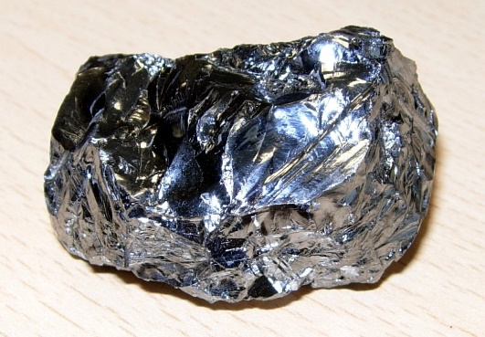
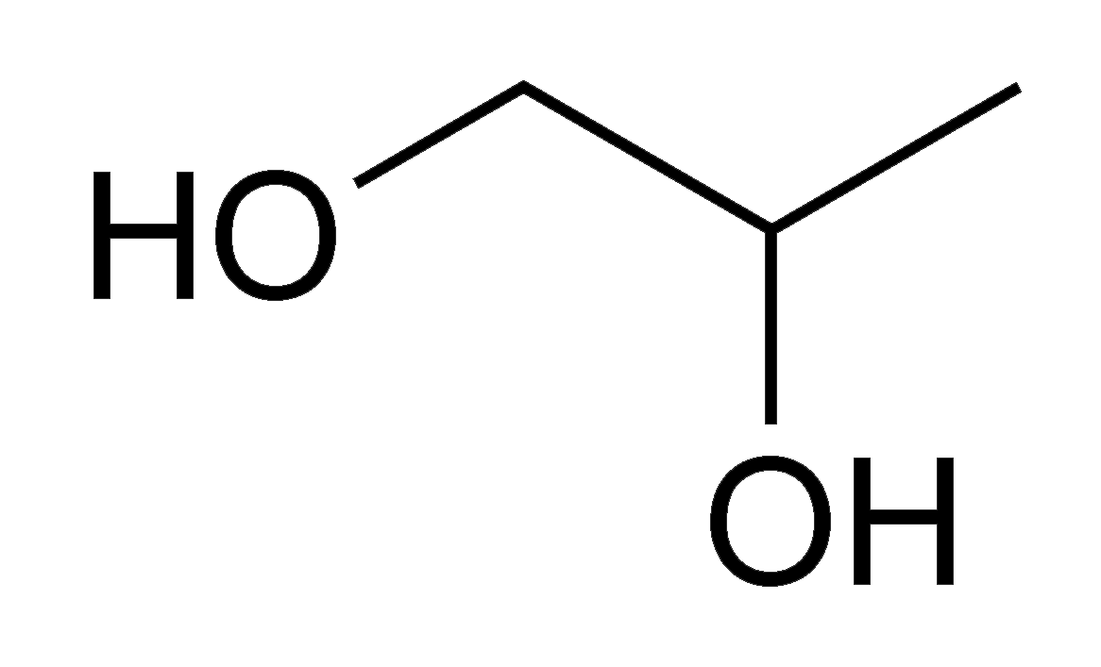
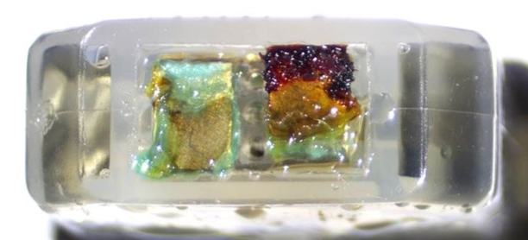
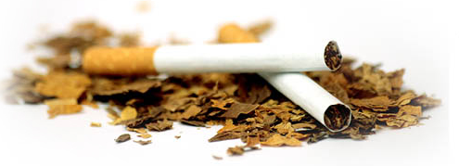
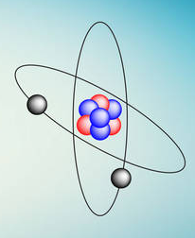

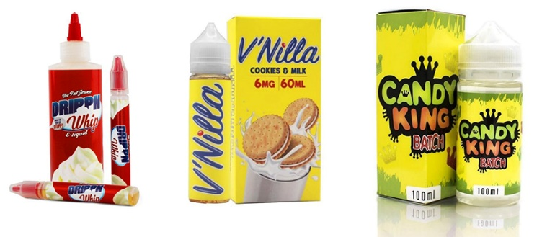
Aerosol dangers: carcinogens and more
Silicon
Propylene glycol
Heavy metals
Nitrosamines
Free radicals
Pesticides
Flavoring
Notes:
MEGHAN
Heavy metals (lead, arsenic, cadmium, chromium, tin, nickel, manganese, lithium, and others): Inhalation of heavy metals lead to lung, liver, and brain damage; has been linked to cancer in the lung, liver, brain, immune system, and cardiovascular system.
Flavoring (diacetyl, acetyl propionyl, acetoin, pulegone): some of these are approved for ingestion, but not for inhalation. Example = diacetal:
Propylene glycol: ingestion → release of formaldehyde
Silicon
Free radicals
Pesticides: some can become hydrogen cyanide when heated
Tobacco-specific Nitrosamines: primary carcinogen in tobacco smoke; animal studies have shown potential for lung and bladder cancers
Image sources:
CC BY-SA 3.0, https://commons.wikimedia.org/w/index.php?curid=105596
By Enricoros at English Wikipedia - Transferred from en.wikipedia to Commons., Public Domain, https://commons.wikimedia.org/w/index.php?curid=3520523
https://www.wingsforlife.com/en/latest/the-good-thing-about-free-radicals-3286/
https://www.kgw.com/article/news/investigations/vaping-samples-tested-vitamin-e-is-vaping-bad-for-you-vape-toxicity/283-7b8c9947-18ab-4895-9283-04c93b6f7a46
https://www.caaquebec.com/en/at-home/guides/your-healthy-home-guide/pesticides/
(https://www.jhsph.edu/news/news-releases/2018/study-lead-and-other-toxic-metals-found-in-e-cigarette-vapors.html)
Jensen, R. Paul, et al. "Hidden formaldehyde in e-cigarette aerosols." New England Journal of Medicine 372.4 (2015): 392-394.
Goel, Reema, et al. "Highly Reactive Free Radicals in Electronic Cigarette Aerosols." Chemical Research in Toxicology 28.9 (2015): 1675-1677.
Allen, Joseph G., et al. "Flavoring Chemicals in E-Cigarettes: Diacetyl, 2, 3-Pentanedione, and Acetoin in a Sample of 51 Products, Including Fruit-, Candy-, and Cocktail-Flavored E-Cigarettes." Environ Health Perspect(2015).
https://www.ncbi.nlm.nih.gov/pmc/articles/PMC5768608/))

Slide 30
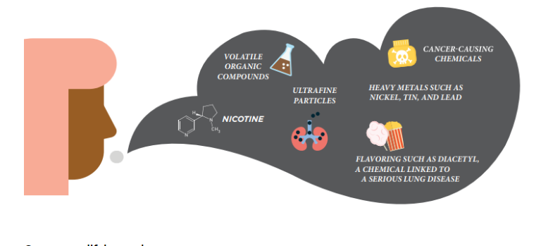
Secondhand exposure: nicotine vaping
Measureable levels of nicotine in secondhand emissions + several cancer-causing toxicants:
Formaldehyde
Acetone
Acetaldehyde
Notes:
What about 2nd hand smoke? Or 2nd-hand aerosol?
Research on what exactly is in e-cigarette emissions have shown some alarming results. They have found not only nicotine, but formaldehyde, acetone, and acetaldehyde; these are all things that also exist in cigarette smoke. Yes, they are present in much smaller amounts than conventional cigarettes, but there are there and until we’ve had the time to see the long-terms effects, we can’t say that it’s in a “safe” amount.
-------
https://www.jhsph.edu/news/news-releases/2018/study-lead-and-other-toxic-metals-found-in-e-cigarette-vapors.html
Schripp T, Markewitz D, Uhde E, Salthammer T. 2013 “Does e-cigarette consumption cause passive vaping?” Indoor Air 23(1):25-31.

Slide 31
NOT an approved tobacco cessation tool
National Academies of Sciences, Engineering, and Medicine Report 2018 - Public Health Consequences of E-Cigarettes
“There is insufficient evidence from randomized controlled trials about the effectiveness of e-cigarettes as a cessation aid compared with no treatment or with FDA approved smoking cessation treatments”
We do NOT know if e-cigarettes can help with smoking cessation
Notes:
ALEX
Last public health issue.
Substantial anecdotal support for e-cigs as cessation tool, but not enough research evidence to support the use of these devices as cessation tools. Even if they may be effective as cessation tools for some or all, they are still gateway tools/risky for youth. Thus need to approach with caution.
Despite claims that vaping devices can be used as a smoking cessation device, there is not actually sufficient evidence to support that. Evidence is honestly, at this point, pretty unclear on this. But for now, just know that vaping devices are not approved by the FDA as an effective tobacco cessation method.

Slide 32
Vaping nicotine may be a gateway to combustible tobacco smoking
National Academies of Sciences, Engineering, and Medicine Report 2018 - Public Health Consequences of E-Cigarettes
“There is substantial evidence that e-cigarette use increases risk of ever using combustible tobacco products among youth and young adults”
We VERY LIKELY know that for youth / young adults, e-cigarette use increases likelihood of later smoking, AND that smoking increases likelihood of later using an e-cigarette
Notes:
Leads to nicotine addiction in youth → emphasize this point more
In one recent study, 9th grade students using e-cigs were 3x more likely than their non e-cig using peers to have started using some other form of tobacco over the course of that year. 12th grade students were 4 times more likely.
NOTES:
The Leventhal study took place in Los Angeles, CA with 9th graders from many backgrounds. Their analysis controls for the various other influencing factors on tobacco use (parental use, socio-economic status, etc).
The Primack study took place in Connecticut and the initial group of students were those who were identified as not having any outside risk-factors for smoking initiation. This group also had a VERY small sample size of e-cig users at the start, so the results (8x more likely) may not be very robust. It is not overly generalizable given the population they started with, especially to low-income communities.
Wills, Thomas A., et al. "E-cigarette use and willingness to smoke: a sample of adolescent non-smokers." Tobacco control (2015): tobaccocontrol-2015.
Leventhal, Adam M., et al. "Association of electronic cigarette use with initiation of combustible tobacco product smoking in early adolescence." Jama314.7 (2015): 700-707.
Primack, Brian A., et al. "Progression to traditional cigarette smoking after electronic cigarette use among US adolescents and young adults." JAMA pediatrics 169.11 (2015): 1018-1023.
McMillen, R.C. et al. 2014. “Trends in Electronic Cigarette Use Among U.S. Adults: Use is Increasing in Both Smokers and Nonsmokers” Nicotine Tobacco Research
Miech, R. et al. (2017) “E-cigarette use as a predictor of cigarette smoking: results from a 1-year followup of a national sample of 12 grade students” Tobacco Control

Slide 33
Gateway to combustible tobacco smoking, cont.
National Academies of Sciences, Engineering, and Medicine Report 2018 - Public Health Consequences of E-Cigarettes
“Among youth and young adult e-cigarette users who ever use combustible tobacco cigarettes, there is moderate evidence that e-cigarette use increases the frequency and intensity of subsequent combustible tobacco cigarette smoking”
We PROBABLY know that for youth / young adults who smoke, e-cigarette use increases later smoking (how often and how much)
Notes:
Leads to nicotine addiction in youth → emphasize this point more
In one recent study, 9th grade students using e-cigs were 3x more likely than their non e-cig using peers to have started using some other form of tobacco over the course of that year. 12th grade students were 4 times more likely.
NOTES:
The Leventhal study took place in Los Angeles, CA with 9th graders from many backgrounds. Their analysis controls for the various other influencing factors on tobacco use (parental use, socio-economic status, etc).
The Primack study took place in Connecticut and the initial group of students were those who were identified as not having any outside risk-factors for smoking initiation. This group also had a VERY small sample size of e-cig users at the start, so the results (8x more likely) may not be very robust. It is not overly generalizable given the population they started with, especially to low-income communities.
Wills, Thomas A., et al. "E-cigarette use and willingness to smoke: a sample of adolescent non-smokers." Tobacco control (2015): tobaccocontrol-2015.
Leventhal, Adam M., et al. "Association of electronic cigarette use with initiation of combustible tobacco product smoking in early adolescence." Jama314.7 (2015): 700-707.
Primack, Brian A., et al. "Progression to traditional cigarette smoking after electronic cigarette use among US adolescents and young adults." JAMA pediatrics 169.11 (2015): 1018-1023.
McMillen, R.C. et al. 2014. “Trends in Electronic Cigarette Use Among U.S. Adults: Use is Increasing in Both Smokers and Nonsmokers” Nicotine Tobacco Research
Miech, R. et al. (2017) “E-cigarette use as a predictor of cigarette smoking: results from a 1-year followup of a national sample of 12 grade students” Tobacco Control

Slide 34


Trends & why youth use
Notes:
JARED

Slide 35

Poison Center data
No mandate = underrepresentation of WA exposures
Our data tells many possible stories
Changing awareness of poison centers
Changing access to or awareness of a substance
Large-scale stressors or traumas
Notes:
Our data tells many possible stories
Awareness of poison centers may change
Not for Kids Logo (cannabis edibles)
Access or awareness of a substance might change
Cannabis legality, vape device prevalence, etc.
Large-scale stressors or traumas can occur
COVID-19 → increased stress/isolation → substance use as coping

Slide 36
Washington Poison Center
Notes:
Speaking ideas:
PC Exposures occur when someone is scared that a poisoning has happened, and thus can reflect more alarming exposures
While we are discussing the potential for clinical severity of nicotine, our total numbers for nicotine exposure are significantly lower than many of our other calls (could give example of over-the-counter meds)
Source:
https://www.wapc.org/

Slide 37
Washington Poison Center
Vape Products
79% of all 2020 nicotine cases were ingested
Notes:
Source:
https://www.wapc.org/

Slide 38
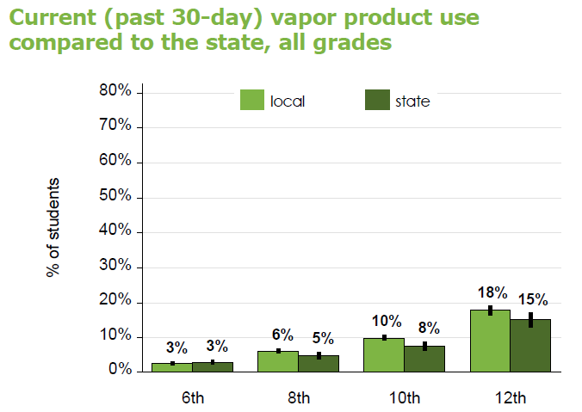
Washington Healthy Youth Survey data (2021)
ESD 112 compared to WA State

Slide 39
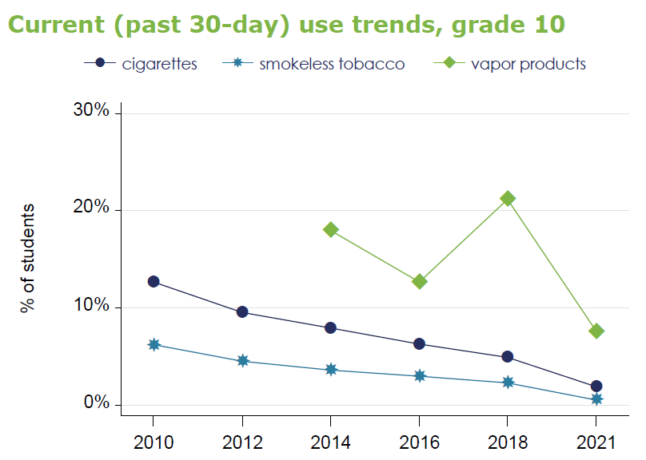
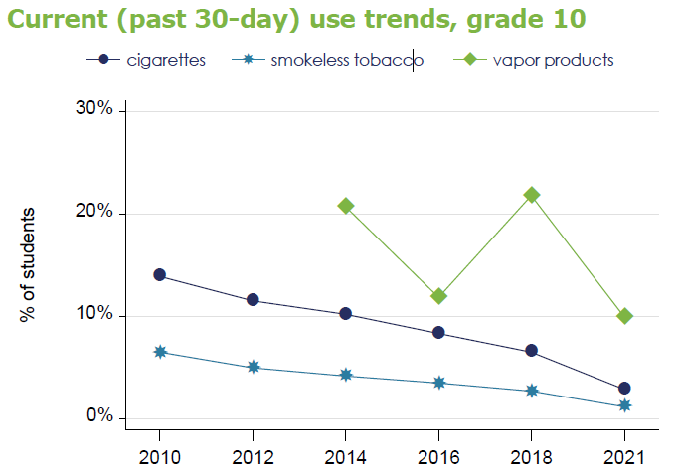
Washington Healthy Youth Survey data (2021)
Washington State
ESD 112
Notes:
https://www.askhys.net/FactSheets
ESD 112 includes:
Clark
Cowlitz
Klickitat
Pacific
Skamania
Wahkiakum

Slide 40
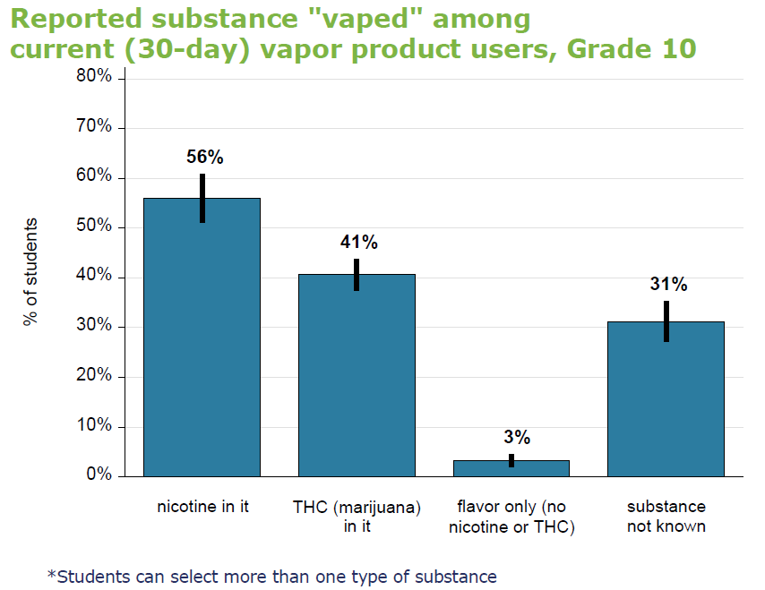
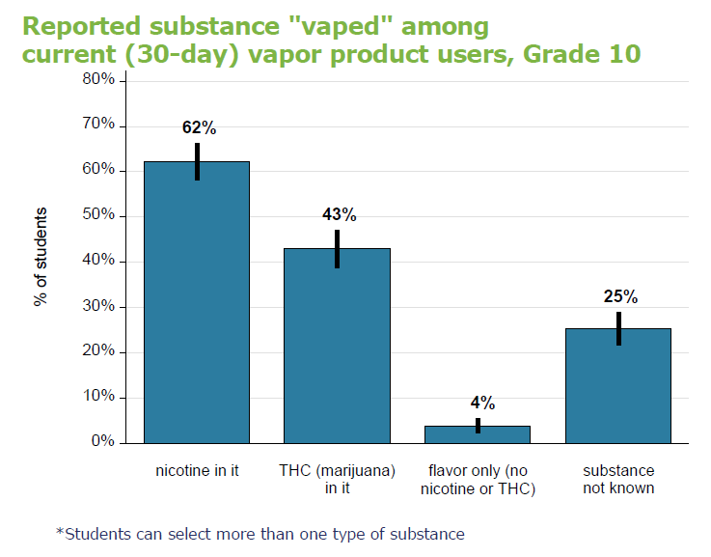
Washington Healthy Youth Survey data (2021)
Washington State
ESD 112
Notes:
When 10th graders were asked what they were vaping, they reported the following:
About half reported vaping nicotine
About a third reported vaping flavor only- so theoretically no nicotine or THC. More on this later.
And then 21% reported vaping THC
We are looking forward to updated numbers next year! 2021 HYS is a go.
https://www.askhys.net/FactSheets

Slide 41



Slide 42
Key findings from Public Health – Seattle & King County Listening Sessions
What youth want | What youth DON’T want
Facts! Unbiased information on: Health effects (short- and long-term) Mechanisms of substances Research about risks and benefits Open discussion with accurate info Relevant risk messaging | No exaggeration or shaming (e.g., scare tactics) No lectures
Youth are aware that most sources of information have an agenda, including health educators and the industry
Notes:
Mention motivational interviewing, recommend that folks look into it for more info on communicating - https://motivationalinterviewing.org/understanding-motivational-interviewing
https://www.kingcounty.gov/depts/health/marijuana-health/youth/~/media/depts/health/marijuana/webinar-youth-perspectives-on-marijuana-info-sheet.ashx
Teen Vaping and Prevention Messaging: Project Finding and Report. Public Health Seattle King County. 30 June 2016.

Slide 43

Rescue Agency – Marketing Health to Teens in a Post-COVID World
Strategies
Acknowledge potential obstacles to addressing a health behavior AND provide ways to help overcome
Reframe behaviors around short-term benefits
Explain science without judgement
Focus on repeated use, not one-time use
Media and marketing inequities
Recommended marketing strategies for teens today
Video link
Notes:
Understand health inequities (that have always been there)
Equality-focused programs:
Over-deliver to lower-risk audiences
Under-deliver to higher-risk audiences
Media channels, by design, target lower-risk audiences because in general, they make more money this way
Thus, by design, they are inequitable
Strategies:
Lean into the complexity of real lives and behavioral decisions
Need to reframe behaviors based on short-term benefits
Linking a behavior with feeling better today, right now
Ex: ad focusing on drinking soda over water, point was you will have better focus in an hour with water than soda. No focus on obesity, long-term health, but the NOW, which is what teens need especially with COVID stress, they want to feel better today
Explain the science while avoiding the judgement
Don’t “dumb” it down, that can come off as disrespectful (you can explain in multiple ways, but honestly
This generation more than any other does NOT want to be judged for their behavior, for how they cope
“Behind the Haze” campaign → includes science
Focus on repeated use prevention vs. one-time use prevention
Generations of prev messaging focus on the first use (idea that smoking once means they are doomed) → excludes every teen who uses once; they feel the messaging no longer applies to them
So, focus on what continued use SHORT-TERM effects; builds credibility

Slide 44
Resources
Public Health – Seattle & King County Tobacco & Vapor Prevention
King County Youth Marijuana Prevention & Education Program
Start Talking Now: https://www.starttalkingnow.org/
Partnership to End Addiction: https://drugfree.org/
Washington Recovery Helpline: https://www.warecoveryhelpline.org/
Rescue Agency YouTube Channel
Rescue Agency Teen Vaping and COVID video

Slide 45



