Slide 1

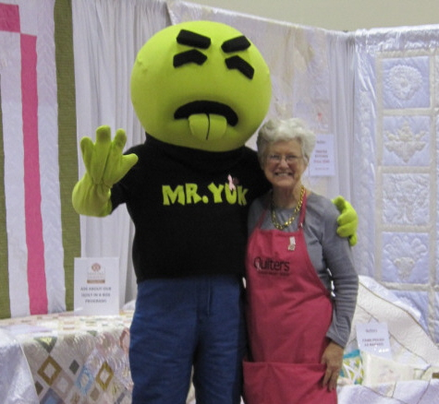
Senior Education Presentation

Slide 2

Table of Contents:
Introduction to Washington State Poison Center….....................3
Our Mission
WAPC Services
Who Do We Serve?
On-call Toxicologists
WAPC Statistics
What is Poison?..........................................................................8
Look-a-Likes………………………………………………………...10
Household Scenarios………………………………………………11
Household Tips……………………………………………………..13
Senior Statistics…………………………………………………….14
Medication Scenarios……………………………………………...15
Medication Safety…………………………………………………..17
Medication Tips……………………………………………………..18
Medication Disposal………………………………………………..19
Are you a Grandparent?............................................................20
Action Steps in Case of an Emergency………………………….21
What Happens when I Call the Poison Center?........................22
Benefits of the Poison Center……………………………………..24
Main Message………………………………………………………25
Materials
Notes:
Create a

Slide 3
Today’s Discussion Topics
Introduction to the WA State Poison Center
What is a poison?
Common Household Mistakes
Medication Safety
Proper Medication Disposal
Safety Tips for Grandparents and Caretakers
What to do in Case of an Emergency

Slide 4

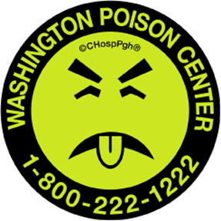
Our Mission
To prevent harm from poisoning through expertise, collaboration, professional, and public education
RCW 18.76 Poison Information system. Statewide Program
Public Law 110-377 Primary poison defense for U.S. (1993)
Public Law 110-377 “Poison Center Support, Enhancement, and Awareness Act of 2008”

Slide 5
WAPC Services
Nationwide
Free
Always Open
For Everyone
Accessible
Expert
1-800-222-1222
We’re for everyone
We’re free
We’re confidential
We have interpretation services with over 150 languages
We’re always open 24/7/365
Confidential

Slide 6
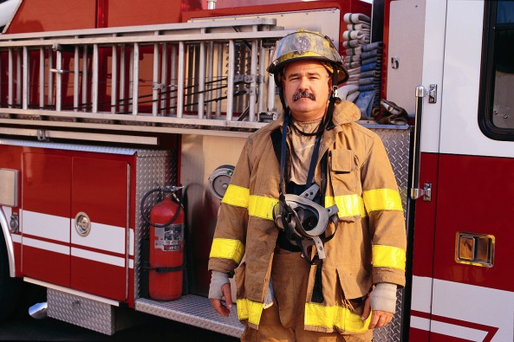


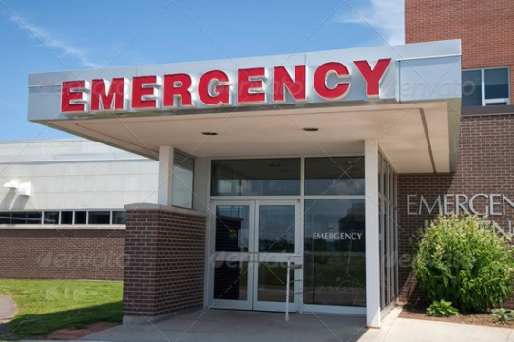


Who Do We Serve?
Federal/State/County Departments of Health and Agencies
EMTs/Paramedics/Law Enforcement
Medical/Pharmaceutical Training Institutions
Hospital Emergency Departments
Washington State
7.06 million people of all ages
Notes:
UW/WSU Logo
ER picture

Slide 7
On-Call Toxicologists
24 hour access to board-certified toxicologists with backgrounds in emergency medicine and pharmacology
Certified Specialists in Poison Information:
PharmDs, RNs, PIPs with a combined 290+ years of experience

Slide 8
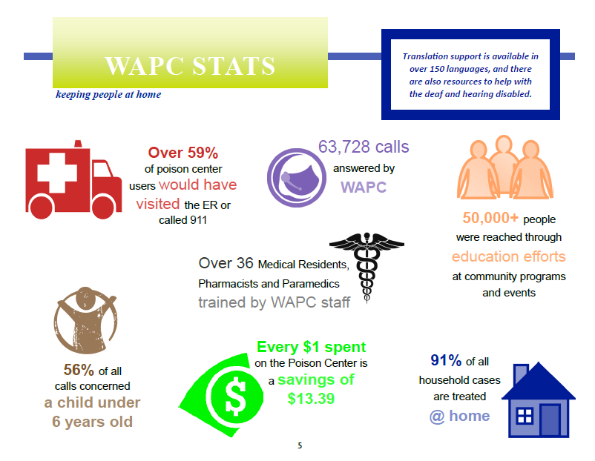
2014 Annual Report

Slide 9

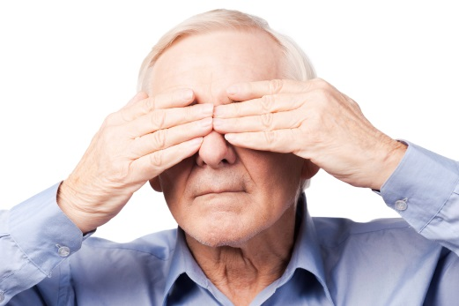
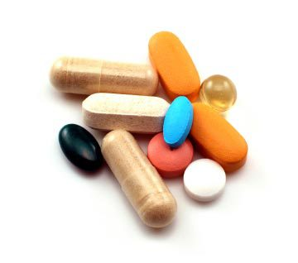


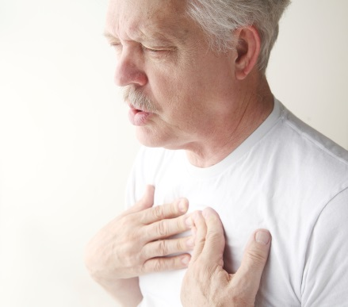
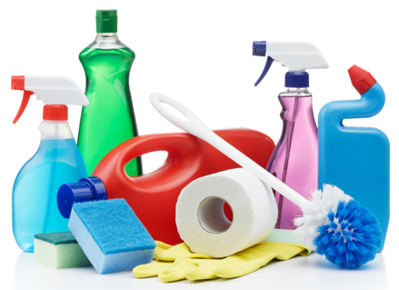
What is poison?
A poison is..
Any product or substance that can be harmful if it is used the wrong way, by the wrong person, or in the wrong amount.
Notes:
Define for your audience what a poison is.
Read the definition on the screen and give some examples such as:
snake bites
poison ivy exposures,
drug and medication exposures
exposure to cleaning products.
Also discuss how a person can get poisoned several different ways:
eating it
drinking it
breathing it
injecting it
getting in on their skin
getting it in their eyes
Use this discussion to help your audience realize the wide variety of things that can poison you and ways one can be poisoned.

Slide 10
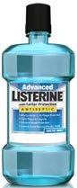


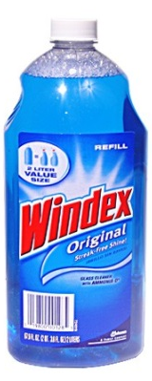
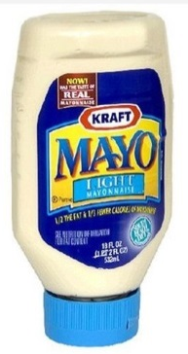

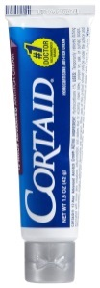
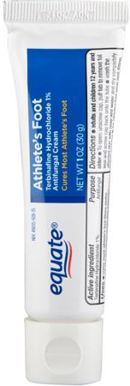
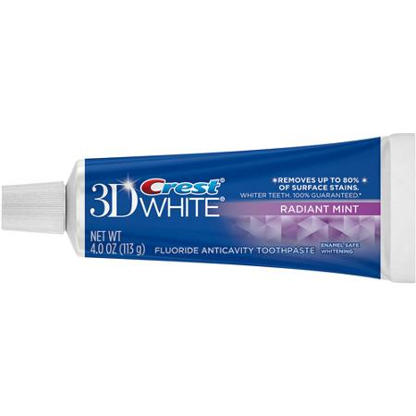


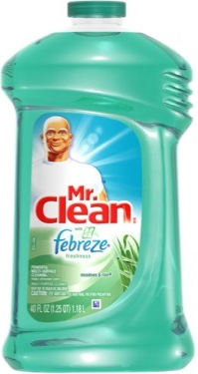
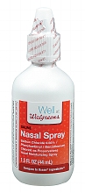
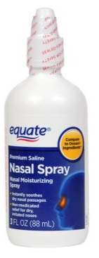
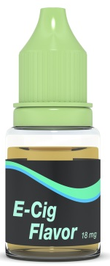
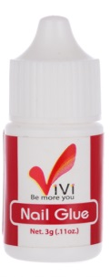
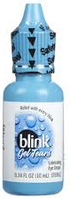
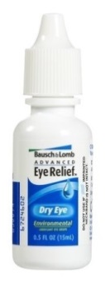
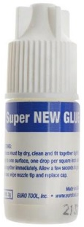
Look-a-Likes
Notes:
Instructions: Often times people make mistakes because they confuse products that look similar. Here we’ve illustrated a few products that are commonly mixed up. Show these products side by side to your audience, so they can see how easy it might be for them to make a similar mistake.

Slide 11
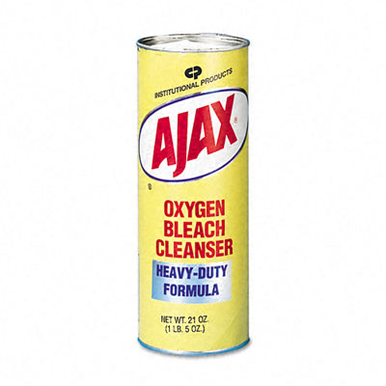

Household Scenarios
Scenario 1: Bob accidentally drank bleach
Tip: Communicate clearly with people around you when using dangerous substances
Notes:
Use these scenarios to help people understand how easily people can poison themselves by making common mistakes.
Scenario 1:
Martha wanted a cup of coffee, so she grabbed a cup from the counter and noticed it had a lot of coffee stains in the bottom. She decided to put some bleach in the cup to remove the stains and set it out on the counter to soak in the bleach for a few minutes then walked away. Five minutes later her husband Bob walks in and doesn’t notice the bleach in the cup, so he pours his coffee in the cup and drinks the bleach. What should Martha and Bob do?
Scenario Conclusion: Luckily for Bob, drinking a little amount of bleach isn’t actually harmful. But by calling the poison center he was able to save himself a trip to the doctor and stop worrying.
Tips to Learn: Communicate clearly with people around you when using dangerous substances. Also try to keep products in their original containers , so there is less room for confusion.

Slide 12
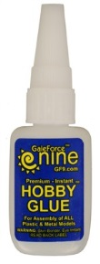
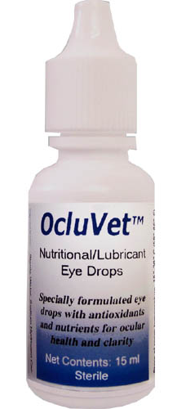

Household Scenarios
Scenario 2: Superglue instead of eye drops
Tip: Always turn the lights on and put on your glasses before using personal products
Notes:
Scenario 2:
Bill gets out of bed to put some eye drops in and doesn’t turn the lights on. Bill keeps many of his small household items in the same drawer, so when he is searching through the drawer, he accidentally grabs super glue because the container looks similar and puts glue in his eyes instead of eye drops.
Scenario Conclusion:
Tip to Learn: Always turn on the lights and put on your glasses before using any type of personal product.
It is very common for people to mix up ear drops and eye drops as well and ear drops in your eyes can be very dangerous.

Slide 13
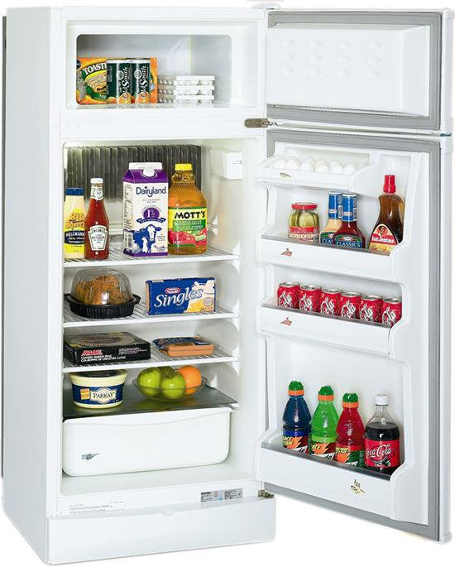
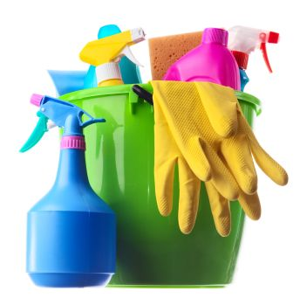


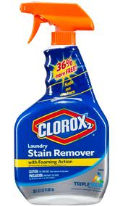
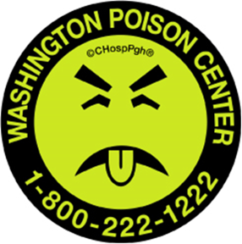
Household Tips
Cook and store food as stated on packages
Separate household cleaning products from food items and medications
Put Mr. Yuk stickers on dangerous items
Keep substances in their original containers
Keep toxic substances out of reach of children and pets and in child-resistant packages
Notes:
These are good tips for maintaining a safe household:
Separate household cleaning solutions from other household items
Separate household items such as glue from toiletries
Keep substances in their original containers
Cook and store food as stated on packages
Keep toxic substances out of reach of children and pets and in child- resistant packages
Put a Mr. Yuk sticker on dangerous items (find list of items on Poison Safety Checklist)
Install and test carbon monoxide (CO) alarms
Post the Poison Center phone number by your phone or on your refrigerator. If you have a cell phone, program it into your phone!

Slide 14
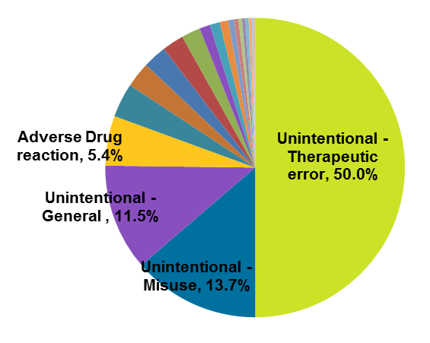
Senior Statistics
Top Reasons for Exposure
Top 6 Medication Mistakes
1.
2.
Took wrong Medication
3.
Took Incorrect Dose
4.
5.
Incorrect Dosing Route
Took someone else’s medication
Took Medication Twice
6.
Took medication too close together
Notes:
These statistics were taken from data collected at the Washington State Poison Center over the past 5 years.
Of the 20,000+ calls the poison center received over the past 5 years regarding seniors, 50% were due to “Unintentional Therapeutic Errors.” These are exposures that happen when a person accidentally veers from the their prescribed medical therapy.
The top 6 mistakes that led to these errors were the following:
Accidentally taking medication twice
Taking the wrong medication
Taking the incorrect dose of medication
Taking the incorrect dosing route
Taking someone else’s medication
Taking medications too close together
Proper medication management can help significantly reduce these types of errors

Slide 15
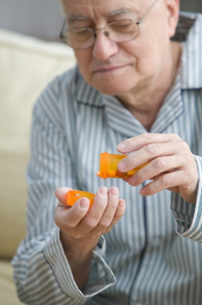
Medication Scenarios
Scenario 1: Taking the wrong medications
Tip: Keep medications separately from living partners’ medications
Notes:
Use these scenarios to help people understand how easily people can poison themselves by making common mistakes.
Scenario 1:
Joe and his wife Sally share a bathroom and keep their medication in the same cabinet. Joe reached in to take his afternoon medications, grabbed a bottle poured out two pills and took them. As he was setting the bottle back in the cabinet, he saw her name on the label and realized he had accidentally taken Sally’s medication instead of his.
Scenario Conclusion:
Tips to Learn: Keep your medications separately from the medications of those you live with. Do not take medications together, it can get confusing what medications are for which one of you.

Slide 16
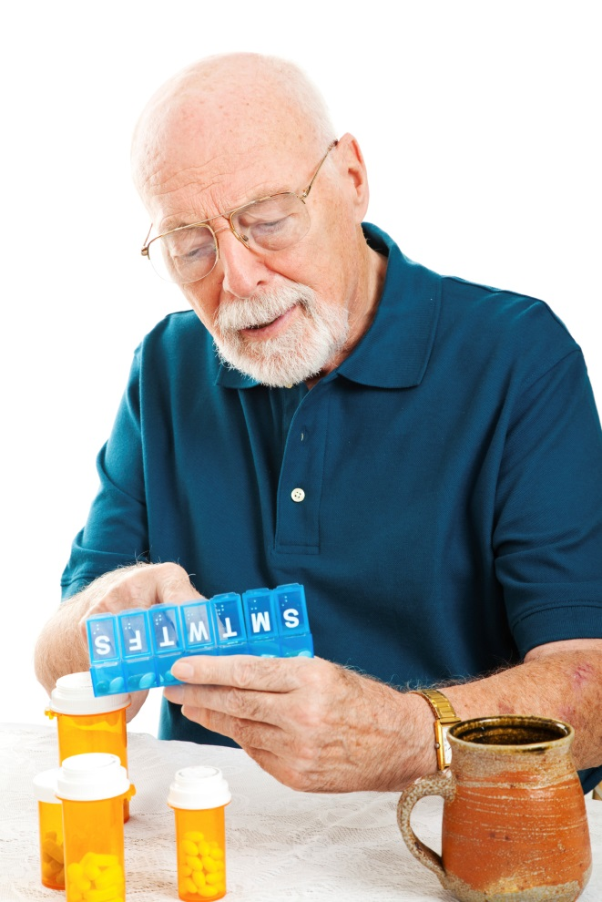
Medication Scenarios
Scenario 2: Taking medication twice
Tip: Create a system to know when you have taken your medication
Notes:
Use these scenarios to help people understand how easily people can poison themselves by making common mistakes.
Scenario 1:
Dave got out his medications to take his morning doses. After he took a couple pills the phone rang so he got up to answer it. He talked on the phone for 15 minutes and then returned to his medications. When he got back he thought he hadn’t actually taken them yet, so he took them all again.
Scenario Conclusion:
Tips to Learn: Create a system to know when you have taken your medication. If a weekly or monthly pill organizer works for you use that. You can also use the medication calendar we have created to mark off when you have taken your medication.

Slide 17
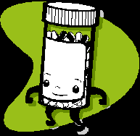
Medication Safety
The right person
The right dose
The right medicine
The right time
The right way
When one of the rights is a wrong- call the Washington Poison Center right away
Notes:
We recommend following the “5 rights” when taking or giving medicine. The “5 rights” are as follows:
The right person: Be sure that the right person is using the medicine and does not take another person’s medicine
The right dose: Always check for the proper amount. Consider writing down each dose to be given
The right medicine: Read the label-each time to avoid making a mistake. Know the name of the medicine when giving or taking it.
The right time: Follow the label and take medicine at the correct time of day. Some medications are used once a day, some four times a day.
The right way: Follow instructions. Some medicines interact with certain foods, some need to be taken with food and some should not be taken with other medications.
Our general rule of thumb is when one of the above rights is a wrong- call the Washington Poison Center right away

Slide 18
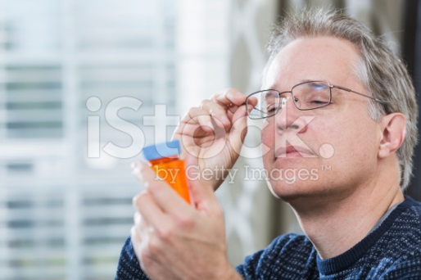
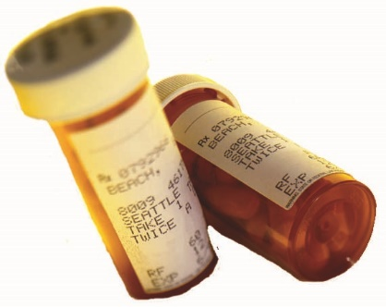

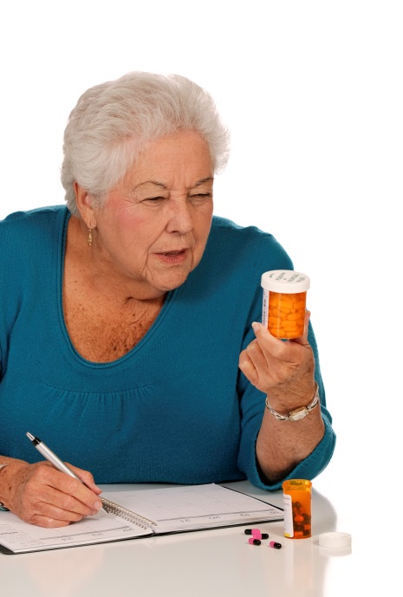
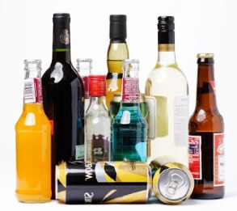
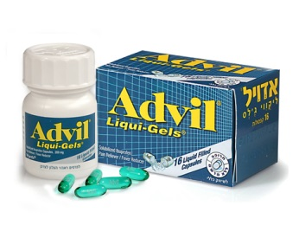
Medication Management Tips
Only take your own medication
Put on glasses & turn on lights before taking medications
Create a routine for taking medication
Know what your medications look like
Check with a health care provider before using over-the-counter drugs
Be cautious when mixing alcohol with medication
Keep an updated list of medications
Notes:
These are tips to help prevent medication errors:
Tips depicted above:
Establish a routine for taking medication
Keep an updated list of medications you are taking that is easily retrievable, considering keeping it in your wallet
Put your glasses on and turn on a light before taking or giving medication
Know what your different medications look like
Never take medication that belongs to someone else
Only take suggested amount of over-the-drugs without asking a health care provider
Be wary of alcohol consumption with medication
Additional Tips:
Do not keep medications in the same drawer as household products
Properly dispose of unneeded medications
If you take medications out of original containers be sure you know which pills are which and keep original containers
Try to fill prescriptions at the same pharmacy, because then it is easier for them to monitor drug interactions
Offer your visitors a safe place to keep their medications, a locking box or drawer

Slide 19

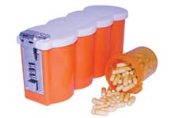
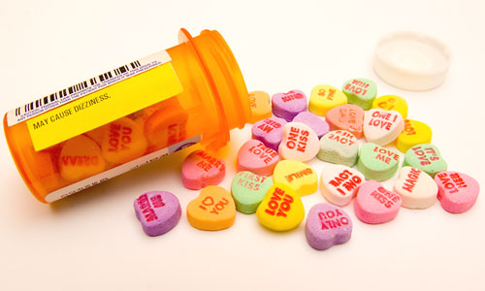
Are you a Grandparent?
Take special precaution around children to keep household items and medication out of reach and in child-resistant containers
CONSIDER LOCKING UP
MEDICATION
WARNING: MEDICINE MAY APPEAR TO BE CANDY
Notes:
Ask audience if they ever have any children visitors.
There are 129,354 grandparents living with grandchildren in Washington State of those 129,354, 33.7% of them take primary responsibility for those children.
Tips for grandparents:
Keep medication and toxic household items out of reach of children and in child-resistant containers. Consider in locked pill boxes.
Do not take medication in front of children because they often mimic adults.
Check carpet/floors periodically to look for dropped medication
Be careful using laundry pods, they can be fatal to children, so keep them well out of reach or locked up
Also be wary of little magnets that appear in things like singing cards, because they can be very dangerous if accidentally ingested

Slide 20
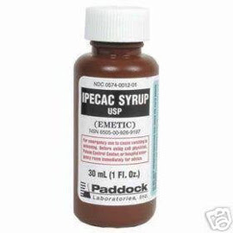
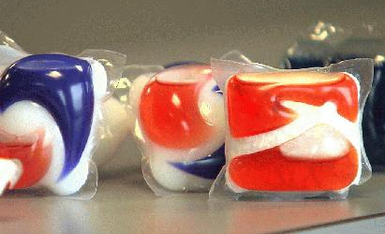
Safety Updates for Children
Ipecac Syrup
Health care providers no longer recommend using Ipecac syrup or any other home remedies to induce vomiting. This may lead to choking, dehydration and increased risk of esophageal injury.
Laundry Pods
Laundry pods contain highly concentrated detergent that can be extremely dangerous, in some cases it has induced seizures and commas. If you choose to purchase these it is very important to keep them out of reach and locked up.
Notes:
Ipecac Syrup:
Health care providers no longer recommend using Ipecac syrup or any other home remedies to induce vomiting.
When agents are ingested that are damaging to the throat it can sometimes be more harmful for them to come back up the throat.
Inducing vomiting increases risk of aspiration, which is inhaling vomit into one’s lungs
If the person was to pass out, vomiting while unconscious is extremely dangerous and can lead to aspirating or choking.
Severe vomiting can also lead to dehydration and esophageal injury.
Laundry pods:
Laundry pods contain highly concentrated detergent that can be extremely dangerous, in some cases it has induced seizures and commas. If you choose to purchase these it is very important to keep them out of reach and locked up.
They explode when they come in contact with moisture

Slide 21


Top Exposures among Children
Top 10 Categories for 13-19 year olds
1. Analgesics
2. Antidepressants
3. Antihistamines
4. Stimulants and street drugs
5. Sedative/hypnotics and BZDs
6. Cough and Cold preparations
7. Cleaning substances
8. Cosmetics/Personal Care Products
9. Anticonvulsants
10. Cardiovascular Drugs
Top 10 Categories in Pediatrics ( < 13 years)
1. Cosmetics/Personal Care Products
2. Analgesics
3. Cleaning Substances
4. Foreign Bodies/toys
5. Topical preparations
6. Vitamins
7. Plants
8. Antihistamines
9. Dietary Supplements/Homeopathic
10. Gastrointestinal preparations

Slide 22


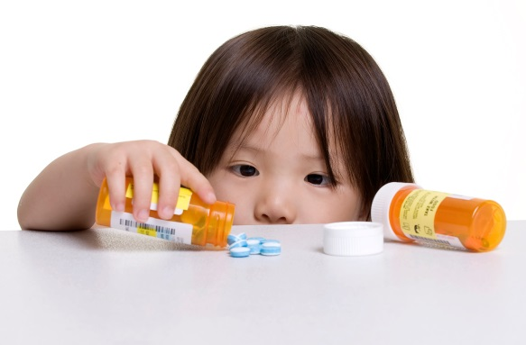

Medication Disposal
Visit http://www.takebackyourmeds.org/ or call Washington State Poison Center 1-800-222-1222
to find a location near you to dispose of your medication
Why Take Back Your Meds?
Safe disposal to prevent therapeutic mistakes
Safe disposal to reduce drug abuse
Safe disposal to reduce accidental poisoning
Safe disposal to reduce medicines in the environment
Notes:
Often times people keep unneeded medication because they do not know how to dispose of it. However it is important to get rid of for several reasons:
It prevents therapeutic mistakes (such as confusing unneeded medications with needed ones and taking the wrong ones)
It reduces drug abuse
It reduces accidental poisoning
It reduces medicines in the environment
Take Back Your Meds is a group of over 270 health organizations, police, drugstores, local governments, environmental groups, and others in Washington State who support medicine take-back programs to reduce access to highly-addictive drugs, reduce the risk of poisonings, and reduce environmental contamination. Currently there is not statewide program to provide this service.
Visit www.takebackyourmeds.org to find locations near you that will accept your old medication.

Slide 23

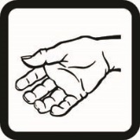


Action Steps in Case of Emergency
Stay Calm. Act Fast.
Inhaled Poison
Get to fresh air right away and avoid fumes.
Open doors and windows wide.
Poison on the Skin
Take off clothing the poison touched.
Rinse skin with running water.
Wash off with soap and water.
Poison in the Eye
Run lukewarm tap water over eye for 10 minutes.
Do not force the eyelid open.
Swallowed Poison
Do not make the person vomit, drink or eat unless told by a poison expert.
Call the Poison Center 1-800-222-1222

Slide 24

What happens when I call the
Poison Center?
What happened?
Tell the poison expert what happened. If you are not sure, that is okay.
What was taken?
  Have the container handy so you can read the label.
How long ago did it happen?
How much was taken?
How is the person feeling?
What should you do?
The poison expert will tell you what to do. Most poisonings can be taken care of over the phone. If you need to go to the emergency room, we will tell you if you can drive or if you need to call 911. If needed, we will call the emergency room to let them know you are on your way and suggest treatment for you.

Slide 25

What happens when I call the
Poison Center?
We want to make sure things are OK.
Often a poison expert will call you back-just to make sure everything is all right. You can ask more questions then or call back later with other concerns.
“I’d feel dumb” if nothing was wrong.
You cannot know all about the things that might hurt you, your family or friends. What you CAN do is call the Poison Center right away. You can also call for prevention ideas.

Slide 26
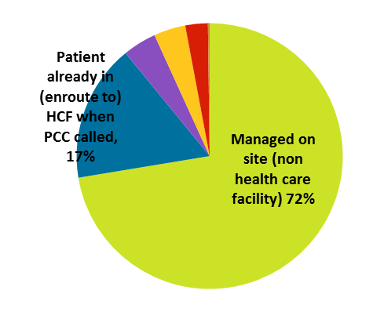

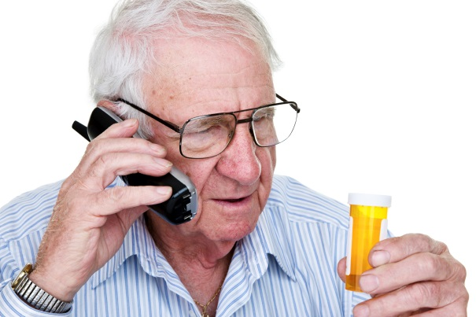

Benefits of Poison Center
Proactive Medical Advice
Avoids trips to the ER
Did you know you can call us just for information?
Call us and ask before you make a mistake!
Reduces health care costs
Every $1 spent on a poison center saves an estimated $7 in overall health care cost.
Notes:
There are many benefits of the Poison Center’s services. A few of the most prominent benefits are:
Offer Proactive Medical Advice
You can call just for information
Call us and ask before you make a mistake!
If you’re unsure if medications will react just call us and ask before you cause yourself problems
Help avoid trips to the ER
Of the 20,000+ calls the poison center received regarding seniors over the past 5 years, 72% of those were managed at home
Reduces health care costs
Every $1 spent on a poison center saves an estimated $7 in overall health care cost

Slide 27
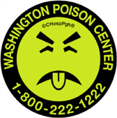

Main Message: Just Call!
Call and ask before you make a mistake!
Everyone
Expert
Confidential
Always Open
Washington State Poison Center
Program us into your phone now!
1 – 8 0 0 – 2 2 2 – 1 2 2 2
Notes:
Phone image and logo

Slide 28
Handouts
Poison Safety Checklist
Senior brochure
Medication Calendars/Lists
Take Back Your Meds Location list
Magnets

Slide 29
Appendix
Poison Safety Checklist
Marijuana Edibles
Carbon Monoxide
Alternative Medicines
Electronic Cigarettes
Button Batteries

Slide 30
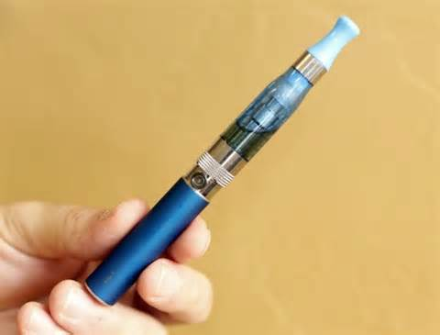

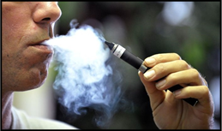
Electronic Cigarettes
Electronic cigarettes, also known as e-cigarettes, are battery-operated products designed to deliver nicotine, flavor, and other chemicals. They turn chemicals, including highly addictive nicotine, into an aerosol that is inhaled by the user.
How much nicotine does an e-cigarette contain?
A typical e-cigarette chamber can hold up to 3 milliliters (mL) of liquid nicotine. Nicotine concentration in common products can range from 6 mg per mL all the way up to 24 mg per mL. This means one e-cigarette can contain anywhere from 18 to 72 mg of nicotine. In comparison, one cigarette can contain 8—20 mg of nicotine.
What other names do e-cigarettes go by?
  E-devices
  E-pens
  E-hookahs
  Hookah pens
  Vape-pipes
  Vape-pens
  Vaporizers
What is “vaping”?
Vaping is the act of using an electronic cigarette, which can resemble the act of smoking a cigarette.
How can I keep my child safe from liquid nicotine?
It is important to store all nicotine products out of reach of children. Children may be attracted to liquid nicotine products because they come in brightly colored packages, are flavored, and are not required to have child resistant packaging. Parents also should not use e-cigarette products around young children as young kids may be tempted to mimic the actions of older adults.
Back to Appendix

Slide 31

Poison Safety Checklist
Back to Appendix

Slide 32

Marijuana Edibles
Back to Appendix

Slide 33

Carbon Monoxide
What is Carbon Monoxide (CO)?
CO is an odorless, colorless, tasteless, deadly gas
CO is made anytime fuel (oil, gas, wood) is burned.
CO poisoning can occur from faulty furnace operation or blocked exhaust systems. Possible sources include:
  Furnaces
  Charcoal or kerosene heaters
  Coal, wood or gas stoves
  Propane grills (do not use inside)
  Running cars in attached garages
  Tobacco smoke
  Motorboats and houseboats
How do I know it’s CO poisoning?
  Symptoms of CO poisoning include headache, nausea and vomiting, weakness, fatigue, and confusion. Symptoms can mimic the flu.
  If several people in the household become ill at the same time, it may not be “just the flu.”
What do I do if I suspect CO Poisoning?
  Get to fresh air right away.
  Open wide all doors and windows.
  Call the Washington Poison Center at
  1-800-222-1222 right away.
How do I prevent CO poisoning?
  Use a CO detector
  Have your heating system serviced yearly.
  Do not sue charcoal or gas grills in the house or a tent.
  Do not use the oven to heat your home
  Unplug portable heaters while sleeping
  Avoid swimming near or under the back deck or swim platform of boats.
  If you think a faulty appliance may be letting out large amounts of CO, call your local fire department for assistance in testing the air for CO.
Back to Appendix

Slide 34

Button Batteries
Button batteries are small, coin-shaped batteries used in and around our homes. When they are swallowed they can be life-threatening because the newer button batteries are more powerful and can cause tissue damage much more quickly.
Most cases, when a button battery is swallowed, it passes in the stool. However, if the side of the battery stays in contact with the lining of the esophagus, stomach, or intestines a micro current can generate hydroxide. This can result in burns and perforation in less than two hours.
Often there are no symptoms early on, so it’s important that an X-ray be taken as soon as possible if you suspect a button battery has been swallowed.
Back to Appendix

Slide 35

Alternative Medicines
Be Careful!
Alternative or Complementary Medicines can be harmful.

Slide 36
Back to Appendix

