Slide 1
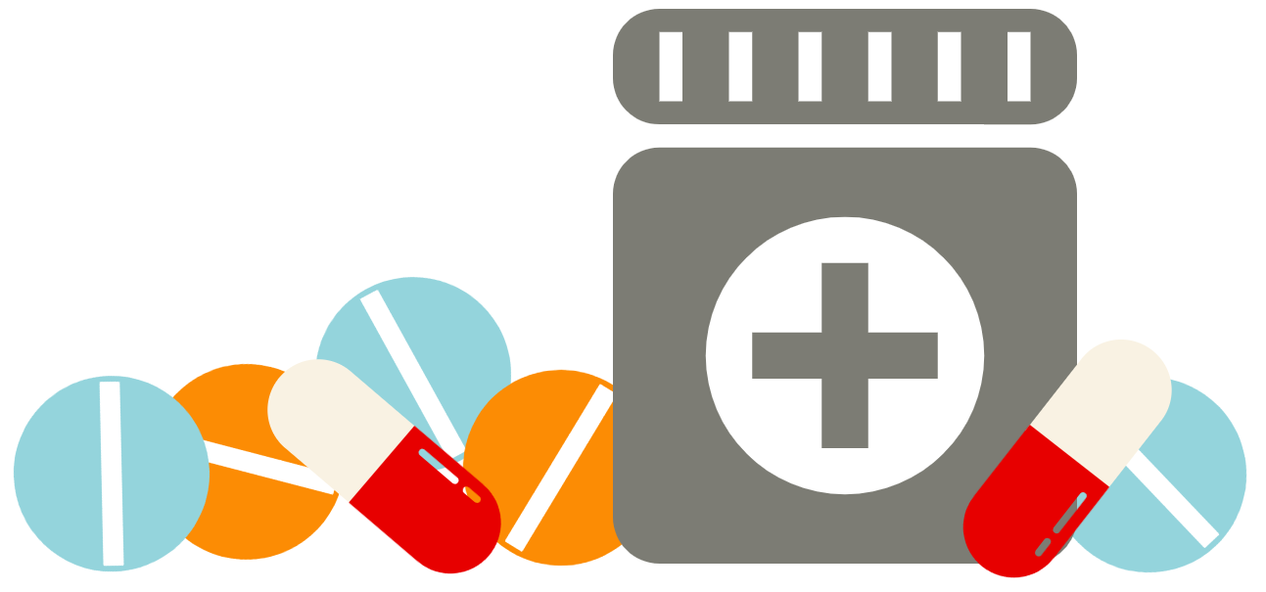
Medication Management
Meghan King, MPH
Public Health Education & Communications Specialist
Washington Poison Center

Slide 2
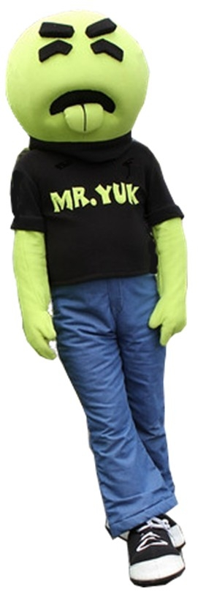
Today’s discussion topics
The Washington Poison Center
Medication Errors
Accidents
Adverse Reactions
Calling the Poison Center

Slide 3
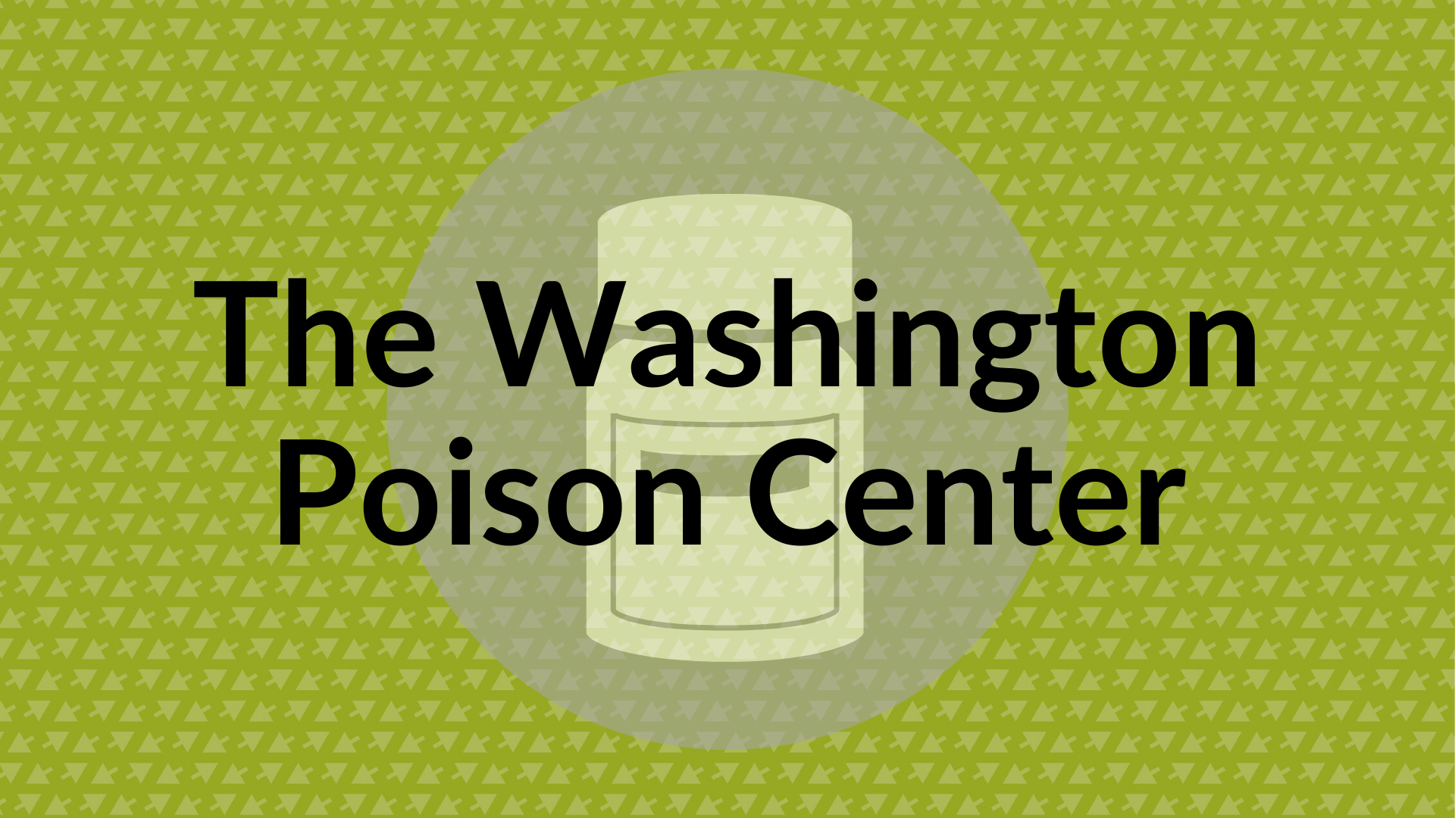
The Wasington Poison Center

Slide 4





The Washington Poison Center
Preventing & reducing harm for over 60 years!
Public Health Education
Poison Center Telephone Helpline

Slide 5

1(800) 222-1222
Free
24/7/365
Confidential
260+ Languages
Notes:
Let’s talk a little more about our telephone helpline.
When you are exposed to potential poison, or if you just want information about a substance, you can call the poison center’s national tollfree helpline at 1-800-222-1222. The helpline is available 24 hours a day/7 days a week/365 days of the year– call us at 2pm or 2am, and we’ll be here ready to help. Anyone can call–it’s completely free, 100% confidential, and we provide services in over 260 languages.

Slide 6
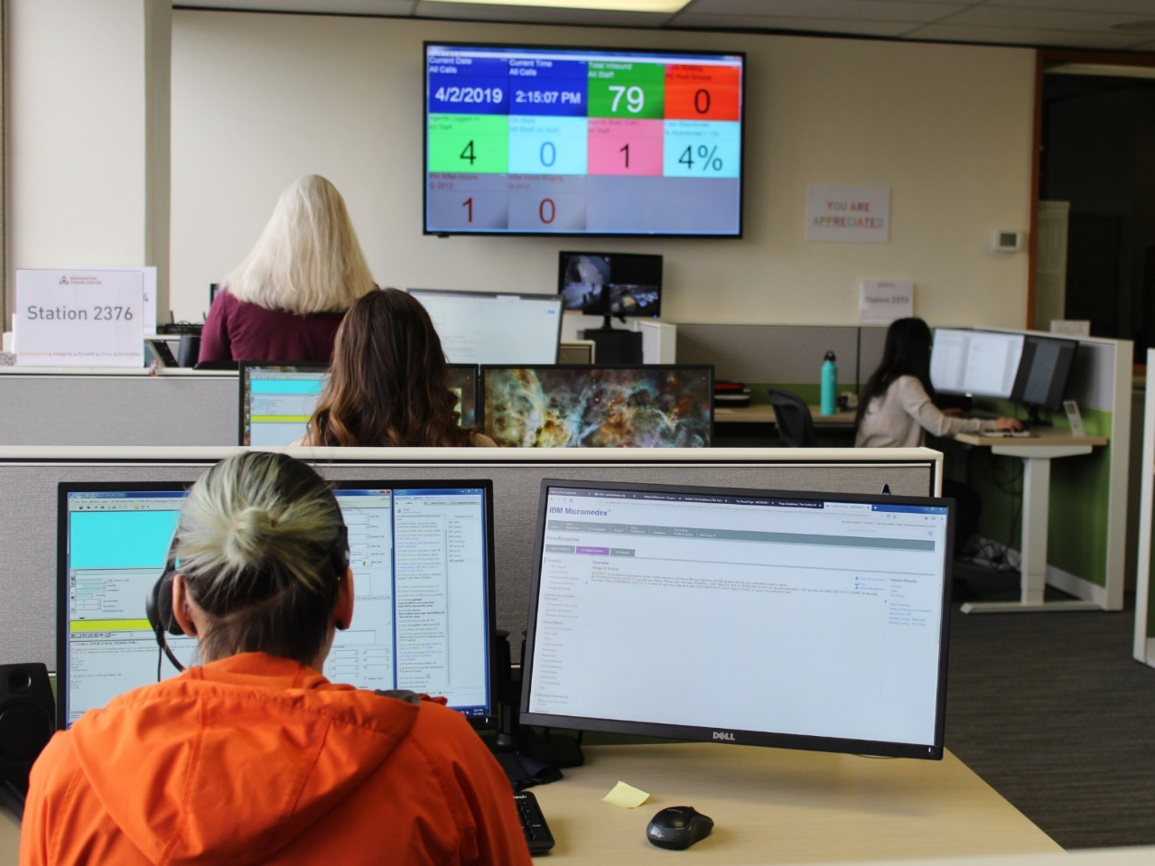
Washington Poison Center staff
Specialists in Poison Information (SPI): expert-level nurses, pharmacists, and poison information providers
On-call Board Certified Medical Toxicologists
Notes:
When you call the helpline, you will speak with one of our expert staff members, who are specialists in poison information, or SPIs. SPIs are nurses, pharmacists, and poison information providers who are specially trained in poisons and toxicology. Our SPIs average 13+ years of experience in the call center, with a combined 272 years’ worth of experience– our staff are highly qualified to talk to you!
We also have on-call Board Certified Medical Toxicologists. These are specialized MDs who are available 24/7 to provide additional guidance for our SPIs, doctors, etc.

Slide 7
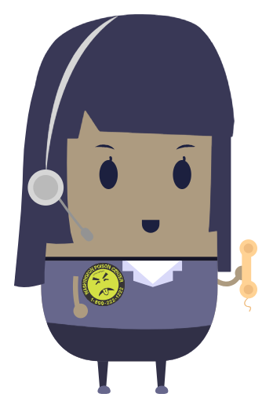
Calls to the Washington Poison Center (2018)
>113,000 calls
>64,000 cases

Slide 8

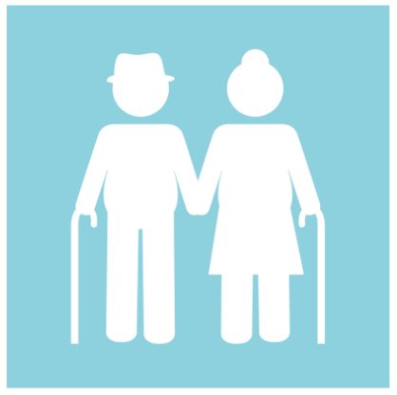
Calls to the Washington Poison Center (2018)
46% of all calls concerned children under 6 years
13% of all calls concerned adults over 60 years
Notes:
Who are getting calls about?
A bit under half of all calls were for younger children under 6 years old, as little ones like to explore the world with their mouths
But, we’re not just for kids. 13% of our calls are for adults older than 60

Slide 9



Calls to the Washington Poison Center (2018)
26% of all calls were from healthcare professionals
Notes:
Calls from a variety of sources. Some at home, workplace, some from medics or EMTs, and some from healthcare professionals in the emergency department or other healthcare facilities. In fact, 26% of our calls in 2018 were from healthcare professionals seeking consultation on poisonings.

Slide 10
Call categories
Unintentional exposures | Adverse reactions | Intentional exposures
Medication errors | Drug | Suspected suicide
Accidents with non-pharmaceutical substances | Food | Misuse
Environmental, animal bite/stings, & more! |  | Abuse
Notes:
As evidenced by how broad the definition of poison is, we receive calls about a LOT of different things. Our SPIs categorize these calls into different buckets, which are up here on this slide. But we’re here today to talk about medication management, so we’re going to focus on the most common call categories relevant to medication use…

Slide 11
Call categories related to medication management
Unintentional exposures | Adverse reactions | Intentional exposures
Medication errors | Drug | Suspected suicide
Accidents with non-pharmaceutical substances | Food | Misuse
Environmental, animal bite/stings, & more! |  | Abuse
Notes:
… so these categories

Slide 12
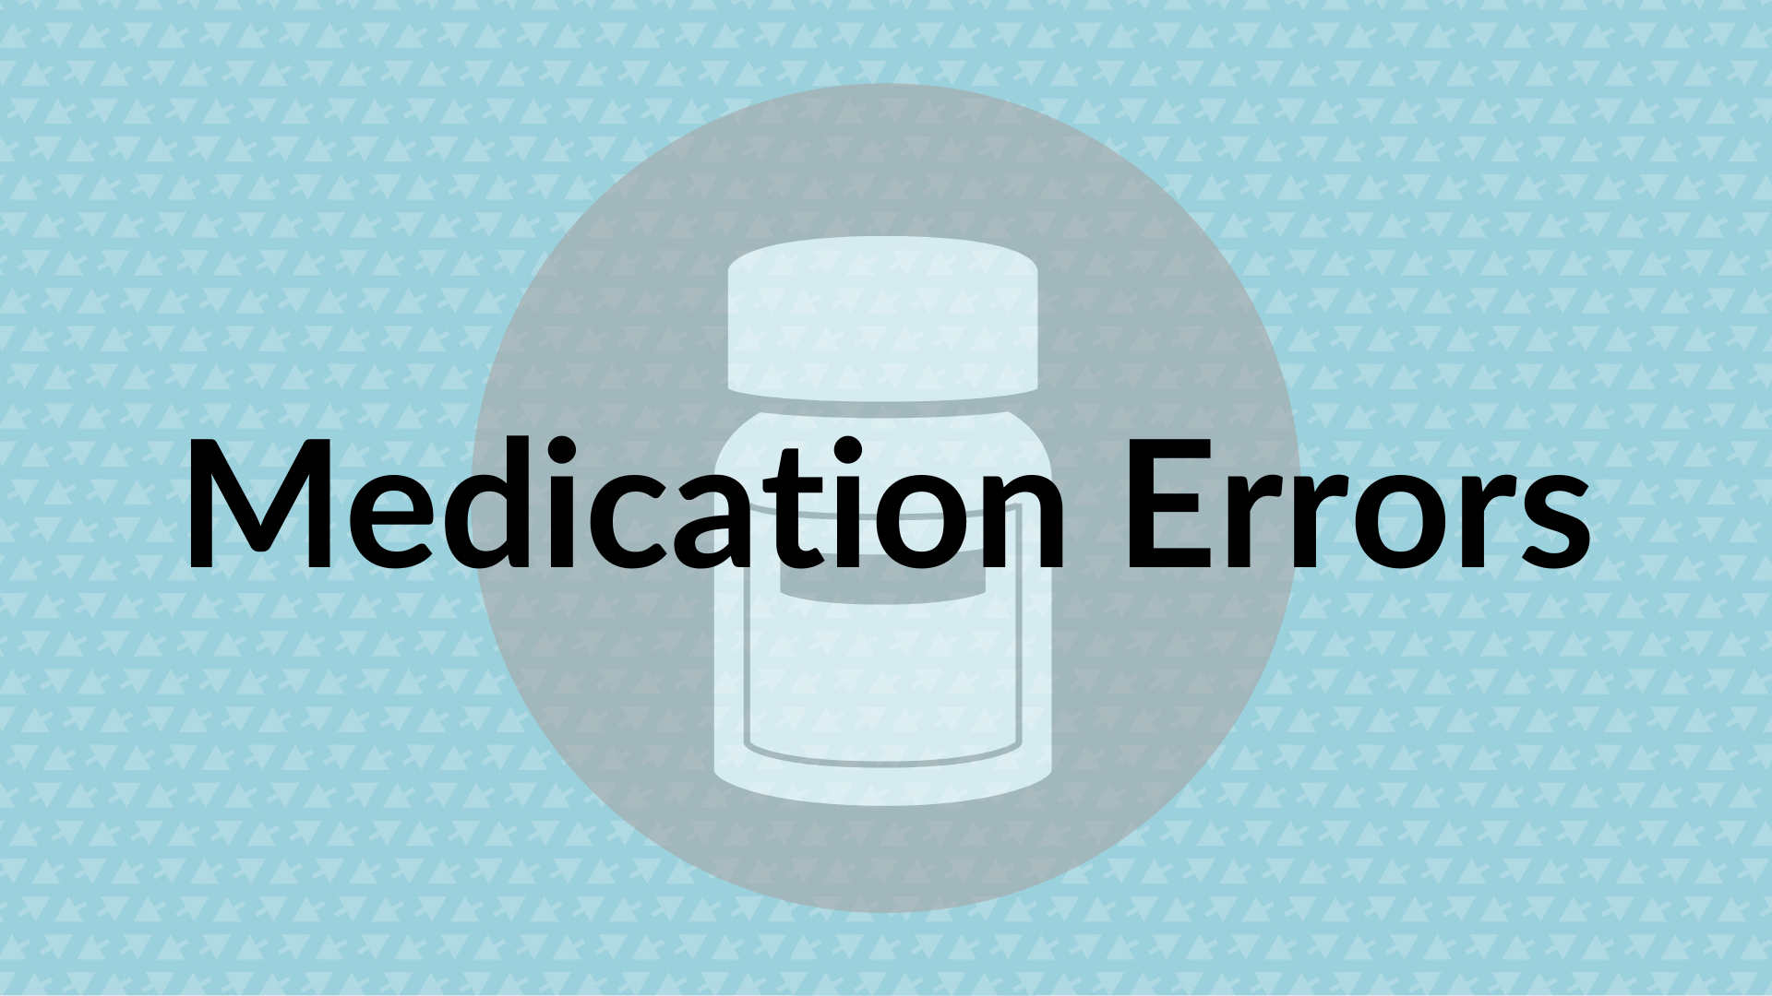

Slide 13




What are medication errors?
Dose
Medicine
THE WRONG…
#
Person
Time
Way
Notes:
A medication error is basically any of these 5 “wrongs”:
The wrong dose means you took your medication twice, or took 3 pills when you were supposed to take 2
The wrong medicine means you took an old prescription, or mixed up which medicines you were supposed to take
The wrong person means you took someone else’s medication, or a pet’s medication
The wrong time: you took your medicines too close together
The wrong way: you swallowed a medicine that was supposed to be put on your skin

Slide 14
Medication errors (2018)
13%
of all cases were about medication errors
(8,565 cases total)
17%
26%
in children <6 years
in adults >60 years
Notes:
# of medication error calls for older adults: 2259 cases

Slide 15
2,259 medication errors cases in adults ≥60 (2018)
Dose
Medicine
THE WRONG…
#
Person
Time
Way
Notes:
For older adults specifically, wrong dose (specifically double dose) is by far the most common error we hear about! Followed by wrong medicine

Slide 16
Type of medication error in adults ≥ 60 (2018)
Notes:
If you’re curious, this is the exact breakdown.

Slide 17

Medication errors are increasingly common
In adults 60+:
Population growth
Medication use increasing
Age-related challenges
More susceptible to consequences
Notes:
Medication errors are a fact of life… it can be really easy to make them, and they can happen at any age! We specifically talk to adults over 60 about them though for a few different reasons.

Slide 18
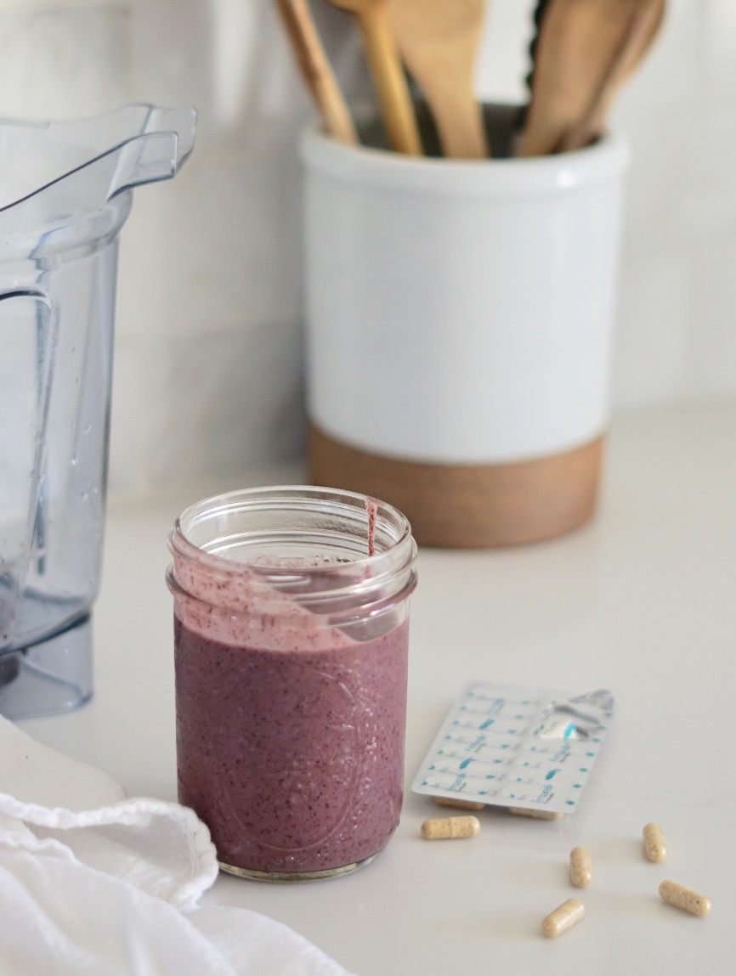
Medication error scenario: wrong dose
Scenario: Charles can’t remember if he already took his morning medication.
Notes:
It can be really easy to make these errors. We’re going to go through some scenarios to show you different examples of how they can happen.
Our first scenario is with Charles. Charles keeps his pills in the pill bottles and packages he receives from the pharmacy. After making breakfast, he gets out his medications for his morning dose. He takes a couple pills, but then the phone rings and he gets up to answer it. He talks to his daughter for 15 minutes or so, and then returns to his medications. But, he can’t remember if he had taken all of them or just some, so he takes them again to make sure. Unfortunately, this means that he has accidentally taken a double dose of some of his medications.
What’s the first thing Charles should do?

Slide 19
1(800) 222-1222
Free
24/7/365
Confidential
260+ Languages
Notes:
If you end up in a situation like we just went over with Charles, the poison center is here to help! Before you take your meds again or decide to skip them, call us and we’ll tell you what would be safest to do.

Slide 20
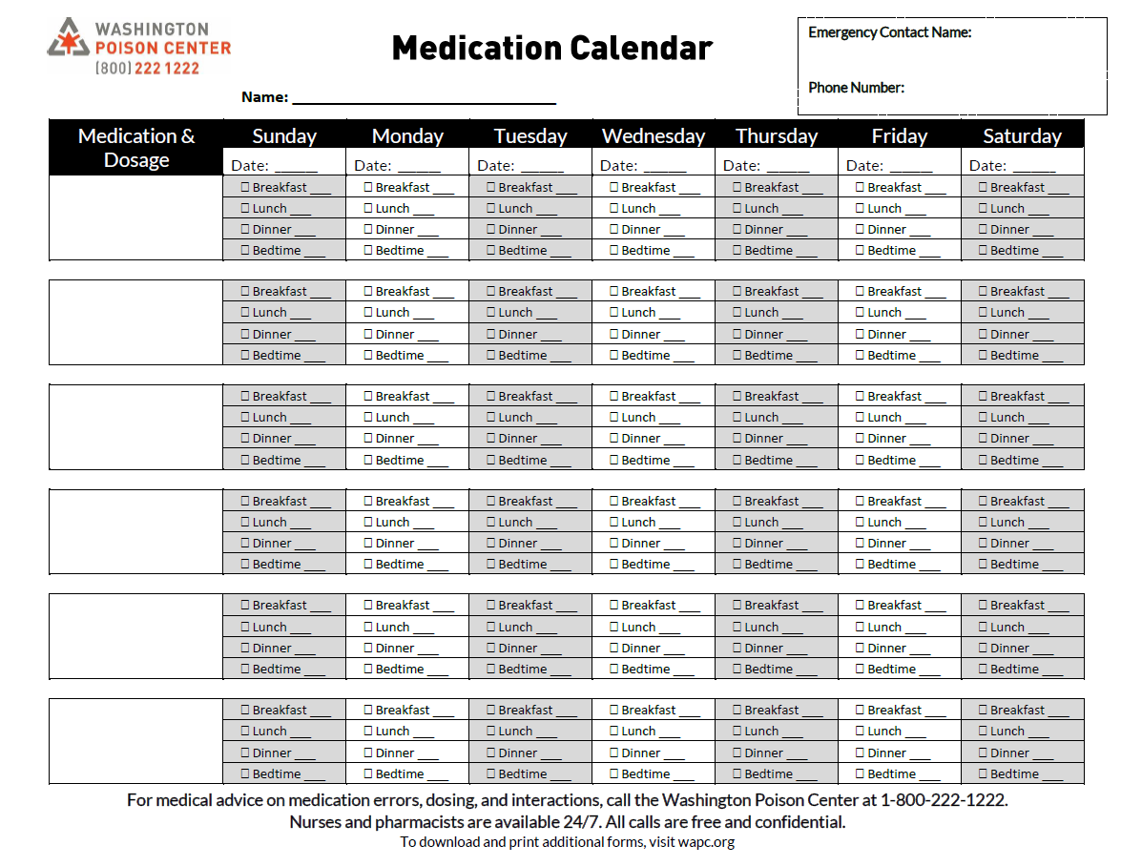

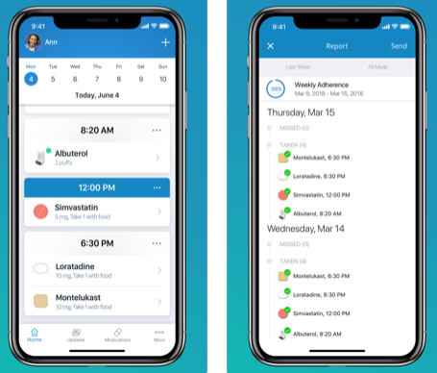
Create a system to know when you have taken your medication
Use a medication calendar
Notes:
A great way to prevent medication errors is by having an organizational system–- basically, a physical way of keeping track of your meds.
Some examples are medication checklists. I brought some paper copies here, you all are welcome to. After you take your meds, you check it off.
You can use a regular calendar too, either paper or on your phone, and just mark it off.
There are also cell phone apps, paid versions or free

Slide 21
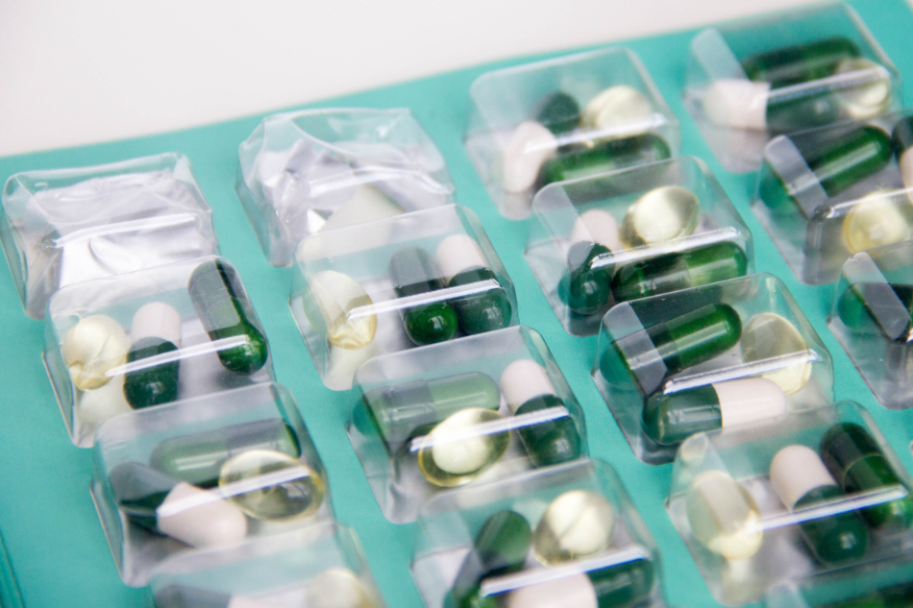
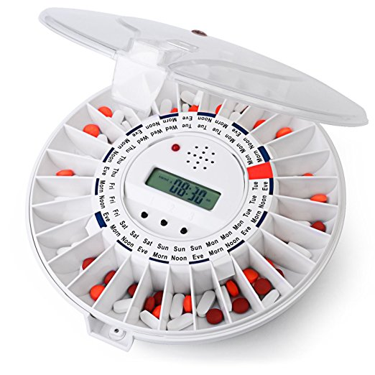
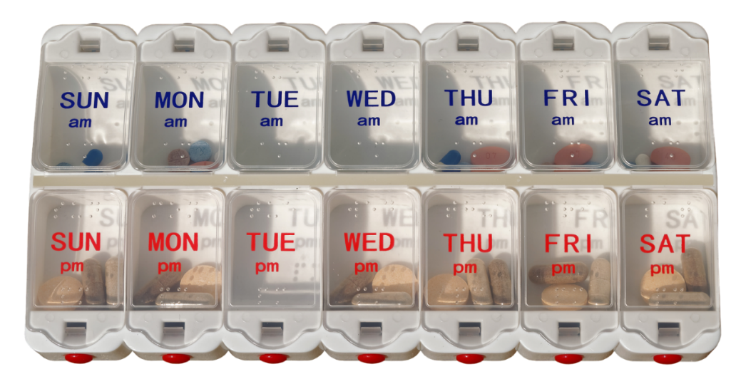
Create a system to know when you have taken your medication
Use a pill organizer
Notes:
Pill organizers are another great system.
Request bubble packaging from pharmacy → Some pharmacies may also offer “bubble” or “blister” packaging like the picture on this slide, where they package medications together by each day or by the time they need to be taken.
Or, you can do it yourself! There are a lot of different kinds of pill organizers, though, that can provide different levels of reminder support. For example, this pill organizer (the Mediset) stays locked until it is time for you to take your medications– only the box for the correct day and time will open. Some medication organizers include other features like flashing lights, audio cues, and notifications to caregivers if medications haven’t been taken.

Slide 22
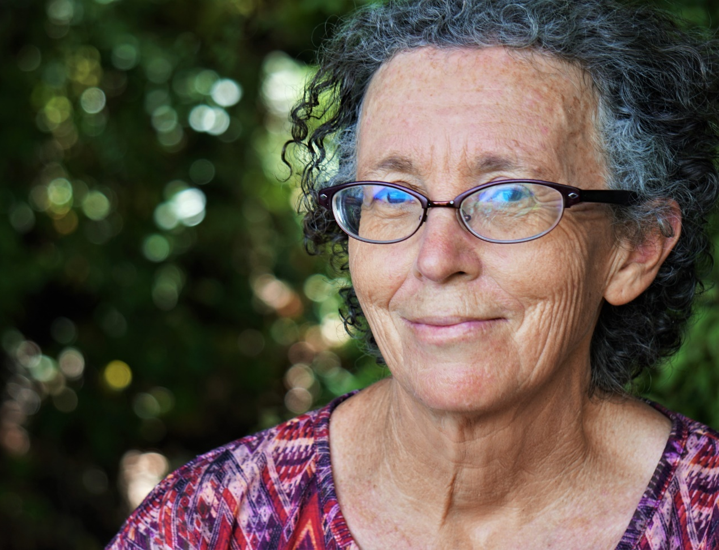
Medication error scenario: wrong medicine
Scenario:
Cynthia took an old prescription.
Notes:
A few months ago, Cynthia’s doctor decided to change a couple of her medications. Cynthia immediately switched to the new meds, but she never got rid of the old prescriptions in her medicine cabinet.
Now it’s time for Cynthia to take her evening dose. She’s talking to her partner as grabs her medication bottles, and accidentally grabs one of her old prescription out of habit– she was on that med for years, after all. She keeps chatting and takes her pills, not realizing she made a mistake. It’s only when she’s putting the pills away that she notices it was the wrong prescription.
What’s the first thing she should do?

Slide 23
1(800) 222-1222
Free
24/7/365
Confidential
260+ Languages
Notes:
Cynthia should call the poison center immediately and tell them what happened. Taking an old prescription is concerning, because it could interact with some of the other medications she’s taking, or could produce effects different or stronger from what she needs.

Slide 24
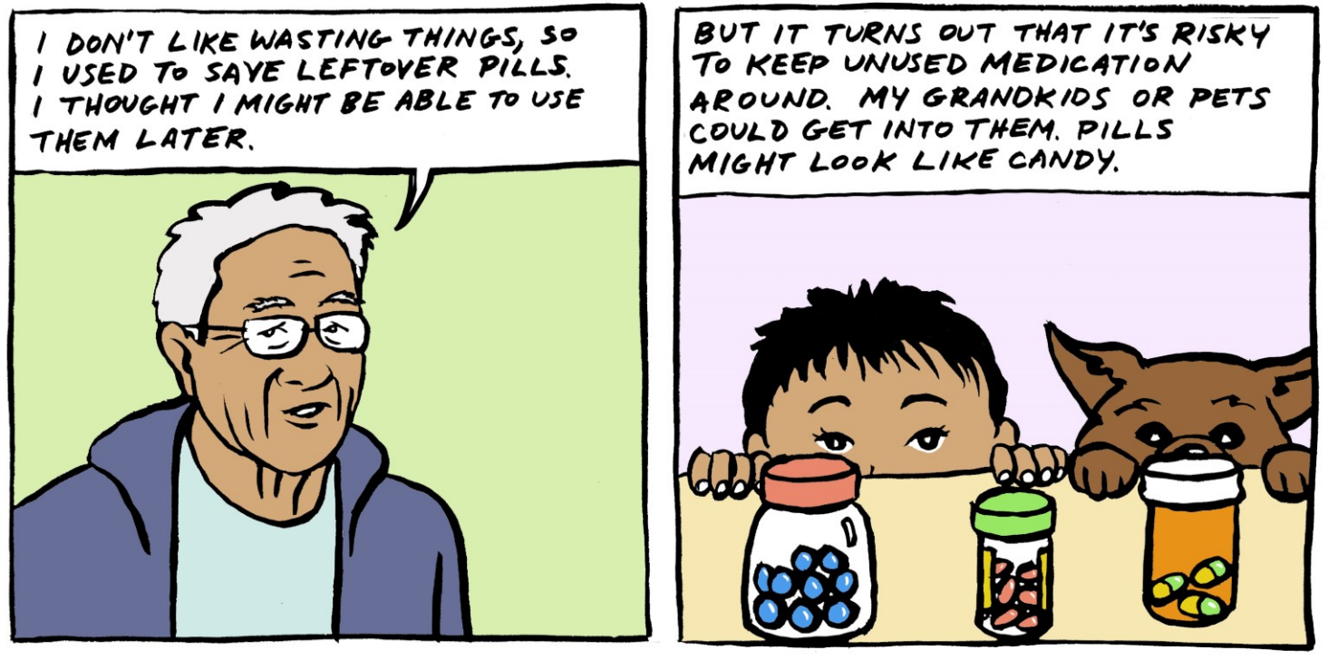
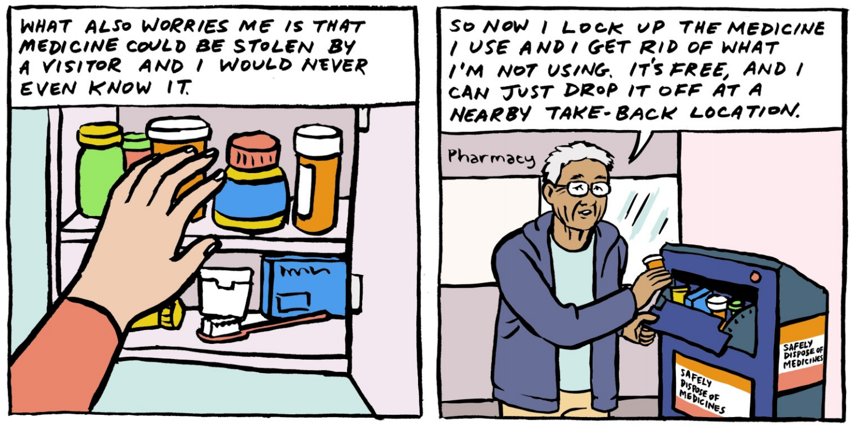
Don’t hang on to meds
Notes:
People frequently keep leftover or expired medication because they do not know how to get rid of it. But, it’s really important to dispose of unneeded medications: doing so can prevent accidentally taking the wrong medication, and prevents medications from accidentally or intentionally getting into the wrong hands.
You may have heard of a couple different ways to get rid of meds: flushing them down the toilet, mixing them with coffee grounds or kitty litter, crushing up pills, throwing them in the trash… all of these methods can be dangerous for you, other people, pets, and the environment. The best and safest way to get rid of unneeded medications is to take them to a medication drop box.

Slide 25
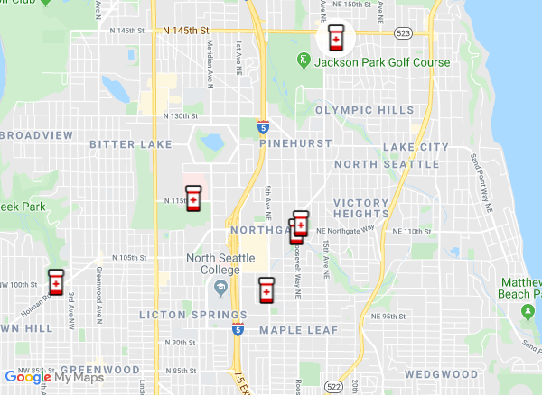
Find Take Back locations near you
takebackyourmeds.org

Slide 26
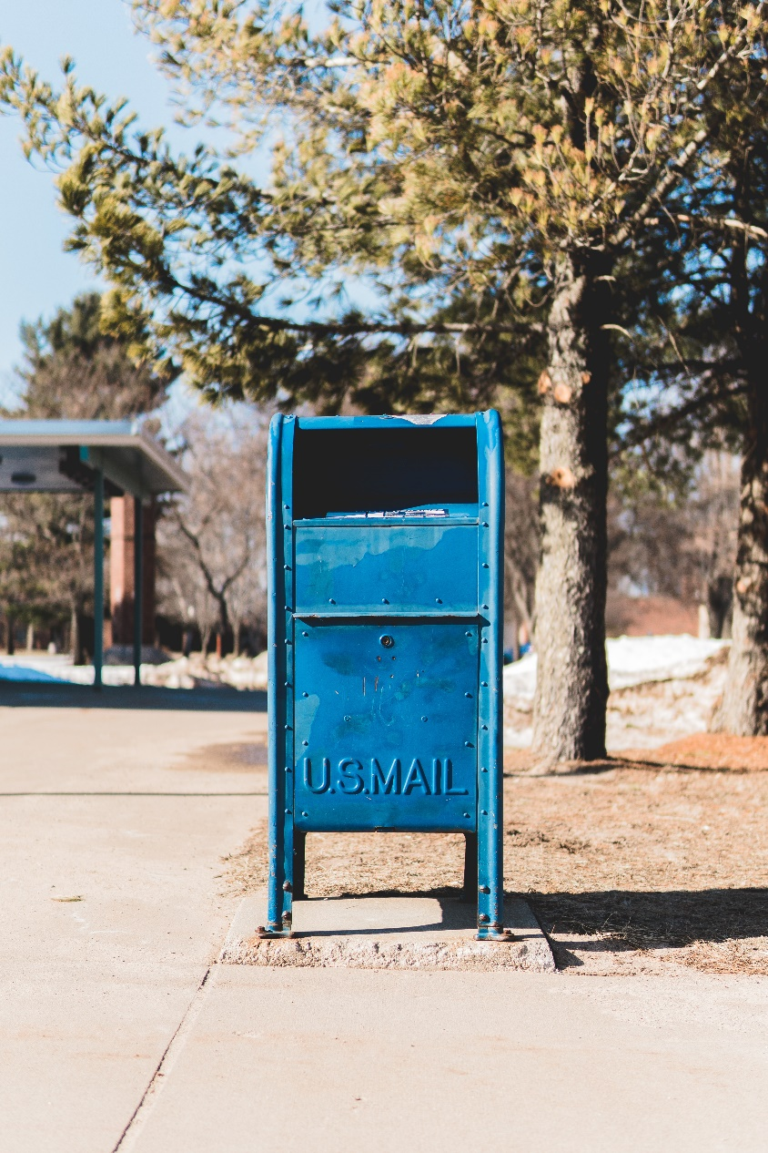
Disposal by mail
For differentially-abled and/or homebound residents, upon request
Not all substances are accepted (no vitamins/supplements, illicit drugs, and more)
Additionally offer mail-back services for inhalers and injectors
med-project.org

Slide 27
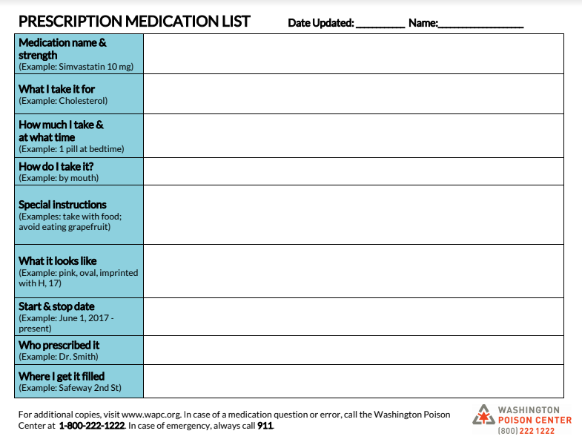
Use a medication list
Include prescriptions, over-the-counter medications, vitamins/supplements, & any other substances
Minimum information:
Name
Dose
Time
Special instructions
Take to every healthcare appointment
Notes:
Use one worksheet per medication, so that you can easily remove a page when a specific medication’s information is no longer accurate. There are separate worksheets for prescription and over-the-counter medications or supplements, as different information is required for each.
We also encourage you to use the wallet list. This abbreviated medication list can be kept in the older adult’s wallet or purse, or be placed on the refrigerator for quick reference to emergency medical information and the basics of the older adult’s medication plan.

Slide 28

Medication error scenario: wrong person
Scenario:
Jackie took one of her husband’s medications.
Notes:
Here is another scenario with Jackie. Jackie and her husband share a bathroom and keep their medications in the same cabinet. Jackie is getting ready for bed, and it’s time to take her evening medications. She reaches into the cabinet and grabs a bottle. But, after she has taken a couple pills, she realizes that she took her husband’s medication.
This can be a dangerous error, because a medication that Jackie is taking could interact react with her husband’s medication or with a health condition that she has– for example, if she already has low blood pressure, and accidentally took a medication that lowers her blood pressure.
What should Jackie do first?

Slide 29
1(800) 222-1222
Free
24/7/365
Confidential
260+ Languages
Notes:
Jackie should call the poison center immediately and tell them what happened.

Slide 30
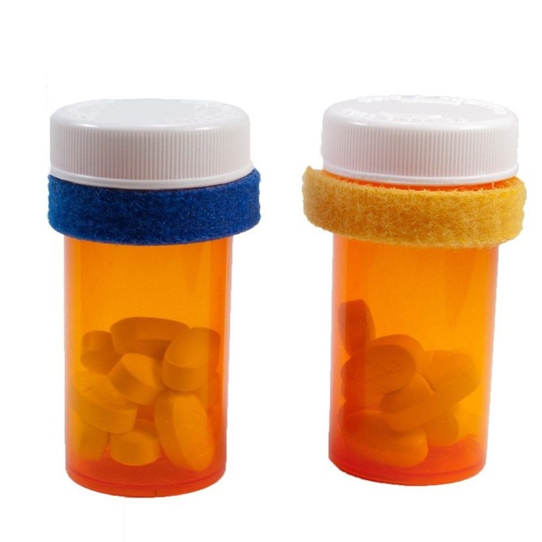
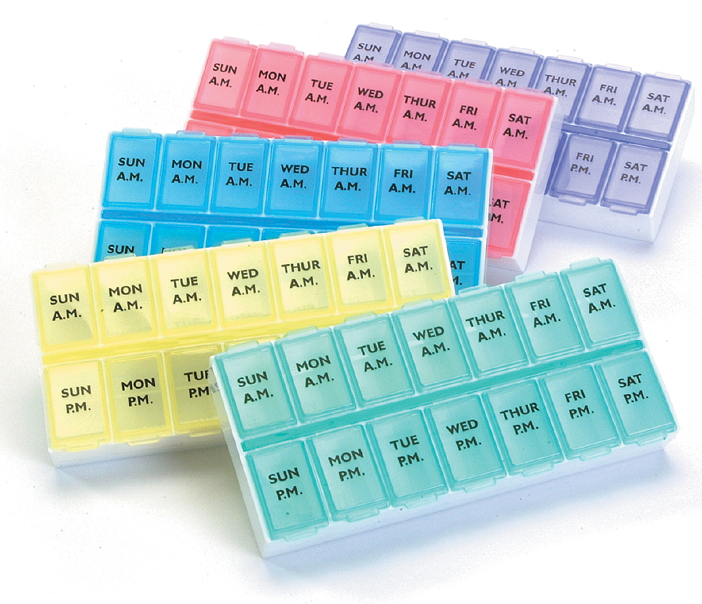
Store medications separate from those of other household members & pets
OR, use colored identification bands or pill organizers
Notes:
There are some simple ways to avoid a scenario like Jackie’s.
First, always keep your meds in containers. If you leave loose medication out, it can be very difficult to tell who’s is who’s.
Store your medications separate from those of other household members and pets. This could be in a completely separate location, or in separate pill organizers.
You can also use colored identification bands or colored pill organizers to differentiate between people. Even different colored rubber bands can do the trick!

Slide 31
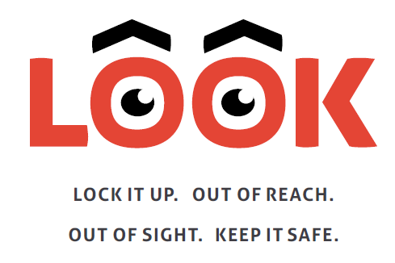
Safely store medications
Keep medications out of reach and out of sight
Lock up medications
Especially “high alert” medications (opioids, cannabis, sedatives, anti-depressants)
High risk with accidental and intentional use by others
Notes:
Wrong person can apply to more than just you! When you take medications, other people can accidentally or intentionally get into them. So, we have some extra safety tips to keep your meds out of the hands of others.
Medication safety is especially important with “high alert” medications: opioids, cannabis, sedatives, and anti-depressants.
The consequences of accidental use of these meds are concerning. Taking a double dose or another household member accidentally taking them could be risky for someone’s health.
And, there can be an issue with intentional use by others…. [NEXT SLIDE]

Slide 32
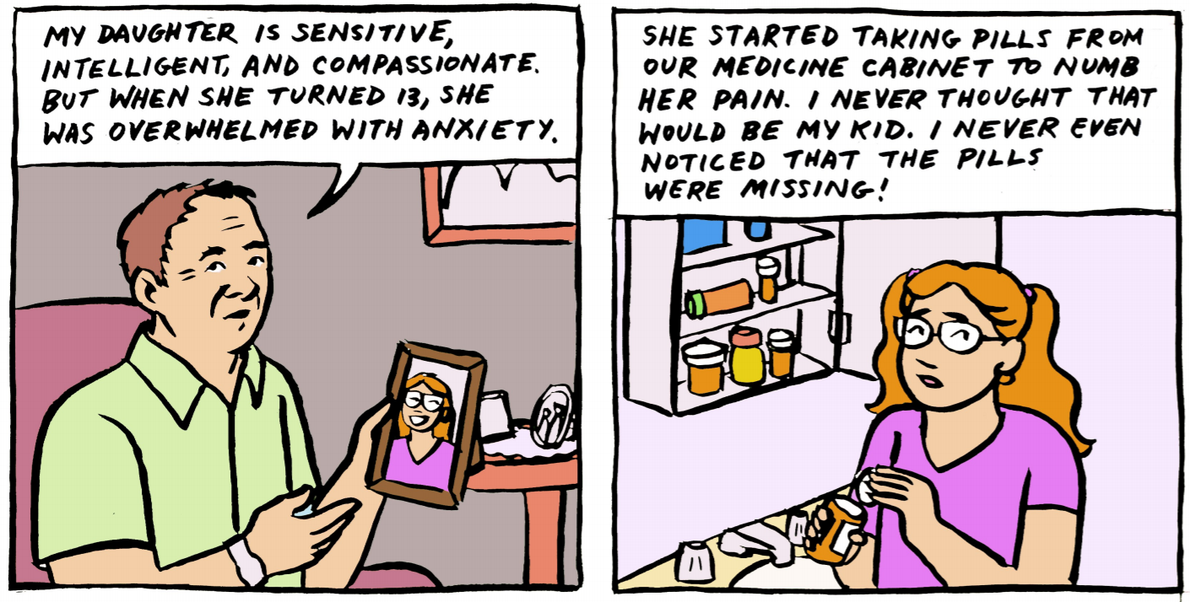
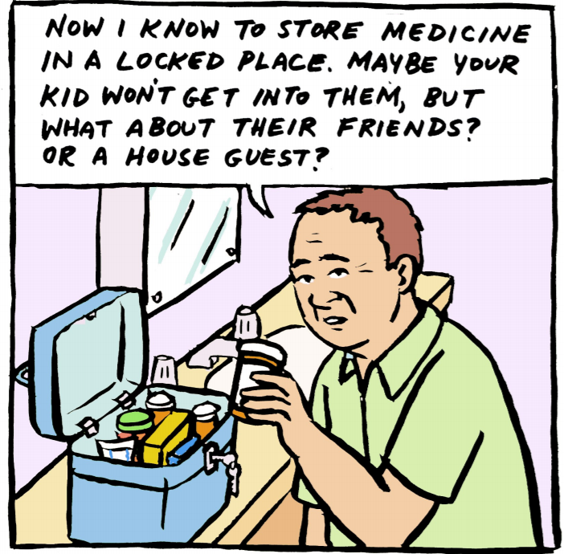
Opioids
Notes:
I’m sure you’ve heard about the opioid crisis going on. We’re experiencing it here in Washington too. In fact, two Washingtonians die from opioid abuse every day.
This connects back to medication safety, because 3 out of 4 people who misuse opioids start by using medication that wasn’t prescribed for them–usually meds taken from a friend or family member. So, if you are taking any of these “high alert” medications, it’s really important to keep them out of reach, out of sight, and locked up.

Slide 33
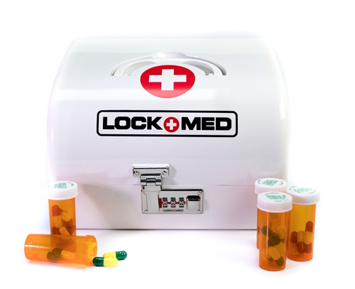
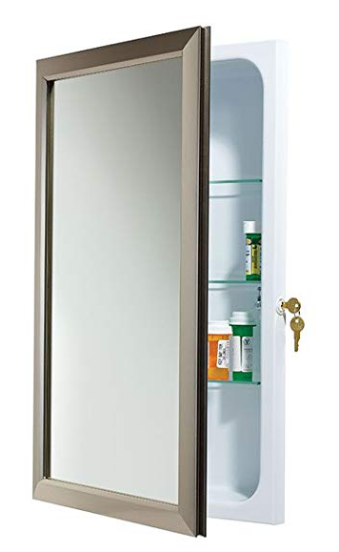
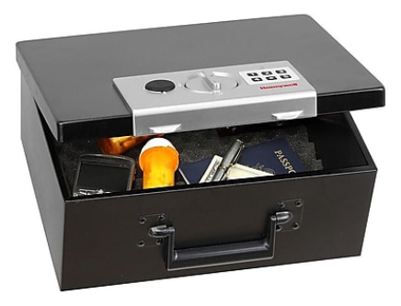
Medication lockboxes

Slide 34

Prevent accidental poisonings in kids
Do not take medication in front of children
Keep medications out of sight and out of reach
Check carpet/floors for dropped medication
Notes:
We have some special tips for grandparents:
Kids often mimic adults, so do not take medication in front of them.
Kids explore the world with their mouths. So, keep medications and any other toxic household items out of sight and out of reach of children and in child-resistant containers. For extra safety, you could use lock boxes.
Check your carpet and floors periodically for dropped medication. Pills can look a LOT like candy, so it’s easy for a kid to just pop it in their mouth.

Slide 35
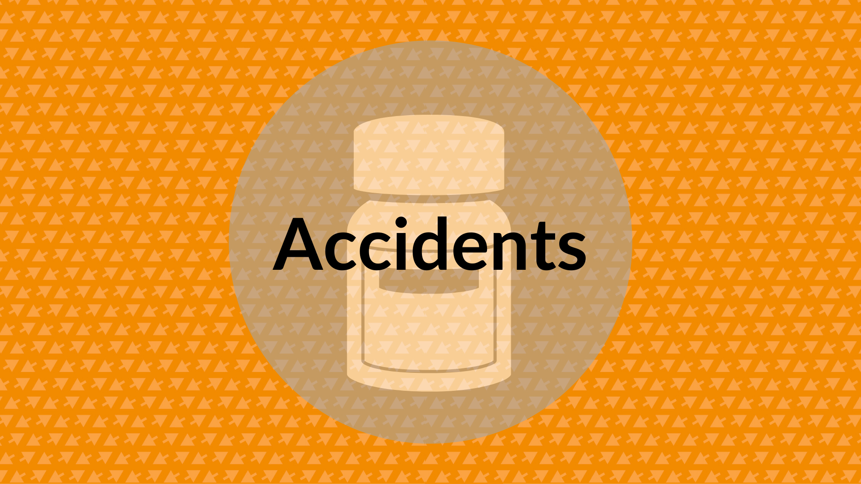
Notes:
We also hear a lot about accidents in adults over the age of 60. Remember, accidents are with non-pharmaceutical substances. In 2018, we had 1,755 cases of accidents in adults 60+.

Slide 36
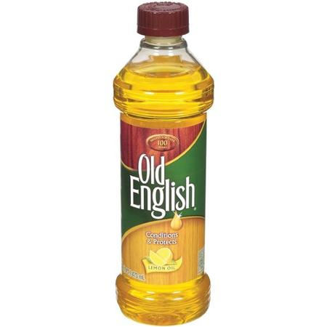

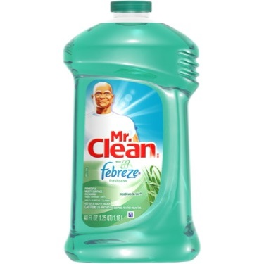
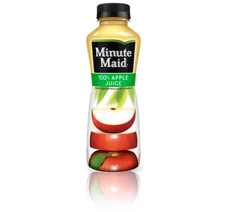
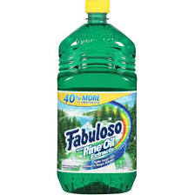
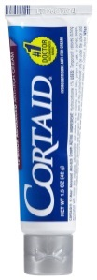
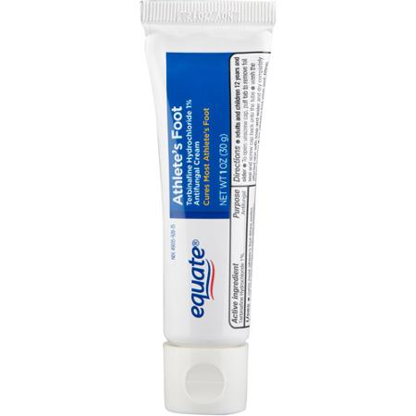
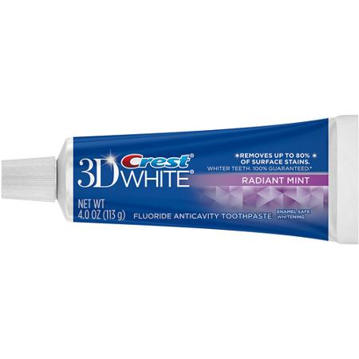
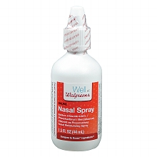
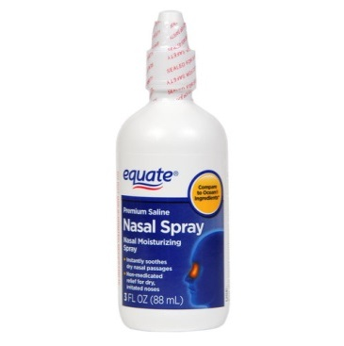
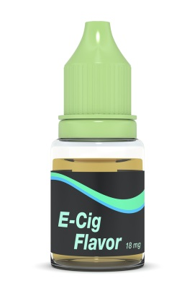
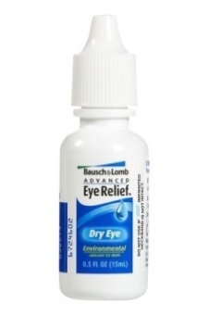
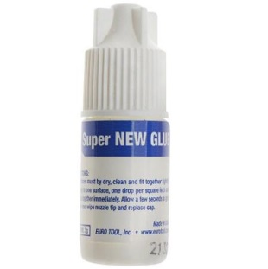
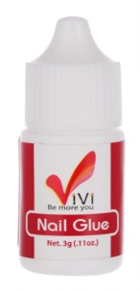
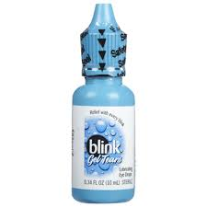
Look-a-likes
Notes:
Oftentimes people make mistakes because they confuse products that look similar. These are just few products that are commonly mixed up, but there are a LOT.

Slide 37
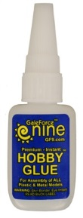
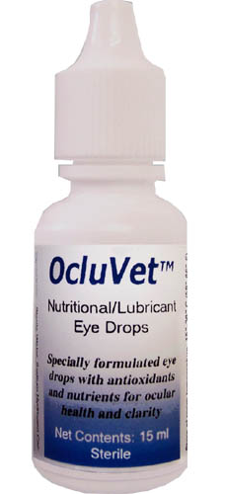
Accidents scenario
≠
Scenario: Jordan used glue instead of eye drops.
Notes:
Just like medication errors, we have a scenario.
It’s late at night, and Jordan is in bed. It’s allergy season, and his eyes are itchy, so he gets up to put some eye drops in. He doesn’t turn the lights on, since he keeps the eye drops in a drawer close by. But, Jordan keeps many other small things in the same drawer. So when he is feeling around for his eye drops, he accidentally grabs a craft glue instead– the container looks and feels similar. He doesn’t realize the error, and puts glue in his eyes instead of eye drops.
So, what’s the first thing he should do? Call the poison center! The SPI will tell him what to do.

Slide 38
1(800) 222-1222
Free
24/7/365
Confidential
260+ Languages

Slide 39
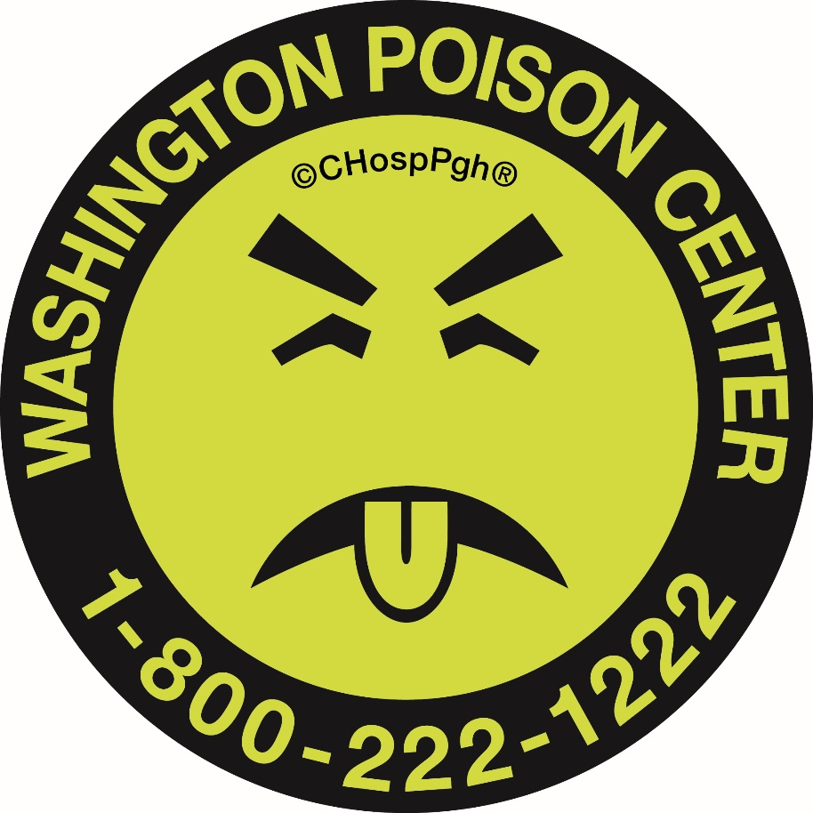
Store medications separate from look-a-likes
Turn on the lights & put on glasses
Use Mr. Yuk stickers
Notes:
Like medication errors, accidents are preventable. Here are some simple tips:
Always turn on the lights and put on your glasses before using any type of personal product.
Store your medications separate from non-pharmaceutical substances, especially those that are “look-a-likes.” Keep them in a different cupboard from cleaning supplies, or at least on a different shelf.
Use Mr. Yuk stickers on household chemicals and other non-pharmaceutical substances.

Slide 40
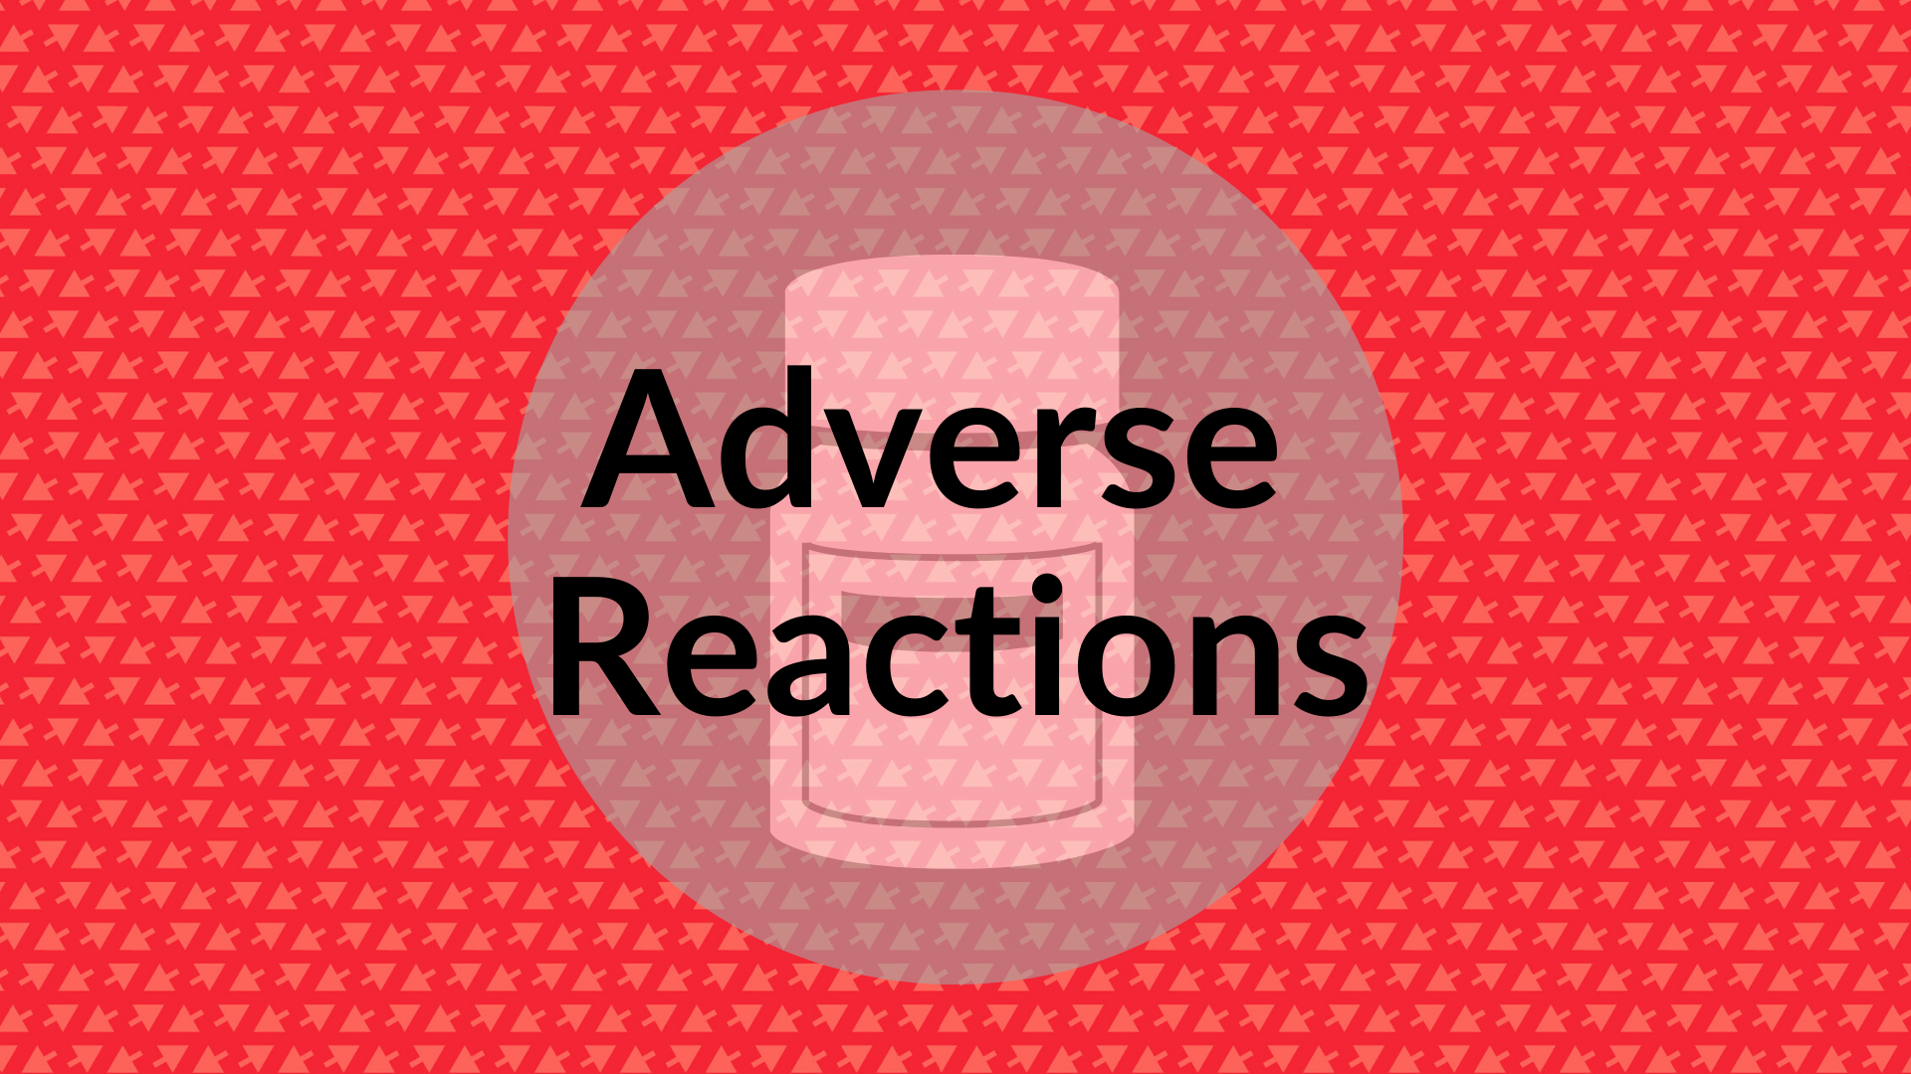
Notes:
Adverse reactions from drugs can be:
Unintended side effects from prescribed medications
And also side effects of drug interactions from prescribed and/or over the counter medications.

Slide 41
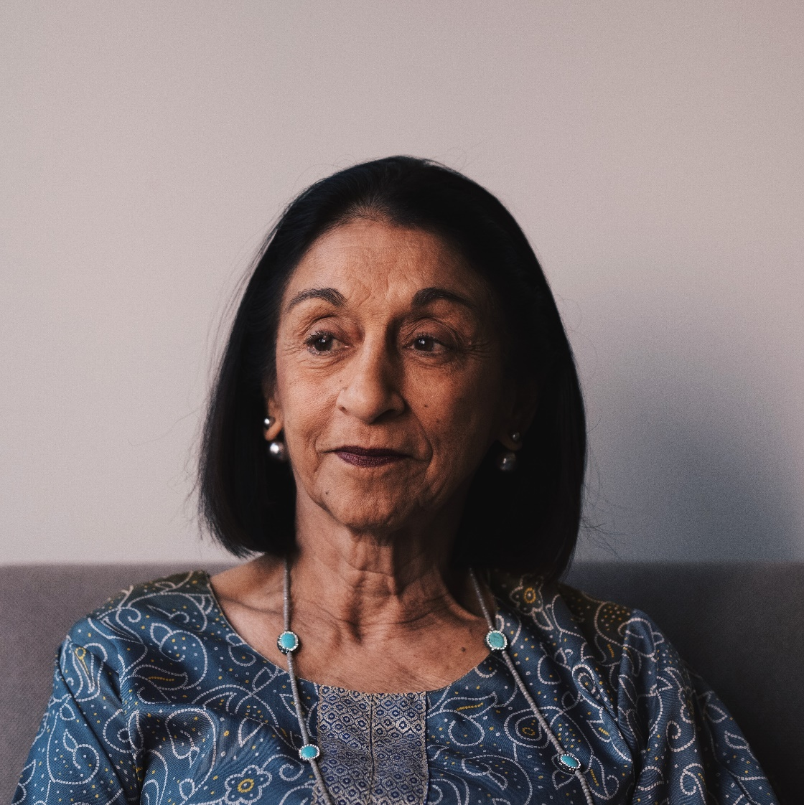
Adverse reaction scenario
Scenario:
Rose has diabetes, and decides to try a Ginseng supplement.
Notes:
Adverse drug reactions are definitely concerning with prescribed medications. But we also want to emphasize alternative and complementary medicines, or supplements, here, because there are so many different kinds that can interact with other medications you take or interact with your body in potentially harmful ways.
As an example, here’s our final scenario:
Rose has diabetes, and she hears that ginseng can help lower her blood sugar levels. She starts taking a ginseng supplement, which then starts interacting with her insulin. It makes it hard for her to regulate her blood sugar levels, and her doctor becomes concerned that her insulin dose is incorrect. Not knowing that she’s taking ginseng, he adjusts her dose.

Slide 42
Talk to your doctor or pharmacist before taking a supplement
Notes:
That’s why it is very important to talk to your doctor or pharmacist before taking a supplement. You can also call the poison center to ask for information about potential adverse reactions or drug interactions.
Ginseng is just one supplement that can result in an adverse drug reaction. And this list contains just a small number of supplements and their potential interactions or side effects.

Slide 43
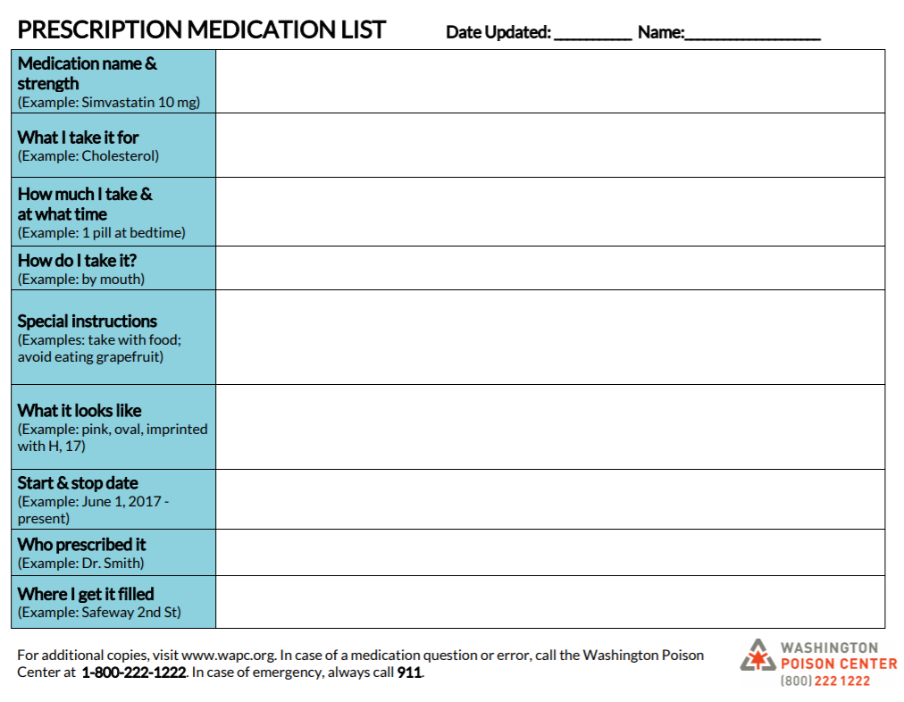
Use a medication list
Include vitamins, supplements, over-the-counter medications, and any other substance/drug
Take to every provider appointment and pharmacy visit
Notes:
When you talk to your doctor or pharmacist about taking a supplement, or if you’re experiencing any adverse effects from medications, have a medication list with all of the medications you are on, and any health conditions you have.

Slide 44
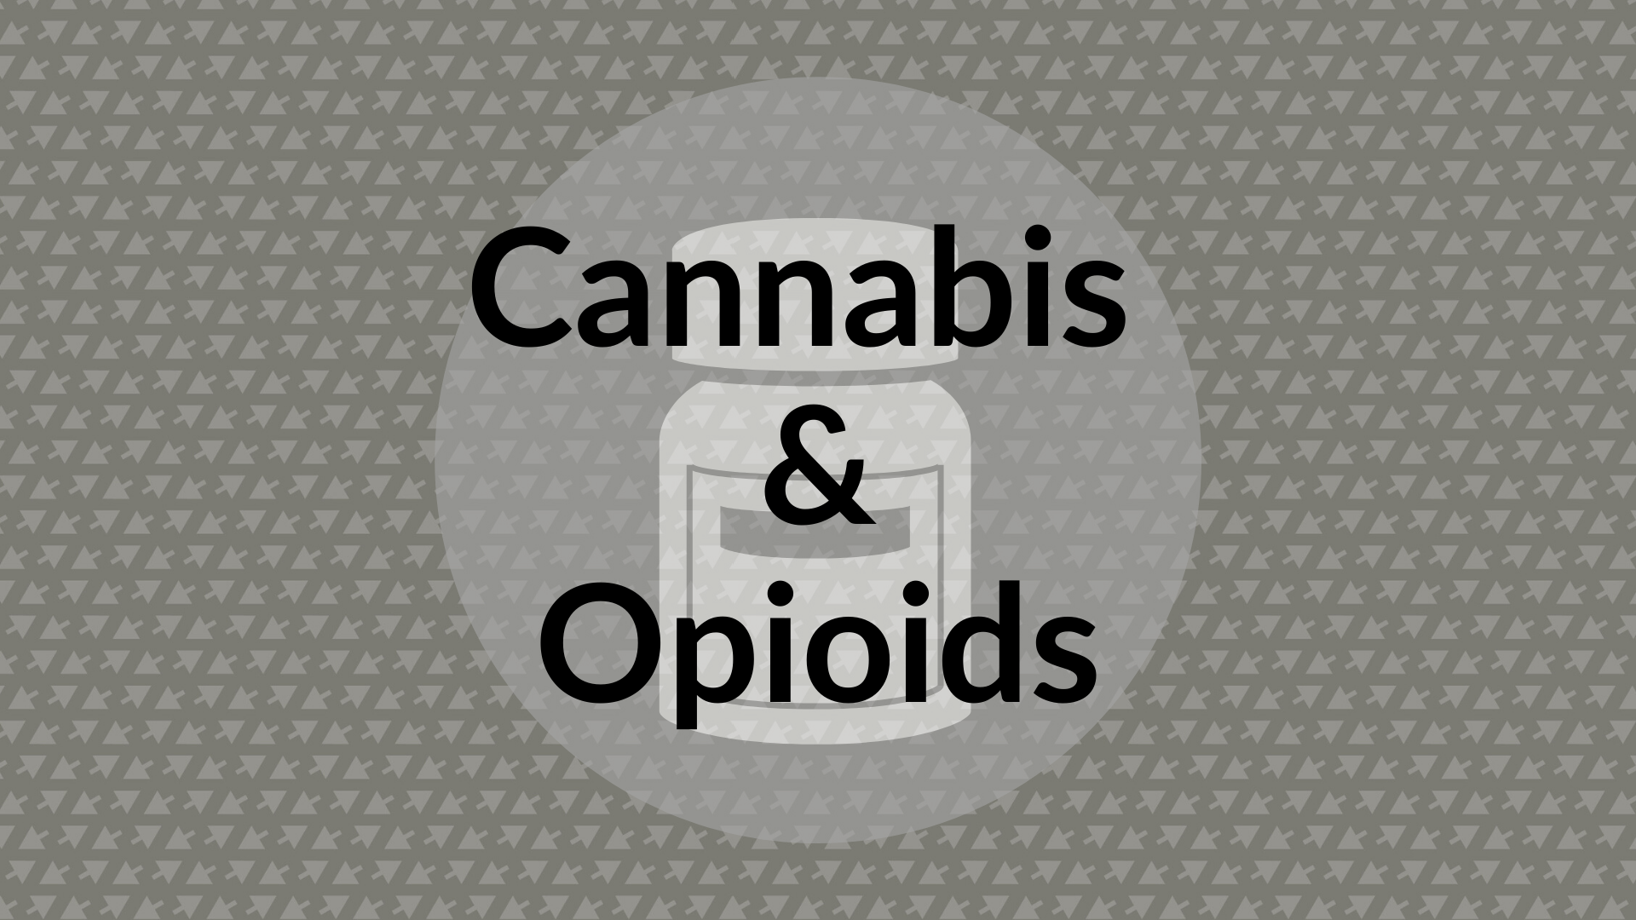
Notes:
That brings us to the end of our medication management tips based on our poison center call categories. I want to also bring to your attention a couple of substances and/or supplements that can affect med management: cannabis and opioids. I’ll give you a brief overview of each substance, and then talk about how some of their effects can affect taking medications.
Just a caveat before we go into this section: I am not telling you to NOT use these substances, there are definite therapeutic benefits for some people and some situations with both opioids and cannabis. I just want to talk about some of the potential risks. If you use cannabis or take opioids, it’s best to talk to your doctor about your specific situation and health, and what is best for you.

Slide 45
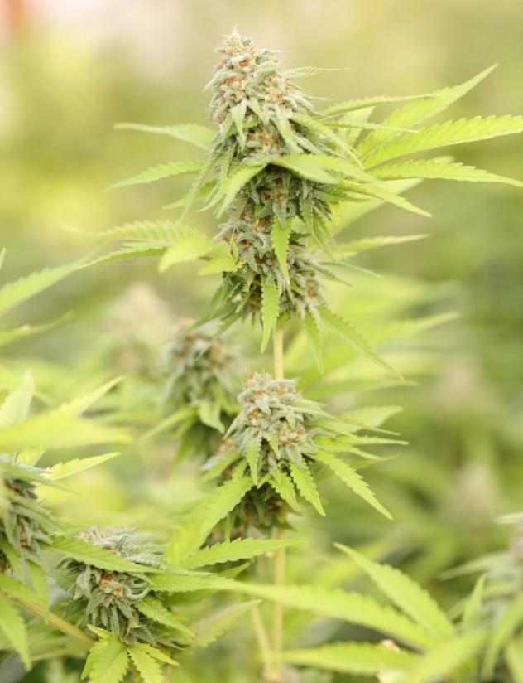


Cannabis/marijuana
CBD
THC
CBD
THC
CBD
Notes:
Cannabis is a plant. The plant is used to make a variety of drug and non-drug products. Drug products are often called “cannabis” (or marijuana/pot/weed/etc.) as well. The cannabis plant contains 2 chemical compounds: THC (which interacts with your brain and is psychoactive) and CBD (non-psychoactive). Products made from the cannabis plant can include both of these chemical compounds, or only one of them.

Slide 46






Cannabis/marijuana products
Dried flower/bud
Tinctures & topicals
Concentrates: oils & waxes
Edibles
&
Drinkables

Slide 47

Medication management risks
Cannabis (THC) can impair: cognition, attention, & short-term memory
Cannabis (THC) alters time estimation
Impacts on medication management:
Memory around taking medications (missed doses or double doses)
Comprehending medication instructions
Notes:
Symptoms are highly dependent on each individual: the amount they take, the concentration of the product, and the individual’s body (& how it reacts/metabolizes the substance)
Cannabis use often has cognitive implications: the substance’s primary psychoactive ingredient, delta-9 tetrahydrocannabinol (THC) can impair attention, executive cognitive function, and short-term memory. These effects may interfere with successful medication management by negatively impacting memory, decision-making, and comprehension around medication use (Lloyd & Striley, 2018; Stoner, 2016).

Slide 48

Cannabis (THC & CBD): drug interactions
Cannabis can affect how certain drugs are metabolized → May lead to increased blood levels of active ingredients
Specific concerns:
Benzodiazepines, narcotics, some antidepressants, aspirin, anticoagulants, non-steroidal anti-inflammatory drugs (NSAIDS), & some herbs or supplements
Effects on drowsiness, bleeding, blood sugar, & blood pressure
Talk to your doctor!
Notes:
REGARDLESS OF PSYCHOACTIVE OR NONPSYCHOACTIVE products (i.e., products containing THC & CBD or only CBD) , there can be drug interactions. Those who take medications, herbs, or supplements that are metabolized by a specific enzyme system in the liver can have increased blood levels of that medication/herb/supplement’s active ingredients, which could cause increased effects or potentially serious adverse reactions.
Safety message: inform providers/pharmacists so that they can look for any potential interactions
http://learnaboutmarijuanawa.org/factsheets/olderadults.htm

Slide 49

CBD products (cannabis)
Products outside of retail cannabis stores are unregulated & may not be tested
Uncertain product quality
CBD concentrations may not be reliable
Image source: https://www.bartelldrugs.com/products/cbd/
Notes:
Proliferation of CBD products due to 2018 Farm Bill, which legalized hemp. Be cautious with products purchased outside of licensed retail cannabis stores.

Slide 50


Opioids & Opiates
Opiate: a drug derived from Opium
Morphine
Codeine
Heroin
Opioid: synthetic/semi-synthetic drug that produces morphine-like effects
Semi-synthetic: oxycodone, hydrocodone, hydromorphone
Synthetic: methadone, fentanyl, tramadol, naloxone
Therapeutic use: pain management
Notes:
Across the U.S., older adults have the fastest growing rate of: opioid use, opioid-related hospital visits, and opioid-related deaths

Slide 51

Opioids: adverse reactions
Medication management:
Opioids can cause confusion/delirium, sedation, and impaired vision
Age-related changes:
Affect how opioids are processed in the body
More frequent use of other medications (interactions)
Risks:
Injury
Hospitalization
Use of emergency departments
Talk to your doc if you have concerns
Notes:
Opioids have a stronger impact on older adults because the body metabolizes drugs more slowly as someone ages

Slide 52

Medication management strategies
Talk to your doctor
Medication checklist
Pill boxes/medication organizers
Medication list
Call the Washington Poison Center!
Notes:
If you’re concerned about these risks, talk to your doc and use the strategies we went over today!

Slide 53


Slide 54
Call us for any error, accident, reaction, etc.
THE WRONG…
Person
Dose
#
Medicine
Time
Way

Slide 55
1(800) 222-1222
Free
24/7/365
Confidential
260+ Languages

Slide 56
What happens when you call?
1
Tell the SPI what happened:
What was taken?
How long ago did it happen?
How much was taken?
How is the person feeling?
What happened?
Notes:
When you call, you can expect the following steps. First, tell the SPI what happened. It is ok if you’re not sure. If you know, tell them what was taken, how long ago it happened, how much was taken, and how you are feeling.

Slide 57
What happens when you call?
2
The SPI will tell you what to do:
Stay home – what to do, what to watch for
2018: 94% of household cases were treated at home
Go to the emergency room
What should you do?
Notes:
Once you’ve provided as much as you know, the SPI will tell you what to do. Most poisonings can be taken care of over the phone, and the CSPI will tell you exactly what to do and what to watch for. Sometimes you need to go to the emergency room. If this is the case, the CSPI will tell you if you can drive or if you need to call for an ambulance. If needed, they’ll also call the emergency room to let them know you are on your way, and will suggest a treatment.

Slide 58
What happens when you call?
3
A SPI will oftentimes call you back – just to make sure everything is alright.
You can ask more questions then or call back later with other concerns.
WAPC wants to make sure things are OK
Notes:
Oftentimes, a SPI will call you back a while after your initial call– just to make sure everything is alright. You can ask more questions then, or call back later with other concerns.

Slide 59
Call us!
“I don’t want to waste their time if nothing is wrong.”
You cannot know all about the things that might be harmful. What you CAN do is call WAPC right away. You can also call for prevention ideas.
1-800-222-1222
Notes:
Never question calling the poison center… you won’t waste our time, we are always here to help. Call the Poison Center right away if you think an error, accident, or adverse drug reaction has occurred.
You can also call the poison center for questions or prevention ideas, even if an error hasn’t occurred. We are here to help!

Slide 60
Thank you!
Contact me at mking@wapc.org with any questions or comments.
Find resources on medication management on our website: wapc.org

