Slide 1
E-Cigarettes: Finding Truth Among the Vapors A Training of Trainers Workshop
Liz Wilhelm, MS
Seattle children’s prevention Wins coalition coordinator
Arti Patel, MPH, CHES
Health Education & Outreach Specialist
Washington Poison Center
Notes:
Adjust information as appropriate here to add presenter’s information
Good (morning/afternoon/evening), and thank you so much for being here. My name is () from (), and I am excited for us to spend the next () minutes together talking about an important prevention issues that has really risen to the forefront over the last year or so.
For TOT: How many of you have gone througWhy can’t we say safe?
h some kind of training of the trainer workshop? Great, then you know that over the next 2.5 hours, we’re going to be going over a lot of information. To help, you have a copy of these slides with a space to take notes. Remember that the goal of a training of trainers workshops is that those in attendance have feel capable of communicating the part of this presentation that resonates most with you and not necessarily for you to internalize every single point, especially not on the first pass! As you prepare to share this information with your networks, you will have access to this presentation with my “script” or notes written in.

Slide 2
Before we begin…THANK YOU!
Notes:
For Presentations HIDE SLIDE: You can offer a word of thanks during the opening slide
For TOT: Thank everyone for committing the time. Thank any other relevant groups (e.g. the person who invited you, the person providing space or snacks, etc)

Slide 3
Agenda
Introductions and Pre-test
E-cigarettes
Basics, Point Counter-Point, Role Playing
One Function Break
Marijuana Vaping
Basics, Washington Info, Vaping Other Substances
Call to Action
Reflection
Post-test
Notes:
For Presentations: You may HIDE SLIDE or adjust to reflect what parts you will be speaking about
For TOT: We’re going to start today by doing some introductions and getting to know one another. Then we will have a pre-test. The goal of the tests is to be able to gage how well we do at meeting out goals and objectives. That will helps us this first time especially. We will then go into the e-cigarette basics, talk about some of the contentious issues with e-cigarettes, talk about how to speak to those issues with current research, and then do some role playing at having conversations with this information. After a break, we will pick back up talking about vaping other substances, specifically marijuana. There isn’t a whole lot of research here, but I will share what we do know. After that we will talk about what each of us can do about the issues and wrap up by reflecting –I personally find that taking the time to reflect helps to cement some of the information. Then we will finish with a post-test to see how well we did at meeting out goals and objectives.

Slide 4
Why are we here?
“For these are all our children, we will profit by or pay for what they become” – James Baldwin
The health and choices of youth will impact the whole community, not just youth and not just parents
Community Coalitions exist to address youth substance use at the community level
This training is specifically developed through a partnership between Washington Poison Center and Prevention Works in Seattle (Prevention WINS) a Drug Free Communities Coalition in NE Seattle
By combining expertise, we expand the reach of community organizing and education
Our hope is that this will be benefit all communities, not just our own
Notes:
For ALL: Read the quote. You may even read it twice
What did James Baldwin mean by “we will profit by or pay for what they become”? I think he’s speaking to relevance of community—that the actions and choices of youth impact everyone because we are all so interconnected. That we can’t say youth issues are just for the schools or just for parents to deal with. Who/what the youth become, is also what we become—our collective future hangs in the balance. After all, this is why we’re here: coaltions exists to address youth substance use and access at the community level involving people from all sectors—not just parents and schools
And one of the benefits of community level action is that we get to combine our expertise! Specifically, we can think about this training created out of the partnership and community work of Prevention WINS in NE Seattle and the Washington Poison Center who’s physical location is in the specific NE Seattle area. By coming together we combine and share our expertise thus we can expand the reach of community organizing. Moreover, this particular issues is one that affects more than just our community, and we find that we can share beyond just NE Seattle.

Slide 5
Let’s hear from you…
Name
Affiliation/Organization/Sector
Answer one of these questions:
What concerns do you have when talking about these topics? What makes you uneasy?
What types of things are you wanting to learn? Are there myths that you want to dispel?
What type of audience do you want to take this information to?
Notes:
For Presentation: Depending on your setting, you may not have time for this activity and thus HIDE SLIDE. You will be responsible for determining if you have the time and the audience is of the appropriate size to take the time for everyone to speak
For TOT: I would like for us to do some introductions. Please take a minutes to say your name, and the organization or community sector you represent. Then I want you to answer one of these 3 questions. Read questions. These questions are two-fold, not only do they get us all introduced and talking, but it gives me a chance to hear about the specific concerns you have in this community and will shape some of my talking points. Let’s start with…

Slide 6
Who Are We?
Prevention WINS
Drug-Free Communities Coalition serving the 98105, 98115, 98125 zip codes in NE Seattle
Began in 2005 and focuses on alcohol, prescription drugs, and marijuana
Includes community members from
Seattle Children’s Hospital
2 Middle and 2 High schools
Local law enforcement
Many, many more!
Washington Poison Center
WA’s non-profit poison control center
Provide free and confidential drug and poison exposure advice 24/7
1-800-222-1222
Collect real time data on poison and drug exposures which is valuable to community coalition
Involved in poison prevention education and legislative action
Notes:
Presentations: You can adjust to fill in the information about your coalitions

Slide 7
Learning Objectives and Goal
GOAL: To equip you with the knowledge, tools, and confidence to provide educational presentations on e-cigarettes and marijuana/cannabis vaping to adults throughout the community
By the end of this session, participants will be able to
Describe the basic principles and paraphernalia of e-cigarette and Marijuana/Cannabis, specifically those items contained in the Washington Poison Center E-Cigarette & Vaping Display Kit
Identify the poisoning-related hazards of e-cigarettes and vaping
Utilize current research to articulate the health risks e-cigarettes and Marijuana/Cannabis pose to youth
Notes:
For PRESENTATIONS: HIDE this slide; you may also recreate to list the specific learning objectives of your presentation
For TOT: read/paraphrase the goals and learning objectives. Then add the caveat.
Caveat: There is a TON of information in this presentation. A lot. It took several people several months to bring all of this together. The expectation is not that you will be able to go out and give this 2 hour presentation verbatim tomorrow. We will all find particular things that resonate with us and the role that we have in the community. THOSE are the things that you will be able to talk about and those are the types of groups that you will want to connect with. Please do not feel daunted by the quantity of information about to come at you. In that vein, we want this to be more of a conversation and discussion—if you have questions or thoughts at any time, please speak up!

Slide 8
Pre-Test
You will have 10 minutes
Remember the primary goal is to see how much you learn, so answer honestly
Please put your initials at the top right hand corner
When everyone is finished, gather together in groups of 2-3, and I will pass around materials to everyone
Notes:
For Presentation: HIDE SLIDE
For TOT: Pass out pre-tests. While they are working on pre-tests, you can set-up the rest of your materials.

Slide 9
E-Cigarettes?
Notes:
For Presentation AND TOT: Raise your hand if you’ve seen something about e-cigarettes in the media, popular press, social media, etc. Looks like all or almost all of us have. Concerns about e-cigs has really expanded in the media recently, especially the last 6 months or so. Issues that are trending include the discussion on if it’s really safe, how does it impact kids, and how are other countries responding.

Slide 10
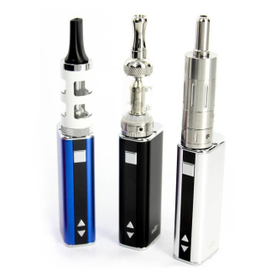
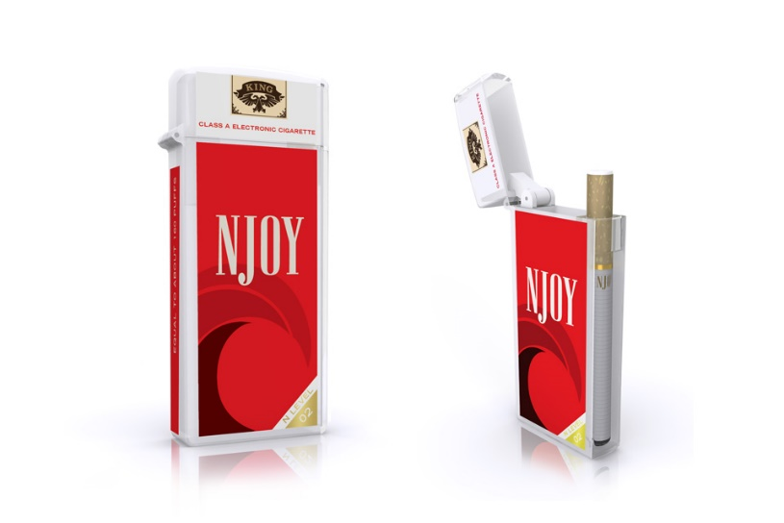
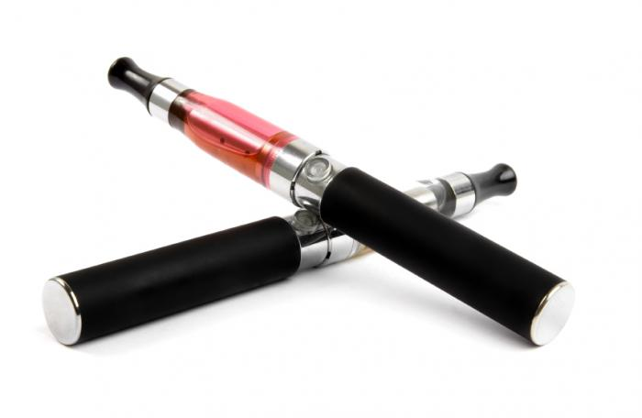
What are e-cigarettes?
Electronic Nicotine Delivery System (ENDS): battery operated device that vaporizes a liquid nicotine for inhalation
Go by several names: e-cig, e-hookah, e-pen, vape pen, mod, vaporizer
Notes:
Read definition. This is in contrast to smoking where one lights the tobacco plant on fire, and as it burns in a combustion reaction, the nicotine is heated and released form the plant. It is inhaled along with the smoke and all the other chemicals we now know are contained within cigarettes. Vaping is an alternative where oils are inhaled without the use of a combustion reaction.
The actual devices go by several names: e-cigarettes, e-hookah, e-pen, vape pen, mod, tank, and on and on. Of note is that there are two ways to use the word vaping, and both will be used throughout this presentation. There is vaping, the process of vaporizing something, making it from a liquid into a gas, and then there is the act of vaping, or using one of these devices.

Slide 11
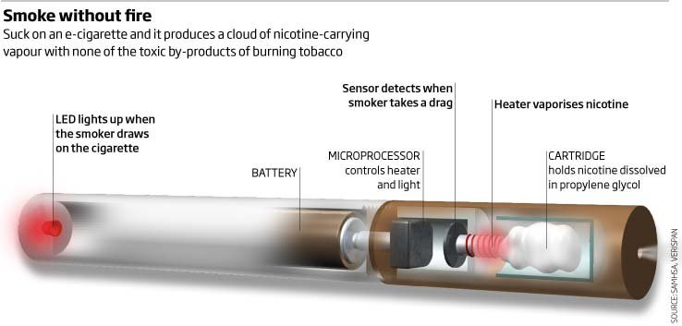
What are e-cigarettes?
3 Main Pieces:
Battery
Atomizer
Cartridge
Notes:
[Have them pick up their devices] Everyone should be able to hold one of some kind. In the next slide we will talk more about the differences between all of these different devices, but they all have the same basic functions: battery, atomizer, liquid cartridge. The battery is the power source and you can buy rechargeable and one-time use devices. It powers the atomizer, which is basically the heating element that both heats the liquid and help is become aerosolized droplets that can be inhaled. Then the cartridge holds the liquid nicotine solution.
Note that this schematic is from a manufacturer. Specifically read the caption and not that it is not necessarily true—we have some evidence, that we’ll talk about later, that the vapor is not necessarily “with non of the toxic by-products” of burning tobacco.

Slide 12
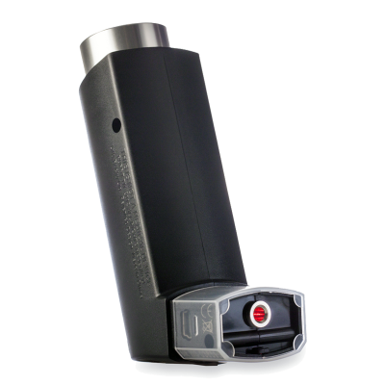
Various e-cigarettes available
3 Basic Types:
Minis or Ciglites
Mid-size rechargeable vape pens
Mods or Advanced Personal Vaporizers
Ideal temperature for nicotine to vaporize is 190 degrees F.
Notes:
Step through each type, and have the groups with each of these show their product as you go.
Minis or Ciglikes are disposable, one time use. Many times there is no ON switch and one would simple tag a drag, or breath in, and the unit will turn on. They have all the same parts as the schematic: a power source, heating element, and liquid cartridge, we usually just can’t see if because they are covered to look like cigarettes. Some will even glow when one uses them to look more like a traditional cigarette. Something like the NJOY or the larger 700 puff version is going to cost $5-$10. Prompt: what are some of the hazards of this product? Potential answers: not very sturdy and thus could break open spilling liquid; no control over power to turn on and off, shameless cigarette look alike totally contrary to smoking cessation push; very concealable
Mid-size rechargeable: This is probably the most familiar looking. These have that refillable liquid cartridge that holds 3 milliliters of liquid nicotine. You can unscrew them (try it!). It has an “on” button, and usually has a “safety lock” whereby you have to hit it 3-5 times in succession to make it power up. This type of device varies in price. The ones you all have are about $20 from a convenience store. You can buy them for as low as $7 online, and they get more expensive in vape shops. Prompt: what are some of the hazards you see with this? Potential answers: refillable and thus can be filled with anything; one must handle the liquid; could break open; idea that it’s “child safety locked” is foolish—consider that we have a tendency to make calls on cell phones when they are in our purses or pockets; fire hazard
Mod or Tank: these are essentially a battery box with a liquid cartridge screwed on top. These are more high powered, and offer more user adjustments. This type of thing typically requires some user assembly. The idea behind having higher power is that better battery allows you to have a better quality heating element. With a better quality element, you get a better quality vapor—meaning that it’s an even temperature and has an even, efficient delivery of nicotine. In that sense it has more of a feel of a traditional cigarette. These are much more costly—and are going to cost over $100. People working in vape shops have said that anyone who is serious about quitting cigarettes will need to use this kind of device. Using a pen will never feel the same and thus the person is more likely to seek out cigarettes to get the right nicotine buzz. Prompt: What are some of the hazards here? Potential answers: more power is a greater fire hazard; the dangers of working with an electrical unit and not really knowing what you’re doing
Albuterol inhaler look alike! It is basically mid-size pen shrunken down and covered by the body of an inhaler. You would turn it on and inside the liquid is vaporized and then comes out of the mouth, where that red dot is. This product is called the Puffit Discrete vaporizer. Again this is more costly--$75 at the cheapest. What are some of the hazards here? Potential answers: dangers of confusing it for an actual inhaler; hazard in that it could get in to more places where is could be dangerous (e.g. on an airplane)

Slide 13
Minis or Ciglites
Disposable
Costs: $7-$10
Comes fully charged right of the box
About 400 puffs (about 1.5-2 packs of cigarettes)
Various flavors (Tropical Twist, Vivid Vanilla, Cherry Crush, Glacier Mint, BlueBlackberry)
Ideal temperature for nicotine to vaporize is 190 degrees F.
Notes:
Step through each type, and have the groups with each of these show their product as you go.
Minis or Ciglikes are disposable, one time use. Many times there is no ON switch and one would simple tag a drag, or breath in, and the unit will turn on. They have all the same parts as the schematic: a power source, heating element, and liquid cartridge, we usually just can’t see if because they are covered to look like cigarettes. Some will even glow when one uses them to look more like a traditional cigarette. Something like the NJOY or the larger 700 puff version is going to cost $5-$10. Prompt: what are some of the hazards of this product? Potential answers: not very sturdy and thus could break open spilling liquid; no control over power to turn on and off, shameless cigarette look alike totally contrary to smoking cessation push; very concealable
Mid-size rechargeable: This is probably the most familiar looking. These have that refillable liquid cartridge that holds 3 milliliters of liquid nicotine. You can unscrew them (try it!). It has an “on” button, and usually has a “safety lock” whereby you have to hit it 3-5 times in succession to make it power up. This type of device varies in price. The ones you all have are about $20 from a convenience store. You can buy them for as low as $7 online, and they get more expensive in vape shops. Prompt: what are some of the hazards you see with this? Potential answers: refillable and thus can be filled with anything; one must handle the liquid; could break open; idea that it’s “child safety locked” is foolish—consider that we have a tendency to make calls on cell phones when they are in our purses or pockets; fire hazard
Mod or Tank: these are essentially a battery box with a liquid cartridge screwed on top. These are more high powered, and offer more user adjustments. This type of thing typically requires some user assembly. The idea behind having higher power is that better battery allows you to have a better quality heating element. With a better quality element, you get a better quality vapor—meaning that it’s an even temperature and has an even, efficient delivery of nicotine. In that sense it has more of a feel of a traditional cigarette. These are much more costly—and are going to cost over $100. People working in vape shops have said that anyone who is serious about quitting cigarettes will need to use this kind of device. Using a pen will never feel the same and thus the person is more likely to seek out cigarettes to get the right nicotine buzz. Prompt: What are some of the hazards here? Potential answers: more power is a greater fire hazard; the dangers of working with an electrical unit and not really knowing what you’re doing
Albuterol inhaler look alike! It is basically mid-size pen shrunken down and covered by the body of an inhaler. You would turn it on and inside the liquid is vaporized and then comes out of the mouth, where that red dot is. This product is called the Puffit Discrete vaporizer. Again this is more costly--$75 at the cheapest. What are some of the hazards here? Potential answers: dangers of confusing it for an actual inhaler; hazard in that it could get in to more places where is could be dangerous (e.g. on an airplane)

Slide 14
Mid-Size Rechargeable Vape Pens
Reusable/Rechargeable
Costs: $10-$40
1.6 ml tank= 800 puffs
One heating element
Ideal temperature for nicotine to vaporize is 190 degrees F.
Notes:
Step through each type, and have the groups with each of these show their product as you go.
Minis or Ciglikes are disposable, one time use. Many times there is no ON switch and one would simple tag a drag, or breath in, and the unit will turn on. They have all the same parts as the schematic: a power source, heating element, and liquid cartridge, we usually just can’t see if because they are covered to look like cigarettes. Some will even glow when one uses them to look more like a traditional cigarette. Something like the NJOY or the larger 700 puff version is going to cost $5-$10. Prompt: what are some of the hazards of this product? Potential answers: not very sturdy and thus could break open spilling liquid; no control over power to turn on and off, shameless cigarette look alike totally contrary to smoking cessation push; very concealable
Mid-size rechargeable: This is probably the most familiar looking. These have that refillable liquid cartridge that holds 3 milliliters of liquid nicotine. You can unscrew them (try it!). It has an “on” button, and usually has a “safety lock” whereby you have to hit it w3-5 times in succession to make it power up. This type of device varies in price. The ones you all have are about $20 from a convenience store. You can buy them for as low as $7 online, and they get more expensive in vape shops. Prompt: hat are some of the hazards you see with this? Potential answers: refillable and thus can be filled with anything; one must handle the liquid; could break open; idea that it’s “child safety locked” is foolish—consider that we have a tendency to make calls on cell phones when they are in our purses or pockets; fire hazard
Mod or Tank: these are essentially a battery box with a liquid cartridge screwed on top. These are more high powered, and offer more user adjustments. This type of thing typically requires some user assembly. The idea behind having higher power is that better battery allows you to have a better quality heating element. With a better quality element, you get a better quality vapor—meaning that it’s an even temperature and has an even, efficient delivery of nicotine. In that sense it has more of a feel of a traditional cigarette. These are much more costly—and are going to cost over $100. People working in vape shops have said that anyone who is serious about quitting cigarettes will need to use this kind of device. Using a pen will never feel the same and thus the person is more likely to seek out cigarettes to get the right nicotine buzz. Prompt: What are some of the hazards here? Potential answers: more power is a greater fire hazard; the dangers of working with an electrical unit and not really knowing what you’re doing
Albuterol inhaler look alike! It is basically mid-size pen shrunken down and covered by the body of an inhaler. You would turn it on and inside the liquid is vaporized and then comes out of the mouth, where that red dot is. This product is called the Puffit Discrete vaporizer. Again this is more costly--$75 at the cheapest. What are some of the hazards here? Potential answers: dangers of confusing it for an actual inhaler; hazard in that it could get in to more places where is could be dangerous (e.g. on an airplane)

Slide 15
Vape Mods or Advanced Personal Vaporizers
Rechargeable/Reusable
Costs: $100-$800
Higher powered
Tanks vary
More user adjustments
Higher powered = better quality heating element because multiple = quality vapor = efficient delivery of nicotine
Notes:
Step through each type, and have the groups with each of these show their product as you go.
Minis or Ciglikes are disposable, one time use. Many times there is no ON switch and one would simple tag a drag, or breath in, and the unit will turn on. They have all the same parts as the schematic: a power source, heating element, and liquid cartridge, we usually just can’t see if because they are covered to look like cigarettes. Some will even glow when one uses them to look more like a traditional cigarette. Something like the NJOY or the larger 700 puff version is going to cost $5-$10. Prompt: what are some of the hazards of this product? Potential answers: not very sturdy and thus could break open spilling liquid; no control over power to turn on and off, shameless cigarette look alike totally contrary to smoking cessation push; very concealable
Mid-size rechargeable: This is probably the most familiar looking. These have that refillable liquid cartridge that holds 3 milliliters of liquid nicotine. You can unscrew them (try it!). It has an “on” button, and usually has a “safety lock” whereby you have to hit it 3-5 times in succession to make it power up. This type of device varies in price. The ones you all have are about $20 from a convenience store. You can buy them for as low as $7 online, and they get more expensive in vape shops. Prompt: what are some of the hazards you see with this? Potential answers: refillable and thus can be filled with anything; one must handle the liquid; could break open; idea that it’s “child safety locked” is foolish—consider that we have a tendency to make calls on cell phones when they are in our purses or pockets; fire hazard
Mod or Tank: these are essentially a battery box with a liquid cartridge screwed on top. These are more high powered, and offer more user adjustments. This type of thing typically requires some user assembly. The idea behind having higher power is that better battery allows you to have a better quality heating element. With a better quality element, you get a better quality vapor—meaning that it’s an even temperature and has an even, efficient delivery of nicotine. In that sense it has more of a feel of a traditional cigarette. These are much more costly—and are going to cost over $100. People working in vape shops have said that anyone who is serious about quitting cigarettes will need to use this kind of device. Using a pen will never feel the same and thus the person is more likely to seek out cigarettes to get the right nicotine buzz. Prompt: What are some of the hazards here? Potential answers: more power is a greater fire hazard; the dangers of working with an electrical unit and not really knowing what you’re doing
Albuterol inhaler look alike! It is basically mid-size pen shrunken down and covered by the body of an inhaler. You would turn it on and inside the liquid is vaporized and then comes out of the mouth, where that red dot is. This product is called the Puffit Discrete vaporizer. Again this is more costly--$75 at the cheapest. What are some of the hazards here? Potential answers: dangers of confusing it for an actual inhaler; hazard in that it could get in to more places where is could be dangerous (e.g. on an airplane)

Slide 16
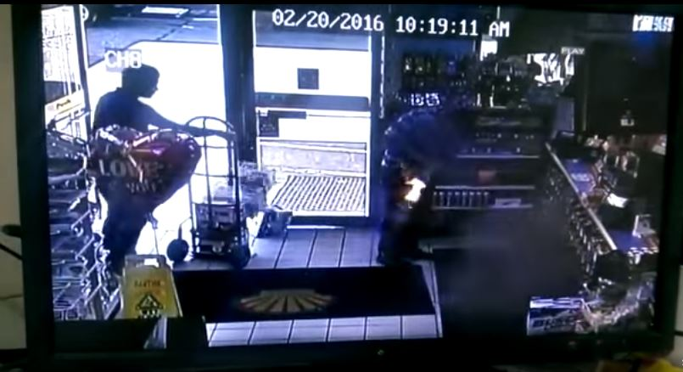
Lithium Ion Fire Hazard
Kentucky Convenience Store Pocket Explosion
KIRO 7 Seattle -- Brooks Stroman interview
Notes:
The devices also pose a fire hazard. The first video provide a great explanation of how the devices containing lithium ion batteries can explode when they come in contact with other metals. This maybe due to packing large amount of power into a small space. In addition, poor design, low quality materials, manufacturing flaws, improper use or handling can all contribute to the internal battery temperature rising that the battery fires or explodes. These stories are both of devices exploding in pockets, but they have causes serious damage when exploding in people’s hands, faces, and cars.
Brooks Stroman: http://www.kiro7.com/news/local/kirkland-mans-vape-pen-battery-explodes/373773562
Kentucky Convenience Store: https://www.youtube.com/watch?v=k1LjSuq0rk8
NYC Grand Central: https://www.youtube.com/watch?v=OtSAIYALni0
https://www.youtube.com/watch?v=OtSAIYALni0

Slide 17
Lithium Ion Fire Hazard
How does the internal battery temperature rise that the battery fires or explodes?
Come in contact with other metals
Maybe due to packing large amount of power into a small space
Poor design
Low quality materials
Manufacturing flaws
Improper use or handling
Notes:
The devices also pose a fire hazard. The first video provide a great explanation of how the devices containing lithium ion batteries can explode when they come in contact with other metals. This maybe due to packing large amount of power into a small space. In addition, poor design, low quality materials, manufacturing flaws, improper use or handling can all contribute to the internal battery temperature rising that the battery fires or explodes. These stories are both of devices exploding in pockets, but they have causes serious damage when exploding in people’s hands, faces, and cars.
Brooks Stroman: http://www.kiro7.com/news/local/kirkland-mans-vape-pen-battery-explodes/373773562
Kentucky Convenience Store: https://www.youtube.com/watch?v=k1LjSuq0rk8
NYC Grand Central: https://www.youtube.com/watch?v=OtSAIYALni0
https://www.youtube.com/watch?v=OtSAIYALni0

Slide 18
Vaping Culture
Notes:
https://www.youtube.com/watch?v=DRUxA8U51xc

Slide 19
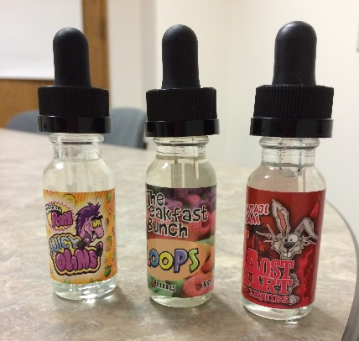
E-Juices
Liquids or “Juices” typically have “4” ingredients:
Liquid nicotine
Propylene glycol
Vegetable glycerin
Flavoring
What flavors do you guys have?
Notes:
The liquid that is vaped generally contains 4 ingredients, and is called “juice”, “e-juice”, or “e-liquid”.
-Nicotine: This essential oil is extracted from a plant source (most likely tobacco). It’s an stimulant drug that gives one a buzz or focus similar to caffeine, but it is way more addictive. One use of nicotine is as a pesticide because it acts on the central nervous system. When exposed to too much, it’s a central nervous system depressant meaning one gets really sleepy, breathing and heat rate slow, and some kids who’ve been exposed to high amounts are very lethargic and cannot be aroused. They become almost like limp rag dolls. Some case reports suggest that as little as a mouth full (~1 teaspoon) is enough of an e-liquid to be lethal to a child. One of the other things to consider with liquid nicotine is that it’s an oil, which means it’s good at entering the body through the skin. This is especially true in kids—there nice soft skin is actually much more porous than adults. A child can experience serious medical issues just by touching it.
Propylene glycol and vegetable glycerins are added to help disperse the vaporized nicotine into droplets that are easily inhaled and the keep it all well mixed together as a miscible, shelf stable liquid.
-Flavor: What flavors do you guys have? everything from grape to gummy bear to lemon drop martini and even chocolate. Cross-encouragement of other addictive behaviors. My co-workers went and actually vaped some of the “zero nicotine” flavors in their field research and say that it tastes exactly as it smells. Can you all smell them?

Slide 20
E-Juices
Come in a variety concentrations (amount/volume)
Can you figure out the concentration? Try to find:
Nicotine amount or amount per volume
Total volume
What else do you notice about the labeling and packaging?
Notes:
Go over how to read a label and interpret the amount of nicotine
Prompt audience to try to determine the amount of nicotine and total volume of liquid to come up with a concentration. Some bottles are marked and some are not. Here are the key concepts to highlight if not done so through discussion
--generally in nicotine concentration comes increments of 6: 0mg, 6mg, 12 mg, 18mg, etc
--bottles will generally just say XXmg nicotine without giving that in a volume unit; they really mean XXmg nicotine IN EVERY 1 MILLILITER OF LIQUID
--Bottles contain 15ml of liquid, so the total amount of nicotine in each bottle is generally much higher than the simple number listed on the label
Prompt: What are some of the other things about the labels that could also be of concern? Possible answers: cartoony nature, lack of warning labels, child resistance, smell, tiny print, etc; overall similarity in shape and style to candy
*Some may notice there seems to be a high-end and low-end product; typically there are “house juices” on the cheaper side. These are liquids that were diluted and flavored in the store made from concentrated liquid nicotine bought in large volumes. As opposed to those made and bottled by a specific producer or brand off site.

Slide 21
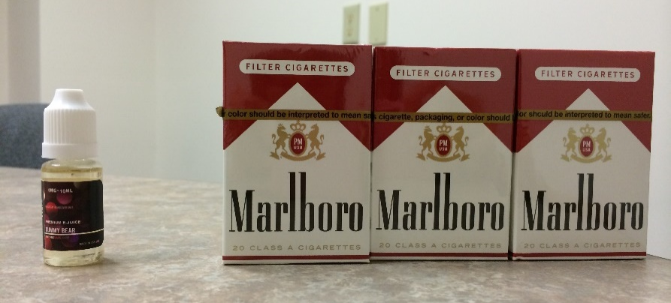
Innocent packaging, dangerous contents
Combustible Cigarettes | Low-dose E-cigarettes | High-dose E-cigarettes
12 mg nicotine/cig | 6 mg/mL | 36 mg/mL
20 cigarettes/pack | 15 mL/bottle | 15 mL/bottle
240 mg nicotine/pack | 90 mg nicotine/bottle | 540 mg nicotine/bottle
$9.75
$9-15
Notes:
Start by describing the nicotine levels in a typical pack of cigarettes, then talk through the math comparing a low- and high-concentration e-liquid alternative. For reference, users say that to achieve the same feel as a cigarette, initially one will have to use a liquid with a concentration of 18-24mg/ml
Combustible cigarettes are anywhere between 8-20mg Nictoine per cigarette. When we do the math comparing a low-dose to a high-dose nictotine concentration, we can see that it is possible to purchase liquids where one bottle is the equivalent to nearly 2.5 boxes of cigarettes. So aside from the massive notice dose, what are some of the problems you see with this?
One issue is price: in WA, cigarettes are taxed at about 97% of their value, meaning half of what you pay is the price of the cigarette and the other is a tax to provide a barrier to entry. A box of cigarettes costs between $8-10 in Washington. How much do you think a bottle of juice costs? As low as $9! Some of the higher concentration of nicotine liquids are more expensive, but we’re look at maybe $15. When we compare the cost with the nicotine amount, that means it’s cheaper. In the high dose case we’re getting 2.5 box of cigarettes for the price of 1.5.
Another thing to consider is time: initial studies on timing show that a single 3ml refillable cartridge could takes on average, 5 hours to vape. This means that in every 15ml bottle, there is somewhere around 25 hours worth of vaping time. This means one is actually spending more time breathing in the heated vapors, which have their own deleterious effects on constricting the airflow in our lungs.

Slide 22
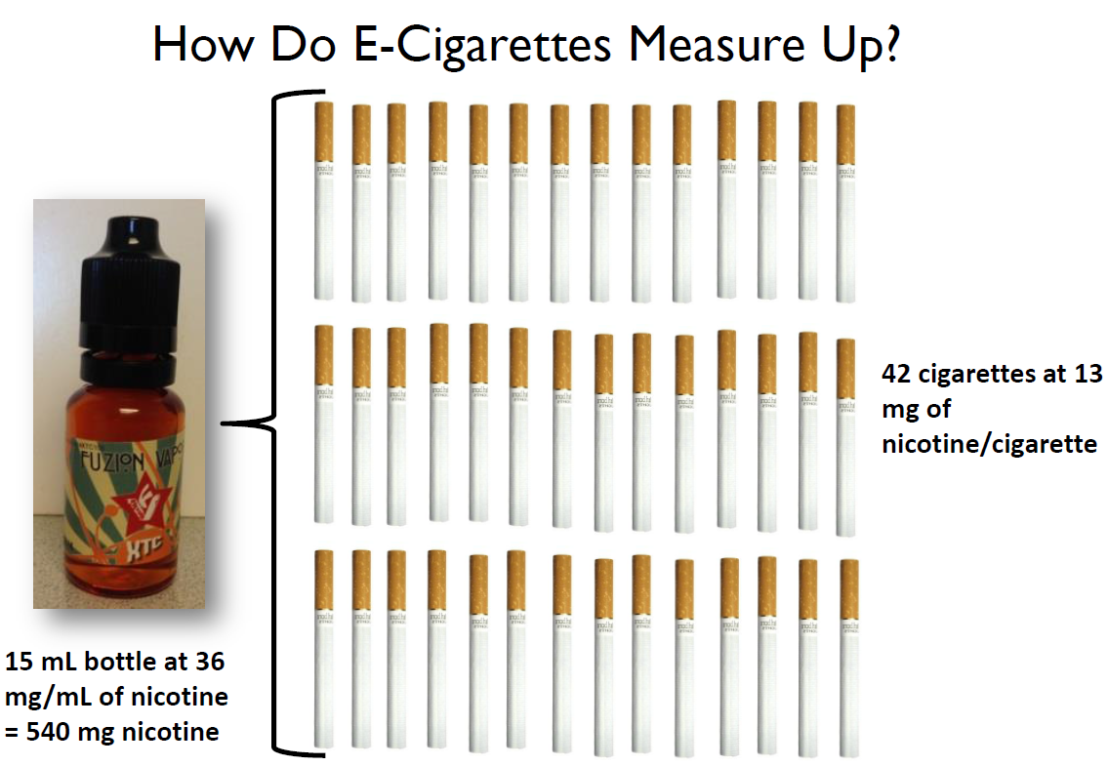
Notes:
This is just another example for you to see: that high dose liquid (36mg nicotine/ml) is equivalent to smoking 42 cigarettes. Also note the flavor of this liquid “XTC” or Ecstasy—a good example of the cross-promotion of unhealthy behaviors

Slide 23
Marketing Targeted Towards Youth
Notes:
Pilot: https://www.youtube.com/watch?v=5UjjqLAP8sQ
Vuse: https://www.youtube.com/watch?v=JSiU3MbhLdw
Prompt: What do you remember about tobacco ads before they were banned? What strategies were used? Who was targeted? Allow discussion.
Currently there are no regulations on Ecig ads, especially where youth are concerned, where the master settlement of 1998 prohibited marketing especially appealing to youth. We’re going to watch a few e-cig ads. Take notes or jot down words, images, reactions. We will watch all of these in succession and then have a discussion.
What did you notice? Who is the focus/target? What did the people look like? What “norms” were promoted? What ideas were being sold? Was is it creative/sneaky or pretty shameless?
Notes:
Vapor Couture ad is just so blatant
Venus Vapor: similarity to Marlboro man!
Vuse: “tobacco experts” Who is this? RJ Reynolds! RJ Reynolds has been fined to doing things like giving out free cigarettes at youth events and knowingly and willingly violating the Master Settlement Act that banned marketing towards youth ☺
Green Smoke: guy that says “never done this, but it’s something I could get in to”
For those who have the desire to talk about how to talk about these issues with youth, this is one such entry point. Tobacco companies market towards youth and even have referred to them as “replacement smokers”. They know they need youth to stay in business and are overt about appealing to them. How does it make you feel to know that they just want you for profit? To know that they are trying to take advantage of you?

Slide 24
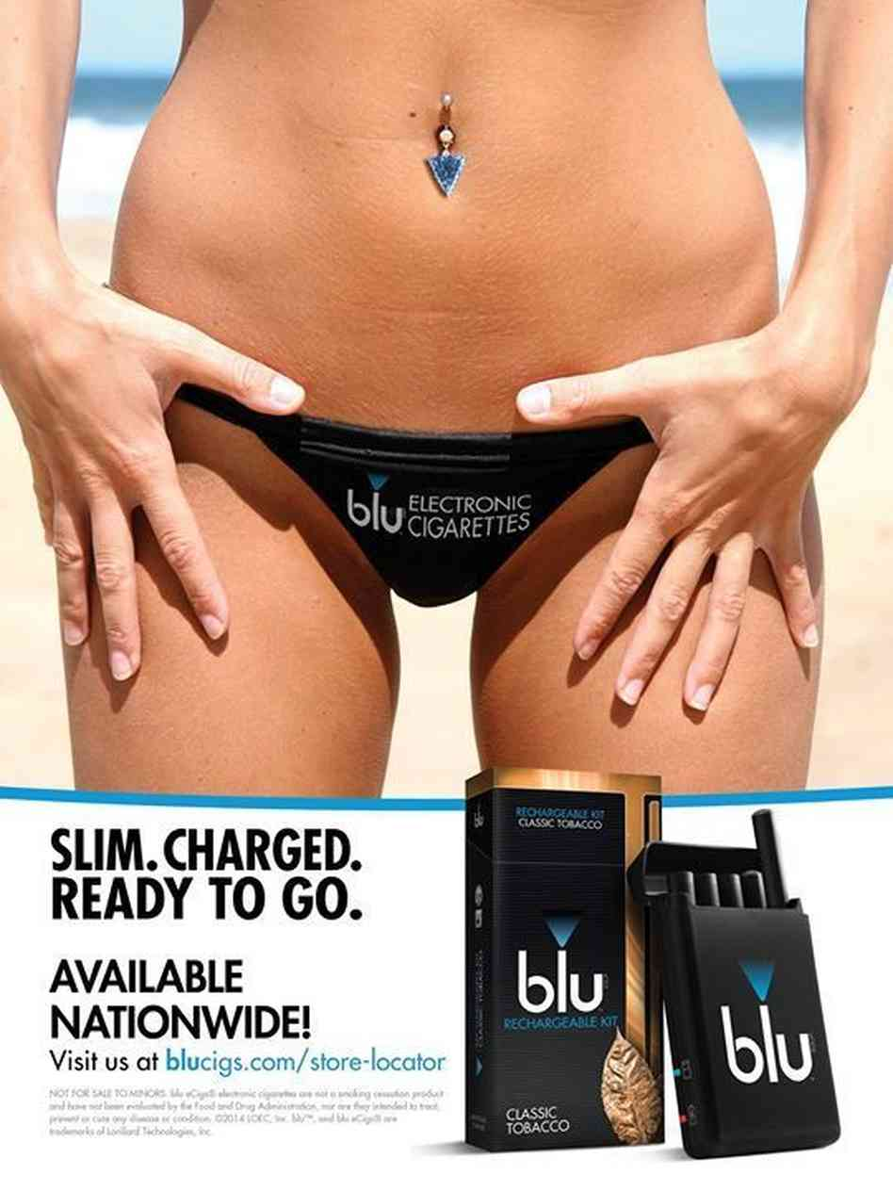
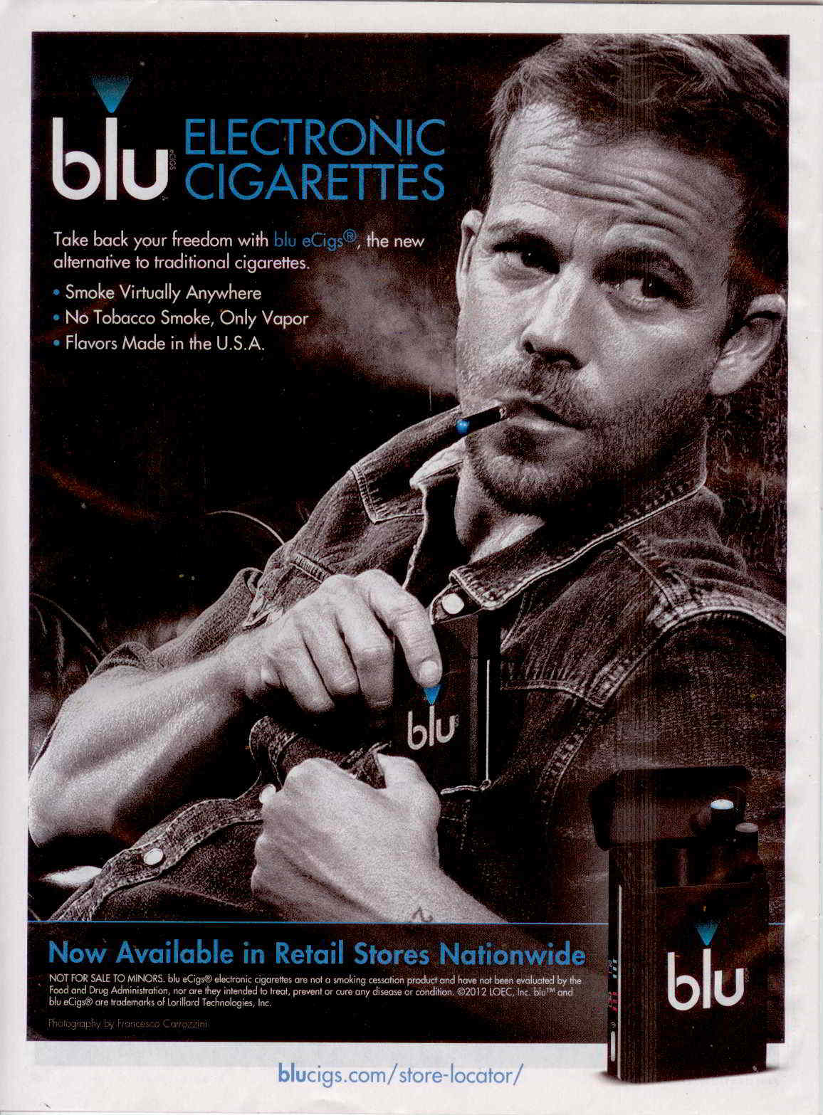
Marketing: blu
Notes:
Prompt: What do you remember about tobacco ads before they were banned? What strategies were used? Who was targeted? Allow discussion.
Currently there are no regulations on Ecig ads, especially where youth are concerned, where the master settlement of 1998 prohibited marketing especially appealing to youth. We’re going to watch a few e-cig ads. Take notes or jot down words, images, reactions. We will watch all of these in succession and then have a discussion.
What did you notice? Who is the focus/target? What did the people look like? What “norms” were promoted? What ideas were being sold? Was is it creative/sneaky or pretty shameless?
Notes:
Vapor Couture ad is just so blatant
Venus Vapor: similarity to Marlboro man!
Vuse: “tobacco experts” Who is this? RJ Reynolds! RJ Reynolds has been fined to doing things like giving out free cigarettes at youth events and knowingly and willingly violating the Master Settlement Act that banned marketing towards youth ☺
Green Smoke: guy that says “never done this, but it’s something I could get in to”
For those who have the desire to talk about how to talk about these issues with youth, this is one such entry point. Tobacco companies market towards youth and even have referred to them as “replacement smokers”. They know they need youth to stay in business and are overt about appealing to them. How does it make you feel to know that they just want you for profit? To know that they are trying to take advantage of you?

Slide 25
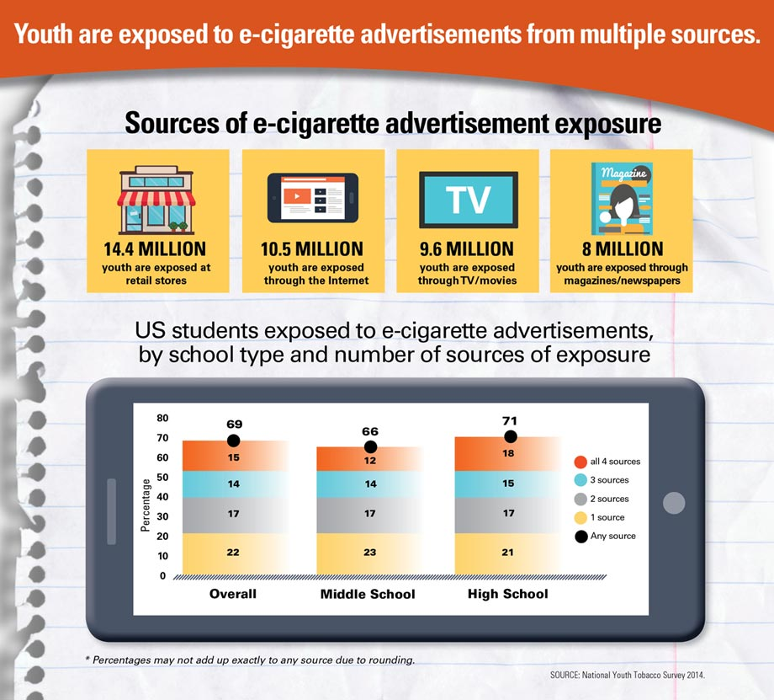
“In 2014, nearly seven in 10 (18.3 million) U.S. middle school and high school students reported exposures to e-cigarette advertisement from at least one source”¹
--CDC’s Vital Signs: Exposure to Electronic Cigarette Advertising Among Middle School and High School Students – United States, 2014
1. Vital Signs: Exposure to Electronic Cigarette Advertising Among Middle School and High School Students – United States, 2014. Morbidity and Mortality Weekly Report. January 8, 2015. 64(52);1403-8.

Slide 26
What are we seeing in Washington State?

Slide 27
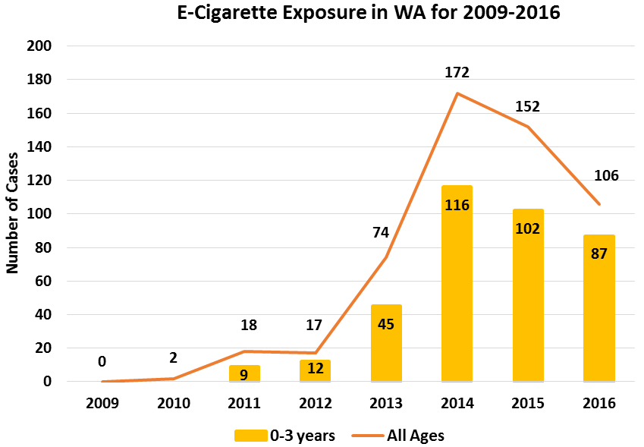
Washington Poison Center Experience
Children ages 0-3 years are still disproportionately affected and account for about 82% (n=87) of the total cases
Notes:
E-cigarette devices, as far as we know, were developed by a pharmacist in China around 2004. There are also thoughts they the technology was devised by the tobacco industry many, many years ago. Regardless, they hit the market in the US around 2010.
This is specific data from the Washington Poison Center. Washington Poison Center receives about 55,000 exposure related phone calls each year, in light of that, this green line that shows the total number of calls related to e-cigarette or liquid nicotine products over the last few years really doesn’t seem like much. But the most striking thing is the jump from 76 in 2013 to 182 in 2014! The orange bar underneath show the number of those cases that occurred in children 19 and under. So as you can see, this is definitely a growing issue.
So far in 2016, the number are down – 79 to date as of late September. But still 80% of those are in kids, and a lot of them

Slide 28
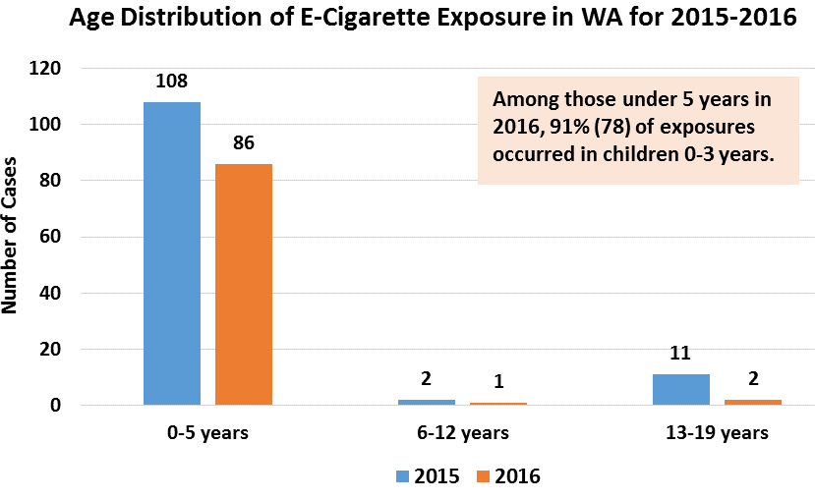
Washington Poison Center Experience
Notes:
The chart on the left shows the breakdown of these calls by WA county. These are not incidence (standardized by population size) so you can see that more calls are coming from the more densely populated areas. It’s also interesting to see Pierce Co. at the top of the list—they have a good number of stores and produces in their county as well as high rates of other tobacco use
The chart on the right shows the breakdown of the cases in children by a specific age group. Not surprisingly, the 1-3 year olds, the ones who are curious, touch and taste everything, are the most common. But the “Teens” are the next highest. It’s not reflected in this data, but this past spring, spring 2015, the poison center was consulted on a cluster of cases from Spokane where a school administrator had discovered that students were selling drops of the liquid nicotine and putting it in each other’s sodas/drinks.

Slide 29
As of August 30, 2017…. The Washington Poison Center has received 55 cases of E-Cigarette Nicotine Exposures

Slide 30
What does research say about the controversial points?
Notes:
Now we’re going to do a bit of a point, counter-point exercise. We’re going to look at 4 specific “pro-vape” arguments and see what new research and information we have to address those issues. For the most part, this is data that comes from 2015. There is a LOT of data rolling out about these issues—things are literally coming out on a weekly basis.

Slide 31
Pro-Vape Point #1
E-Cigarettes are less harmful and safe than combustible cigarettes.
Notes:
This is the number one argument—using e-cigarettes is less harmful than cigarettes. And that lacking all other evidence, this is enough to say they are safe for widespread use. What do say to that? I’m always a fan of the argumentative approach where you give a concession right away. And so I would say cigarettes contain over 7000 chemicals, so vaping probably isn’t as harmful as smoking just based on that sheer numbers game. BUT we do have some evidence to show that it is completely safe. Safer does not mean safe. In other words, cigarettes are one of the absolute worst things for us. We know this. We have done lots of work and major lawsuits have taken place to show us this. By saying they are safer, we may not be saying much—it doesn’t take a lot to be safer than cigarettes.
Yes, this doesn’t sit well with some people in that we don’t go far enough to totally nix e-cigs; but the reality is for youth, they want the truth. And this is it.

Slide 32
Pro-Vape Point #1
E-Cigarettes are less harmful and safe than combustible cigarettes.
Raise your hand if you have you heard of this pro-vape point before?
Notes:
This is the number one argument—using e-cigarettes is less harmful than cigarettes. And that lacking all other evidence, this is enough to say they are safe for widespread use. What do say to that? I’m always a fan of the argumentative approach where you give a concession right away. And so I would say cigarettes contain over 7000 chemicals, so vaping probably isn’t as harmful as smoking just based on that sheer numbers game. BUT we do have some evidence to show that it is completely safe. Safer does not mean safe. In other words, cigarettes are one of the absolute worst things for us. We know this. We have done lots of work and major lawsuits have taken place to show us this. By saying they are safer, we may not be saying much—it doesn’t take a lot to be safer than cigarettes.
Yes, this doesn’t sit well with some people in that we don’t go far enough to totally nix e-cigs; but the reality is for youth, they want the truth. And this is it.

Slide 33
Pro-Vape Point #1: Less Harmful and Safe
Response:
Yes--Cigarette smoke contains > 7,000 chemicals, so vaping is probably not as harmful as smoking
But– The information we have shows that safer ≠ safe
safer ≠ safe
Notes:
This is the number one argument—using e-cigarettes is less harmful than cigarettes. And that lacking all other evidence, this is enough to say they are safe for widespread use. What do say to that? I’m always a fan of the argumentative approach where you give a concession right away. And so I would say cigarettes contain over 7000 chemicals, so vaping probably isn’t as harmful as smoking just based on that sheer numbers game. BUT we do have some evidence to show that it is completely safe. Safer does not mean safe. In other words, cigarettes are one of the absolute worst things for us. We know this. We have done lots of work and major lawsuits have taken place to show us this. By saying they are safer, we may not be saying much—it doesn’t take a lot to be safer than cigarettes.
Yes, this doesn’t sit well with some people in that we don’t go far enough to totally nix e-cigs; but the reality is for youth, they want the truth. And this is it.

Slide 34
Pro-Vape Point #1: Less Harmful and Safe
Why can’t we say safe?
Vape aerosols have been found to contain the following:
Formaldehyde releasing chemicals¹ (at high voltage)→ Cancer
Free Radicals² → Causes cellular damage → Cancer
Diacetyl³ → Bronchitis Obliterans or “Popcorn lung” (form of irreversible lung damage)
And more!!
X
There has not been sufficient time to show a direct link to long-term health consequences
E-Cigs
Specific Chemicals
Specific Injury
Jensen, R. Paul, et al. "Hidden formaldehyde in e-cigarette aerosols." New England Journal of Medicine 372.4 (2015): 392-394.
Goel, Reema, et al. "Highly Reactive Free Radicals in Electronic Cigarette Aerosols." Chemical Research in Toxicology 28.9 (2015): 1675-1677.
Allen, Joseph G., et al. "Flavoring Chemicals in E-Cigarettes: Diacetyl, 2, 3-Pentanedione, and Acetoin in a Sample of 51 Products, Including Fruit-, Candy-, and Cocktail-Flavored E-Cigarettes." Environ Health Perspect(2015).
Notes:
So what sort of literature or research can we draw upon for this? Several things:
First: the flavoring agents and the propylene glycols used in the liquids, have not been sufficiently tested for their safety when inhaled. We have some data on what happens to the body when these substances are eaten and ingested, but not when we breathe them in.
Second there are now more and more papers, some of them as recent as early December 2015, that illucidate an intermediate link between e-cigs and long term injury by showing that e-cig vapors contain chemicals we know are associated with specific injuries in another setting. So for example, vapors have been found to contain formaldehyde releasing chemicals which have been proven carcinogens, free radicals which are a specific oxygen atom that cases cellular damage that leads to cancer, and most recently a chemical diacetyl that leads to bronchitis obliterans, or “popcorn lung”, a form of irreversible lung damage.
Right now there hasn’t been enough time for studies to establish a direct-link between e-cigarettes and any long-term health outcomes (positive or negative) that is to say, no one can say what e-cigarettes do to the body after years of use because they haven’t been on the market that long. Think about the diagram: We know that e-cigs lead to exposures of a specific chemical. And we know that in other settings these specific chemicals have led to irreversible injury, even death. What we can’t show right now is that e-cigs will lead to the same things, but we can make some assumptions using this pathway.
One note--the Formaldehyde study: these chemicals are released ONLY when the devices are used a very high voltage. Opponents state that nobody vapes at this temperature because it will taste bad (a state known as “dry vaping”); we will discuss later where this might be relevant

Slide 35
Pro-Vape Point #1: Less Harmful and Safe
Why can’t we say safe? (cont’d)
Flavoring agents and propylene glycol not tested for safety via inhalation
There was a liquid that had more than 141 flavor chemicals have been identified¹
One study found that “Strawberry” vape aerosols caused as much acute damage to lung cells as cigarette smoke²
Cause acute clinical effects on respiratory cells INDEPENDENT of nicotine exposure^{3,4,5,6}
Inflammation & Decreased Cell Viability
Hutzler et al. “Chemical hazards present in liquids and vapors of electronic cigarettes.” Arch Toxicol 2014;88:1295-308
Leigh NJ et al. “Flavourings significantly affect inhalation toxicity of aerosol generated from electronic nicotine delivery systems (ENDS). Tob Control. 2016;0:1-7
Wu Q et al. “Electronic Cigarette Liquid Increases Inflammation and Virus Infection in Primary Human Airway Epithelial Cells. Plos One. 2014; e108342
Scheffler S et al. “Evaluation of E-Cigarette liquid vapor and mainstream cigarette smoke after direct exposure of primary human bronchial epithelial cells.” Int J Eviron Res Public Health. 2015; 12:3915-25.
Yu V et al. “Electronic Cigarettes include DNA strand breaks and cell death independently of nicotine in cells lines.” Oral Oncol. 2016;52:58-65
Cervellati F et al. “Comparative effects between electronic and cigarette smoke in human keratinocytes and epithelial lung cells.” Toxicol in Vitro. 2014;28:999-1005
Leigh NJ et al. “Flavourings significantly affect inhalation toxicity of aerosol generated from electronic nicotine delivery systems (ENDS). Tob Control. 2016;0:1-7
Notes:
So what sort of literature or research can we draw upon for this? Several things:
First: the flavoring agents and the propylene glycols used in the liquids, have not been sufficiently tested for their safety when inhaled. We have some data on what happens to the body when these substances are eaten and ingested, but not when we breathe them in.
Second there are now more and more papers, some of them as recent as early December 2015, that illucidate an intermediate link between e-cigs and long term injury by showing that e-cig vapors contain chemicals we know are associated with specific injuries in another setting. So for example, vapors have been found to contain formaldehyde releasing chemicals which have been proven carcinogens, free radicals which are a specific oxygen atom that cases cellular damage that leads to cancer, and most recently a chemical diacetyl that leads to bronchitis obliterans, or “popcorn lung”, a form of irreversible lung damage.
Right now there hasn’t been enough time for studies to establish a direct-link between e-cigarettes and any long-term health outcomes (positive or negative) that is to say, no one can say what e-cigarettes do to the body after years of use because they haven’t been on the market that long. Think about the diagram: We know that e-cigs lead to exposures of a specific chemical. And we know that in other settings these specific chemicals have led to irreversible injury, even death. What we can’t show right now is that e-cigs will lead to the same things, but we can make some assumptions using this pathway.
One note--the Formaldehyde study: these chemicals are released ONLY when the devices are used a very high voltage. Opponents state that nobody vapes at this temperature because it will taste bad (a state known as “dry vaping”); we will discuss later where this might be relevant

Slide 36
Pro-Vape Point #2
E-Cigarettes do not have secondhand harm
Notes:
This is the number one argument—using e-cigarettes is less harmful than cigarettes. And that lacking all other evidence, this is enough to say they are safe for widespread use. What do say to that? I’m always a fan of the argumentative approach where you give a concession right away. And so I would say cigarettes contain over 7000 chemicals, so vaping probably isn’t as harmful as smoking just based on that sheer numbers game. BUT we do have some evidence to show that it is completely safe. Safer does not mean safe. In other words, cigarettes are one of the absolute worst things for us. We know this. We have done lots of work and major lawsuits have taken place to show us this. By saying they are safer, we may not be saying much—it doesn’t take a lot to be safer than cigarettes.
Yes, this doesn’t sit well with some people in that we don’t go far enough to totally nix e-cigs; but the reality is for youth, they want the truth. And this is it.

Slide 37
Pro-Vape Point #2
E-Cigarettes do not have secondhand harm
Raise your hand if you have you heard of this pro-vape point before?
Notes:
This is the number one argument—using e-cigarettes is less harmful than cigarettes. And that lacking all other evidence, this is enough to say they are safe for widespread use. What do say to that? I’m always a fan of the argumentative approach where you give a concession right away. And so I would say cigarettes contain over 7000 chemicals, so vaping probably isn’t as harmful as smoking just based on that sheer numbers game. BUT we do have some evidence to show that it is completely safe. Safer does not mean safe. In other words, cigarettes are one of the absolute worst things for us. We know this. We have done lots of work and major lawsuits have taken place to show us this. By saying they are safer, we may not be saying much—it doesn’t take a lot to be safer than cigarettes.
Yes, this doesn’t sit well with some people in that we don’t go far enough to totally nix e-cigs; but the reality is for youth, they want the truth. And this is it.

Slide 38
Pro-Vape #2: No Secondhand Harm
Similar Response:
Yes—Secondhand “vape” is probably safer than secondhand smoke
But– We don’t know for sure. The data we do have shows it’s not just water vapor
safer ≠ safe
Notes:
A similar argument is that there is not second-hand harm from exposure to vapors as there is for second-hand smoke. We know that those who have been exposed to cigarette smoke second-hand suffer from the same injuries and deaths as smokers themselves. Think back to our schematic of a vape pen that said that you can enjoy the vapors without the harms from smoking, and as we just discussed this isn’t really true.
We’re in a similar situation when we think about the second-hand harms. Since cigarettes are so bad, it’s probably also true that second-hand vape exposure is not as bad as second-hand smoke exposure. We don’t know for sure, but we have some evidence that shows it’s more than just water vapor. Again, safer does not mean safe

Slide 39
Pro-Vape #2: No Secondhand Harm
Minimal but measurable levels in secondhand vapors:
Measurable levels (albeit minimal) of nicotine found in secondhand vapors¹
Formaldehyde, acetone, isoprene, and acetaldehyde were also measured¹
Until we have the time and studies to directly study this, we don’t know for sure
1. Schripp T, Markewitz D, Uhde E, Salthammer T. 2013 “Does e-cigarette consumption cause passive vaping?” Indoor Air 23(1):25-31.
Notes:
Specifically this study looked at what was in second hand vapors. And they found not only nicotine, but formaldehyde, acetone, and acetaladehyde; these are all things that also exist in cigarette smoke. Yes, they are present in much smaller amounts, but there are there and until we’ve had the time to see the long-terms effects, we can’t say that it’s in a “safe” amount

Slide 40
Pro-Vape Point #3
E-cigarettes can be used as a smoking cessation method. Why are you preventing something that helps people quit?
Notes:
This is the number one argument—using e-cigarettes is less harmful than cigarettes. And that lacking all other evidence, this is enough to say they are safe for widespread use. What do say to that? I’m always a fan of the argumentative approach where you give a concession right away. And so I would say cigarettes contain over 7000 chemicals, so vaping probably isn’t as harmful as smoking just based on that sheer numbers game. BUT we do have some evidence to show that it is completely safe. Safer does not mean safe. In other words, cigarettes are one of the absolute worst things for us. We know this. We have done lots of work and major lawsuits have taken place to show us this. By saying they are safer, we may not be saying much—it doesn’t take a lot to be safer than cigarettes.
Yes, this doesn’t sit well with some people in that we don’t go far enough to totally nix e-cigs; but the reality is for youth, they want the truth. And this is it.

Slide 41
Pro-Vape Point #3
E-cigarettes can be used as a smoking cessation method. Why are you preventing something that helps people quit?
Raise your hand if you have you heard of this pro-vape point before?
Notes:
This is the number one argument—using e-cigarettes is less harmful than cigarettes. And that lacking all other evidence, this is enough to say they are safe for widespread use. What do say to that? I’m always a fan of the argumentative approach where you give a concession right away. And so I would say cigarettes contain over 7000 chemicals, so vaping probably isn’t as harmful as smoking just based on that sheer numbers game. BUT we do have some evidence to show that it is completely safe. Safer does not mean safe. In other words, cigarettes are one of the absolute worst things for us. We know this. We have done lots of work and major lawsuits have taken place to show us this. By saying they are safer, we may not be saying much—it doesn’t take a lot to be safer than cigarettes.
Yes, this doesn’t sit well with some people in that we don’t go far enough to totally nix e-cigs; but the reality is for youth, they want the truth. And this is it.

Slide 42
Pro-Vape Point #3: Smoking Cessation
Yes — some people have quit combustible cigarettes with this device
But – it is not an FDA approved cessation device
Notes:
Vaping community touts vaping as a smoking cessation method. Anecdotal evidence suggests people have decreased or given up combustible cigarettes with help from e-cigarette devices. However, in order to be a ‘smoking cessation device’ you do have to go through a process and be approved by the FDA. E-cigarettes have not been approved.

Slide 43
Pro-Vape Point #3: Smoking Cessation
Not approved by the FDA as a legitimate smoking cessation method, though devices must now be FDA approved to be on the market
Questions as to whether the creation of an e-cigarette was intended as a smoking cessation product
Cessation versus redirection
Some adults do use the product to quit, but youth and young adults indicate predominantly social reasons for initiating use^{1,2}
*Note that in the UK, one e-cigarette company has recently been given a “medicine license” meaning they can be sold through a pharmacy as a smoking cessation device. (As of January, 2016).
Article on UK Medicine License: http://www.theguardian.com/society/2016/jan/04/british-american-tobacco-e-cigarette-wins-uk-medicine-licence
Coleman et al. “It’s not smoke. It’s not tar. It’s not 4000 chemicals. Case Closed: Exploring attitudes, beliefs, and perceived social norms of e-cigartte use among adult users”. Drug Alcohol Depend. 2016
Kong G et al. “Reasons for electronic cigarette experimentation and discontinuation among adolescents and young adults.” Nicontine Tob Res. 2014;17:847-854.
Notes:
Again, the FDA has not approved the device as smoking cessation. There are questions as to whether the original inventor really created and intended for the device to be for quitting smoking, and most of the time people are shifting from one from of nicotine to another, and really, one from of tobacco to another since tobacco is most likely the source of the liquid nicotine. Not to mention now there are stealth means of being “discrete”
Guardian article on medicine license for e-cigs in the UK: http://www.theguardian.com/society/2016/jan/04/british-american-tobacco-e-cigarette-wins-uk-medicine-licence

Slide 44
Harm reduction is great, but…
If those already addicted to nicotine can shift to something safer, GOOD!
If someone using combustible cigarettes can quit smoking all together using this product, GREAT!
But this isn’t the only thing going on…
Notes:
In certain settings, even as an unapproved smoking cessation device, the idea of a “healthier” alternative to communities that are heavily embroiled in tobacco use is appealing. These devices most likely can serve a purpose to reduce the harms caused by smoking in areas where asking someone to quit will not happen. So if people can switch to something else, good. If people can quit all together, great! But if this was the case, the only thing happening, we wouldn’t be here! I’m not so sure there are too many groups out there having 2.5 hour long trainings on nicotine gum…
So what else is going on?

Slide 45
“Gateway” to Tobacco
E-cigs as an entry into traditional tobacco use
E-cigarette using youth have higher “willingness” to smoke cigarettes¹
E-cigarette users almost 3X as likely to initiate cigarette smoking a year later (9th graders in LA)²
E-cigarette users almost 8X as likely to initiate cigarette smoking a year later (young adults in CT)³
32% of current adult users of nicotine vapor products are not former smokers or had previously quit smoking⁴
1 year longitudinal study among national sample of 12th graders⁵
Youth who never smoked a cigarette, baseline, recent vapers were >4X more likely to report past-year cigarette smoking at follow-up
Youth who smoked in the past but not recent smokers, recent vapers were 2X more likely to report smoking in the past year
Wills, Thomas A., et al. "E-cigarette use and willingness to smoke: a sample of adolescent non-smokers." Tobacco control (2015): tobaccocontrol-2015.
Leventhal, Adam M., et al. "Association of electronic cigarette use with initiation of combustible tobacco product smoking in early adolescence." Jama314.7 (2015): 700-707.
Primack, Brian A., et al. "Progression to traditional cigarette smoking after electronic cigarette use among US adolescents and young adults." JAMA pediatrics 169.11 (2015): 1018-1023.
McMillen, R.C. et al. 2014. “Trends in Electronic Cigarette Use Among U.S. Adults: Use is Increasing in Both Smokers and Nonsmokers” Nicotine Tobacco Research
Miech, R. et al. (2017) “E-cigarette use as a predictor of cigarette smoking: results from a 1-year followup of a national sample of 12 grade students” Tobacco Control
Notes:
There is now evidence that the answer is “yes”, that e-cigarettes are a gateway to initiation of other tobacco products, specifically in youth. There are a couple ways of estimating this.
One is by assessing one’s willingness to smoke—being less like to give a definite no to questions about the likelihood one would smoke in the future or smoke if friend or influences smoked. Many years of work has gone into studies that show that this holds true for cigarettes, those with initial higher willingness scores are more likely to initiate smoking when followed over time. New research shows that youth who use e-cigarettes have higher willingness scores to use other forms of tobacco.
Two newer studies have actually followed e-cig and non e-cig using high schoolers for a year. In one study, those using e-cigs were 3x more likely than their non e-cig using peers to have started using some other form of tobacco over the course of that year and in the other study they were 8x more likely to initiate tobacco use.
NOTES:
The Leventhal study took place in Los Angeles, CA with 9th graders from many backgrounds. Their analysis controls for the various other influencing factors on tobacco use (parental use, socio-economic status, etc).
The Primack study took place in Connecticut and the initial group of students were those who were identified as not having any outside risk-factors for smoking initiation. This group also had a VERY small sample size of e-cig users at the start, so the results (8x more likely) may not be very robust. It is not overly generalizable given the population they started with, especially to low-income communities.

Slide 46
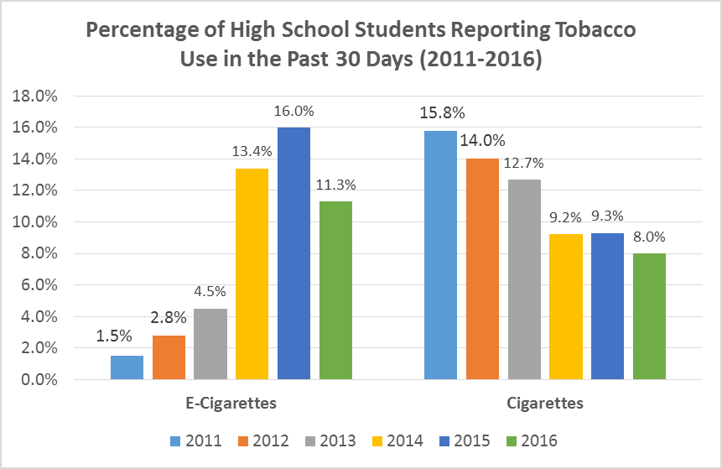
High School Students in past 30 days
Tobacco Use Among Middle and High School Students – United States, 2011 – 2014. Morbidity and Mortality Weekly Report 64(14):381-385.
Tobacco Use Among Middle and High School Students – United States, 2011 – 2015. Morbidity and Mortality Weekly Report 65(14):361-367.
Tobacco Use Among Middle and High School Students – United States, 2011 – 2016. Morbidity and Mortality Weekly Report 66(23):597-603.
Notes:
We have an increasing trend of people using these products, specifically use. Read the quote. You can see from the graph, on the left is the increase in use of e-cigs while on the left is the decrease in smoking. And everyone’s big question is: are the two linked? Will the increase in e-cigs lead to an increase in the use of other tobacco products, something many people have worked so hard to reduce.

Slide 47
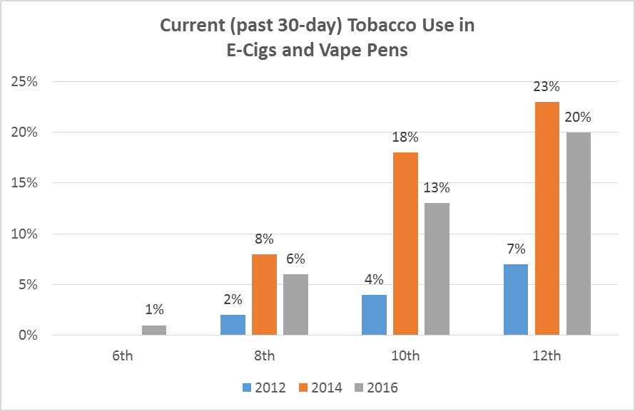
Youth Trend (Washington HYS)
Notes:
Is this happening here? We don’t know. But this is data from the 2014 Washington Healthy Youth Survey, that for the first time in 2014 asked students about their use of e-cigarettes. The graph shows the answer for 10th graders—a somewhat ominous 18% had used a device in the last 30 days. And for each grade level (except 6th grade), the incidence of vaping was higher than the incidence of smoking traditional cigarettes. It will be interesting to see over the next few years if cigarette use increases as we would expect it to in light of this gateway research.

Slide 48
How do you talk to youth about safe vs. safer
1. Teen Vaping and Prevention Messaging: Project Finding and Report. Public Health Seattle King County. 30 June 2016.
Notes:
For a copy of King County’s report, please contact Lindsey Greto with Public Health Seattle King County at Lindsey.Greto@kingcounty.gov or 206-263-7886

Slide 49
PHSKC Teen Vaping and Prevention Messaging Report¹
Nuanced conversation: youth want to know facts but also “romanticize” some things
“Vaping” is the preferred term. “E-Cigarette” refers to the original, disposable type devices.
Focus on nicotine/tobacco – teens think of vaping as an alternative to smoking cigarettes. That’s the main way they see vaporizers used
Unlabeled chemicals in the vapors and potential negative health effects
Humor can help bridge gap, if used in a way that doesn’t undermine seriousness of message
Focus on candy flavoring and marketing to minors and disingenuous advertising
Don’t use vape clouds and candy right beside each other
Engage the youth and connect with them. Don’t tell but share the facts.
1. Teen Vaping and Prevention Messaging: Project Finding and Report. Public Health Seattle King County. 30 June 2016.
Notes:
For a copy of King County’s report, please contact Lindsey Greto with Public Health Seattle King County at Lindsey.Greto@kingcounty.gov or 206-263-7886

Slide 50
What doesn’t work as well?
1. Teen Vaping and Prevention Messaging: Project Finding and Report. Public Health Seattle King County. 30 June 2016.
Notes:
For a copy of King County’s report, please contact Lindsey Greto with Public Health Seattle King County at Lindsey.Greto@kingcounty.gov or 206-263-7886

Slide 51
Less Effective
Ads or social media focused on what to do instead of vaping:
“Don’t vape, just play sports”
Teens participate in a contest where they create and share content saying vaping is lame
“…Teens have their own individual reasons why they smoke or vape…”
Celebrities thank teens for pledging to not vape
“Pledging does nothing to help the cause…Life changes and people will go back to their words…”
Using the term “Big Tobacco”
Shaming vapers or saying it’s lame
Scare tactics
1. Teen Vaping and Prevention Messaging: Project Finding and Report. Public Health Seattle King County. 30 June 2016.
Notes:
For a copy of King County’s report, please contact Lindsey Greto with Public Health Seattle King County at Lindsey.Greto@kingcounty.gov or 206-263-7886

Slide 52
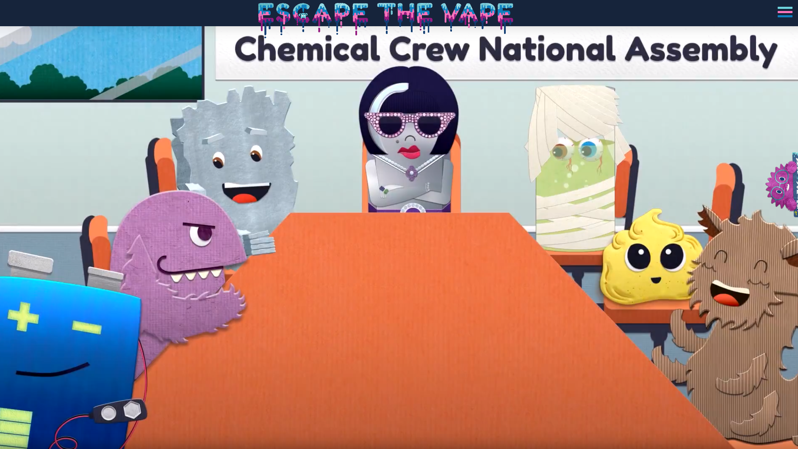
Escape the Vape
1. Teen Vaping and Prevention Messaging: Project Finding and Report. Public Health Seattle King County. 30 June 2016.
Notes:
For a copy of King County’s report, please contact Lindsey Greto with Public Health Seattle King County at Lindsey.Greto@kingcounty.gov or 206-263-7886
https://escapethevape.org/

Slide 53
Questions?

Slide 54
Let’s Role Play
In your partner or group of 3, role play one of these scenarios and have a conversation using some of the evidence just discussed:
Option 1: You are a teacher/healthcare provider having a conversation with a youth. This teen keeps saying that e-cigs aren’t cigarettes since you can get them without nicotine. That means they are safe, and they should be able to use them.
Option 2: You are a parent or educator discussing e-cigs with another parent. This parents says their friends have been able to quit smoking using the device and is wondering why e-cigarettes are such a big deal.
Notes:
One of you bring up the pro-vape points (e.g. it’s safer, less second-hand harm, smoking cessations, etc) while the other uses this research or data to redirect.

Slide 55
What about vaping other substances?
Notes:
With the advent of vaping devices, there has been a lot of talk about what else one can do with these devices. We’re going to spend a little time talking about vaping other substances, mostly marijuana.

Slide 56
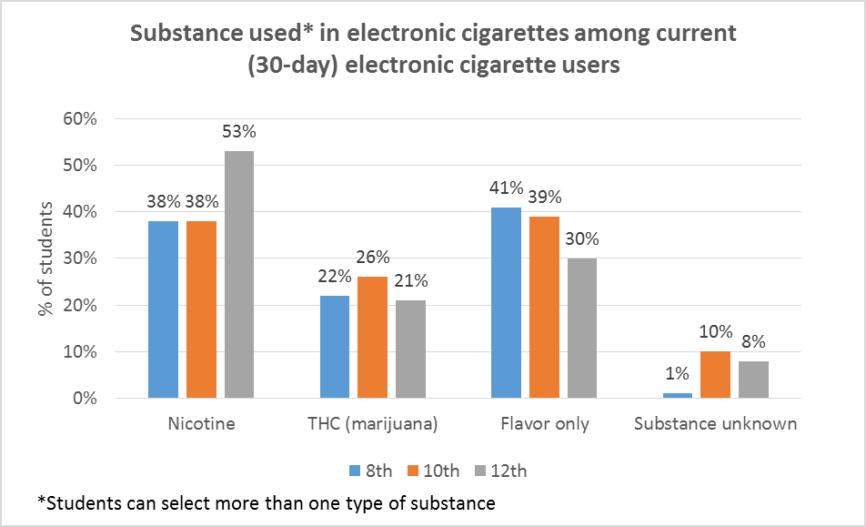

Slide 57
Why Vaporize Marijuana?
Get higher, faster
Limited odor
Discretion and “stealth vaping”
Perceived as healthier than smoking
REMEMBER WE HAVE TWO DEFINITIONS:
Vaping: process of heating and inhaling the essential oils from the plant--which means for cannabis vaping isn’t limited to liquids (Vaporizing)
Vaping: act of using a e-cig or vape pen device
Notes:
Why vape marijuana? Most of these perceived benefits are compared with smoking marijuana.
First of all, the form of marijuana that is vaped is very concentrated, so by vaping, one can get higher, faster. Vaping delivers a higher concentration of THC for each “hit”. Also, if this form that is vaped is processed correctly, there will not be the same skunky odor of smoking. There is also the advantage of discretion. Similar to many of the ways we indicated that using e-cigs can be discrete, the need to be discrete when using marijuana seems to be more pronounced – probably because of laws and culture. “Stealth vaping” is not just the idea that you can hide these small devices but that there seems to be a correlation between the amount of time one holds his or her breath after taking a hit, and the amount of visible vapors exhaled. So, if I can take a hit and hold my breath long enough, when I finally breathe out, there will be no visible exhale.
As with using e-cigs, vaping marijuana is also perceived to be “healthier” because one is avoiding inhaling the smoke and other particles released during a combustion reaction when say smoking a joint.
In this section I’m going to be using both definitions of “vaping” so just a reminder: we can talk about the process of heating and releasing essential oils from the plant (vaporizing) and also use vaping to refer to the act of using a “vaporizer”. A note here that the essential oils from marijuana are a little different than nicotine, so people have been found to vape more than just liquids.

Slide 58
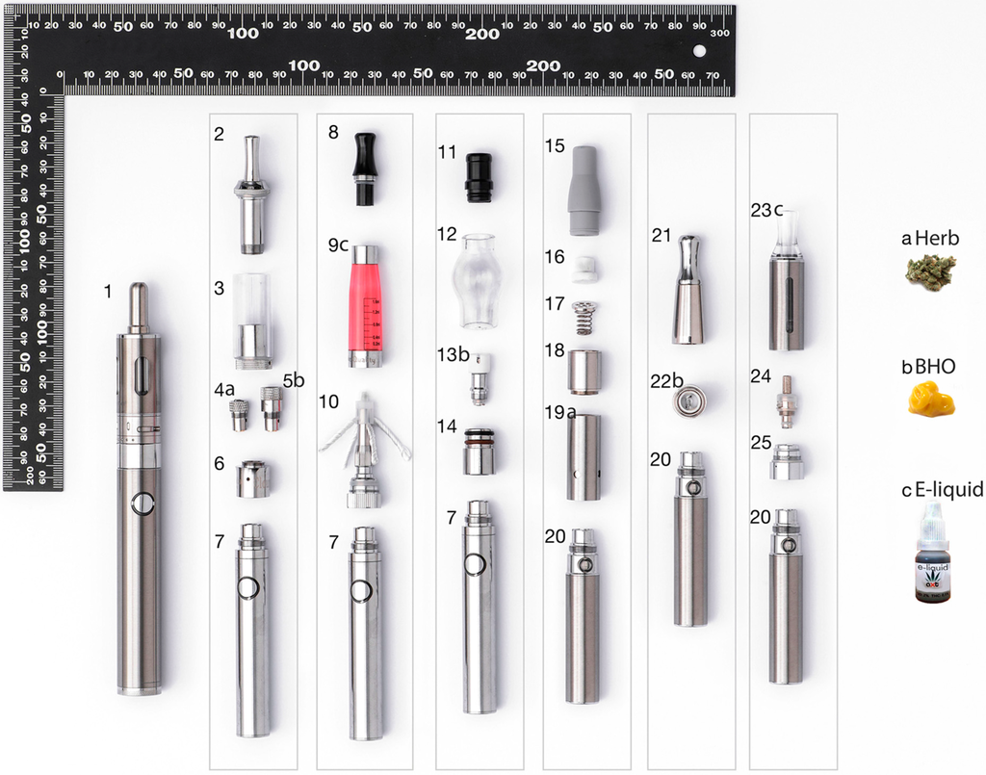
Because of an increase in technology vape pens can be adapted to vape:
Plant materials/herb
Waxes/Concentrates (“BHO”, “Shatter”)
“E-Liquids” (“CO2 Oil”)
Exchange of specific parts:
Heating elements and coils
Tank
liquid
liquid
wax
wax
wax
herb
herb
Adapted from Giroud et al. “E-Cigarettes: A review of New Trends in Cannabis Use” (2015)
Notes:
The majority of the information in this section comes from a paper by authors in Switzerland who did a lot of combing of the internet to see what the trends are in vaping marijuana. Included in that is this graphic, which shows the different adaptations now available to your standard re-chargeable mid-size vape pen to make it suitable for vaping three different kinds of marijuana: plant materials, waxes/concentrates, and e-liquids. Prompt: Look at the pens we have and the parts on this graphic. What is the same and different? Unscrew yours and look at the parts

Slide 59
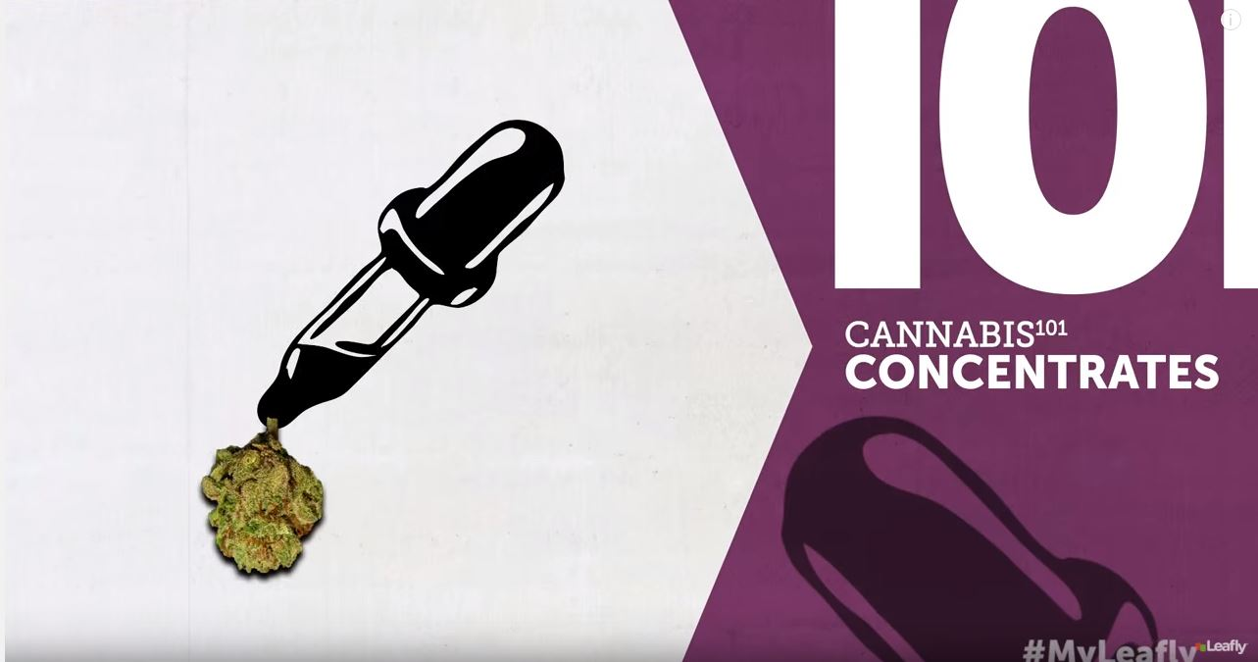
Marijuana
Video – Cannabis 101: Concentrates
Notes:
To get more acquainted with the “vapable” marijuana substances, we’re going to watch a video. This is a video by Leafly, an company that is the “yelp” of marijuana. They review stores but also put out a lot of promotional and informational content. While it is in the “pro-cannabis” camp, the content is still accurate. We’re going to watch this video. It is dense, especially if a lot of this is new, so we will debrief after watching it.
Watch whole video, and then us a flipchart or discuss what was talked about for each concentrate:
Kief: dry-sift/pollen; this is the pollen from the cannabis flowers, which is where the vast majority of the THC/CBD (psychoactive ingredients) is found; freezing the plant with dry ice makes it easier to remove this pollen
Hash: oldest forms of concentrate; compressed pollen (kief); high quality is called bubble-melt because it melts and disappears as vaporized
Hash Oil: the essential oils from the plant removed; most widely used way of removing the oil from the plant materials is to use the solvent butane, hence giving the name butane hash oil (BHO); sticky or oily at room temperature (think about butter or coconut oil); can also be brittle like candy; has names like honeycomb or shatter
CO2 Oil: removes the essential oils using a “super critical fluid extraction” (CO2); leaves an amber oil often used as an “e-liquid”; thought to be more safe than BHO
CBD Oil and RSO: specifically looking at removing the CBD cannabinoids, this is the cannabinoid thought of to have therapeutic properties instead of psychoactive ones; this becomes more tar-like; **note that you need to start with a more CDB rich strain
Tinctures: cannabis medicine; alcohol extraction to pull out CBD; add drops under the tongue.

Slide 60
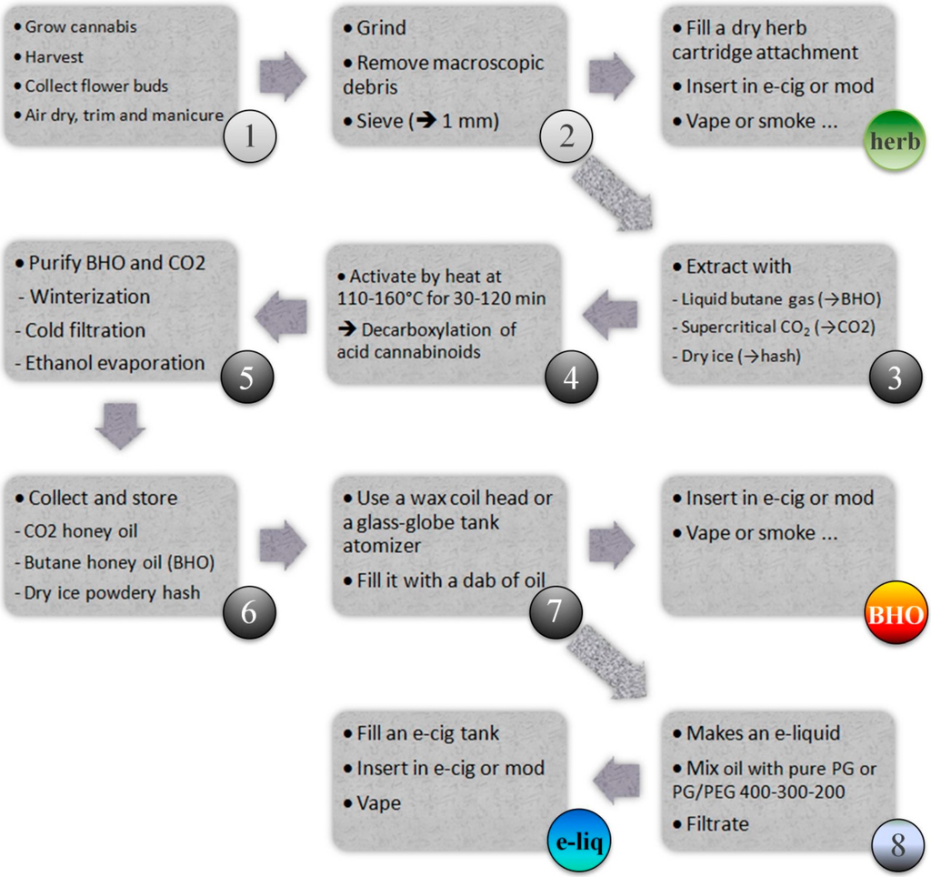
Extraction: An important step
Most concentrates are made through an extraction process
Use solvents like Butane or CO₂ to separate plant and oil
Home extracting is dangerous! The internet has lots of information….
*Note that this is also how liquid nicotine is prepared
Giroud et al. “E-Cigarettes: A review of New Trends in Cannabis Use” (2015)
Notes:
This is how we get from a grown plant to the “vaped” substances. It’s an involved process. This is just looking at the 30,000 foot level
Broadly speaking we have herb/plant materials that go through a multi-step process using heat , filtration, and other compounds (like butane or CO2) to remove the oil from the plant materials. This leaves us with a substance that is really just the active ingredients (psychoactive or medicinal). This is where things get dangerous, especially if using butane, but there are videos and information on the internet on doing it at home. Note that this is also how you would get the nicotine out of the tobacco plant too

Slide 61
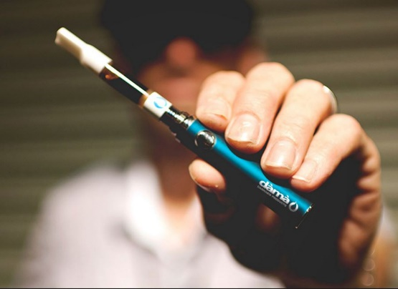
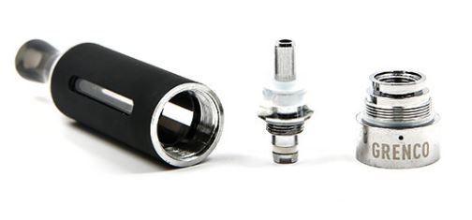
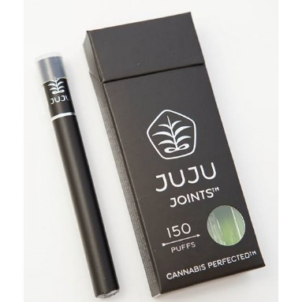
Vaping MJ in WA’s Retail Market
One-time use and refillable e-cig products
One-time use: JuJu Joints
Refillable: dama Cannabis
“Pen” = battery power + heating element
“Cartridge” of vape/oil screws on, repurchase this part
Refillable: Grenco G Pens
Purchase modifiers
$65-$100
$45
Notes:
This is why the CO2 oil extraction method is important. This process extracts a concentrate that can be mixed into a liquid, and this is much of what’s available on Washington’s retail market. It is often called “honey oil” or “flower oil”, and the devices used mirror the trends we talked about for e-cigarettes.
There are one-time use options, like the JuJu Joints where everything is ready to go for you in a cig-like look. Then there are refillable options where you have the pen part that contains the battery power and heating element, and then you can keep repurchasing cartirdges that screw into your power source. Note that this liquid is amber colored and that this flat style mouthpiece is often used for these devices.
Also like the graphic with all the pen parts showed, here are some specific tank and heating elements that one would switch onto a reuseable pen. Specifrcally this is from a brand called Grenco, who sells different parts for its G Pen to vape each of the marijuana substances we’ll talk about. The photo on the left is of the parts for e-liquids. You can buy this set-up on the internet for $20-$30.

Slide 62
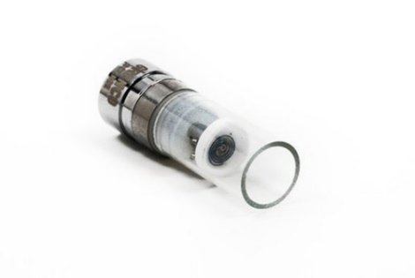
Vaping Herb or Plant Material
Heat finely ground, dried cannabis buds
Difficult because line between combustion and vaporization
Generally devices are more sophisticated to avoid combustion
More heat control
Ceramic inserts to avoid direct contact with heating element and evenly disperse heat
G Pro Vaporizer – Dry Herb
Dry Materials Tank
Notes:
Lastly, there is the vaporization of dried herb. This is where finely ground cannabis flower buds are ground down and inserted into a specific chamber on a device or pen. I don’t know about you, but the first think that I think about when I think of heating any sort of dried plant materials is fire. To avoid the ignition and combustion of the materials, these devices are more sophisticated. They need to heat hotter than the 190 degrees of vaping nicotine liquids, but also cannot get too hot as to start a fire. So in order to do that one usually has greater heat control and the heating elements have ceramic inserts to disperse heat. This is the same idea as many stove coils---the ceramic evenly distributes the heat which prevents one single spot from getting to hot and causing ignition.
Here we have two products: on the right is the specific tank and element we’d screw onto that same micro g pen unit. The left is a specific device from the same company meant exclusively for dry herb. It has control over temperature where the white on button changes color for the specific temperature setting.

Slide 63
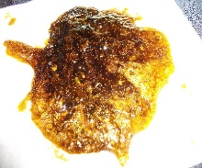
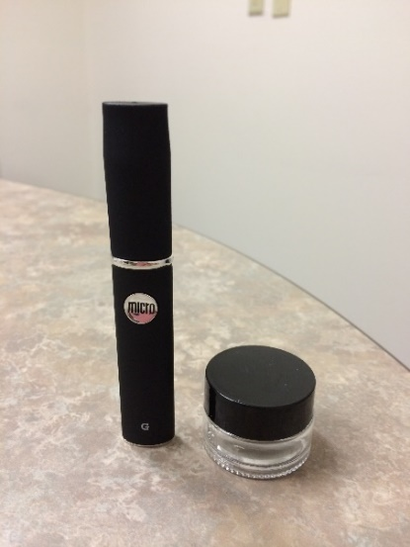
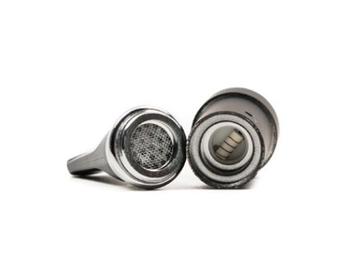
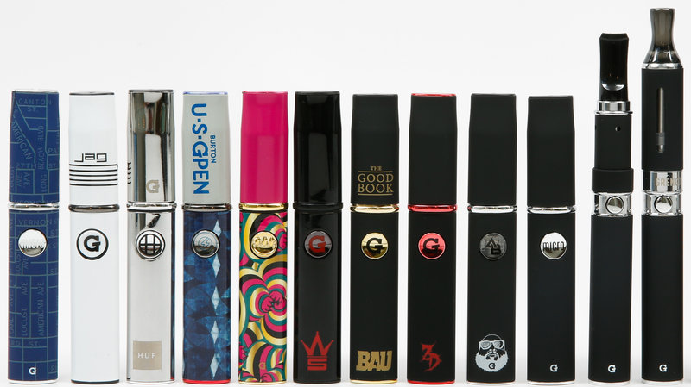
Marijuana “Waxes”
Butane Hash Oil (BHO) is a wax-like or pollen-like residue
Placed directly onto coil that is then turned on
Need temperatures to reach 350-450 ˚F to release cannabinoids
Homemade BHO
Wikimedia commons
G Pen Coil
http://www.npr.org/sections/health-shots/2014/04/18/302992602/pot-smoke-and-mirrors-vaporizer-pens-hide-marijuana-use
Micro G Pen & Container
Notes:
Next is vaping waxes, which I think is the most widespread and originally popular marijuana vaping technique. Grab your devices that look like this. Open them up and take them apart and tell me what you see? You should see metal coils. In this device you would place a small amount of BHO (wax, shatter, honeycomb) onto those coils. Then the device heats it to 350-450 degrees to vaporize the THC. This give you a good sense of how potent it is too—just look how small the chamber and coils are!
Accompanying this is the small glass container used to store your concentrate.
What comments do you have about the size and shape of these devices?

Slide 64
Is Vaping Marijuana Healthy?
Similar story as nicotine e-cigarettes
Long-term effects are unknown because use is new
Healthier than combustible smoking, but not expressly “healthy”
Formaldehyde formation concerns are more real here since cannabis vapes do use higher temperatures (higher voltage) than nicotine vapes
Concerns for other chemical production due to high heat and melting of solder in the device
Notes:
Is vaping marijuana really healthy? Well, it’s much the same story as with e-cigarettes. We don’t know what the long-term health effects are because there hasn’t been enough time for any effects to have taken place. We can make a similar assumption that by avoiding “smoke”, it is probably better for our lungs, but this does not make it healthy.
And when we think back on the studies of liquids vaped at high temperatures releasing formaldehyde, it was unrealistic for e-cigs but with marijuana vaping, one does need this higher temperature. Another thing to consider is that at high temperatures, one should consider what is happening to the parts inside of a electrical device. SO when you heat up the solder inside, are other chemicals off-gassing?

Slide 65
Is Vaping Marijuana Healthy?
Source and Suggested Reading:
Giroud, Christian, et al. "E-Cigarettes: A Review of New Trends in Cannabis Use." International journal of environmental research and public health 12.8 (2015): 9988-10008.
**Special thank you to Washington State University Pharmacy Student, James Leonard, who helped with the marijuana vaping research!
Notes:
Two additional notes here: I really suggest reading this paper. There is some analytical chemistry in it looking at whethere e-liquids contain what the labels say, but the majority is a good summary of everything related to e-liquids. Also, a special thank you to WSU pharmacy student James Leonard who helped do the research for this portion of the training!

Slide 66
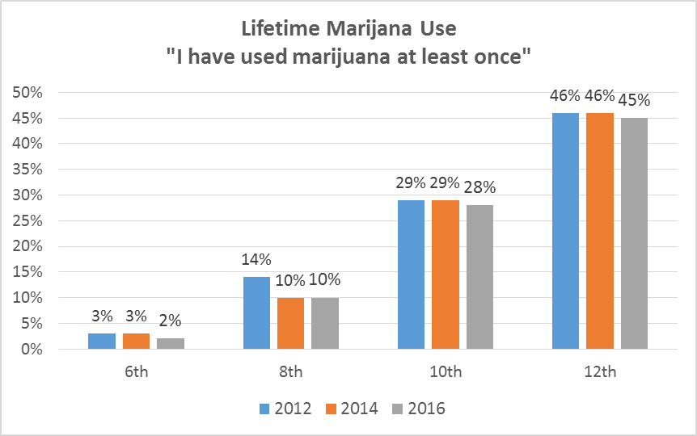
Marijuana Vaping in Washington – HYS
Notes:
Finally—what is the landscape of marijuana vaping in adults? The 2014 Washington Healthy Youth survey asks the form of marijuana used, and across the various ages, 5-7% of students say they have vaporized marijuana. This is consistent with a national survey that indicated 5% of marijuana using youth had vaped it. In terms of cases from the poison center, a rough look at our data for 2015 shows that our calls related to concentrates are also around the 5% level.
Giroud et al. also did a survey of marijuana users to see vaping was popular. Their very basic survey of adults in the UK revealed that vaping cannabis was not terribly popular. But this was mostly done in adult and in the UK, so it’s not certain how applicable it is to our setting. We know that the popularity and use is probably age dependent.

Slide 67
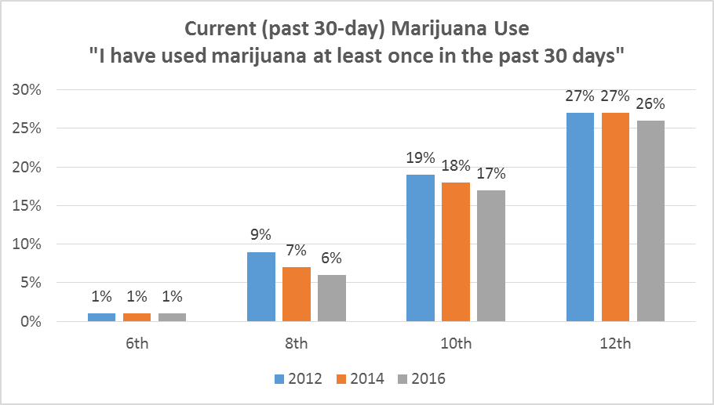
Marijuana Vaping in Washington – HYS
Notes:
Finally—what is the landscape of marijuana vaping in adults? The 2014 Washington Healthy Youth survey asks the form of marijuana used, and across the various ages, 5-7% of students say they have vaporized marijuana. This is consistent with a national survey that indicated 5% of marijuana using youth had vaped it. In terms of cases from the poison center, a rough look at our data for 2015 shows that our calls related to concentrates are also around the 5% level.
Giroud et al. also did a survey of marijuana users to see vaping was popular. Their very basic survey of adults in the UK revealed that vaping cannabis was not terribly popular. But this was mostly done in adult and in the UK, so it’s not certain how applicable it is to our setting. We know that the popularity and use is probably age dependent.

Slide 68
Marijuana Vaping in Washington
In youth:
5% indicate that they “vaporized it”
Study from Connecticut was much higher -29%¹
About 5% of WAPC Marijuana cases are about concentrates
In adults²:
Conflicting evidence popularity
Probably age dependent
Morean ME, Kong G, Camenga DR, Cavallo DA, Krishnan-Sarin S. High school students’ use of electronic cigarettes to vaporize cannabis. Pediatrics. 2015;136(4):611-6.
Giroud, Christian, et al. "E-Cigarettes: A Review of New Trends in Cannabis Use." International journal of environmental research and public health 12.8 (2015): 9988-10008.
Notes:
Finally—what is the landscape of marijuana vaping in adults? The 2014 Washington Healthy Youth survey asks the form of marijuana used, and across the various ages, 5-7% of students say they have vaporized marijuana. This is consistent with a national survey that indicated 5% of marijuana using youth had vaped it. In terms of cases from the poison center, a rough look at our data for 2015 shows that our calls related to concentrates are also around the 5% level.
Giroud et al. also did a survey of marijuana users to see vaping was popular. Their very basic survey of adults in the UK revealed that vaping cannabis was not terribly popular. But this was mostly done in adult and in the UK, so it’s not certain how applicable it is to our setting. We know that the popularity and use is probably age dependent.

Slide 69
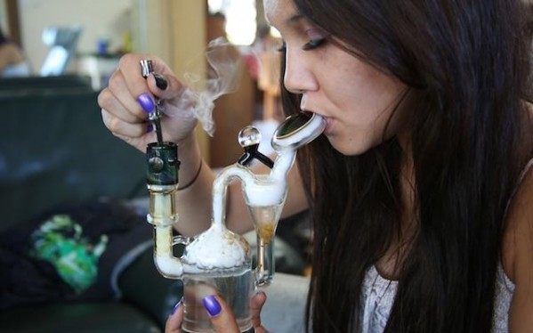
Vaping & Dabbing: Not quite the same
Dabbing is a specific way to vape* BHO
A blowtorch is used to heat a metal “nail” to over 900˚F
This BHO is then dropped through the nail, releasing a short burst of vapors that passes through a water pipe and then inhaled
*process of vaping, not act of vaping
http://googleweed.com/
Notes:
We’re going to divert here briefly to mention dabbing. How many have heard of dabbing? What have you heard about it? It has a reputation of being very dangerous.
So what is it? Well it’s a specific way to flash vaporize BHO. It’s done using this sort of rig/ water pipe pictured to the right. You start by using a blow torch to heat a metal head to 900 degrees. Once it’s hot, you use a tool (often referred to as a nail) to drop a small bit of BHO (often called “dabs”) into the rig. It’s so hot that it immediately vaporizes shooting the vapors down through the pipe, over some water to drop out any heavy impurities and potential cool it a bit, and then you inhale through a mouthpiece on the other side.

Slide 70
Vaping & Dabbing: Not quite the same
Dabbing is perceived as highly dangerous¹ and “vaping” is preferred
Use of a blowtorch and EXTREMELY high temperatures
Super heating effect releases other chemicals
Note that the concerns about explosions are in extraction, not dabbing
Vaping BHO from a pen is not the same a dabbing because the vape pen could never heat as hot (although some are trying)
1. Loflin, Mallory, and Mitch Earleywine. "A new method of cannabis ingestion: The dangers of dabs?." Addictive behaviors 39.10 (2014): 1430-1433.
Notes:
It is perceived as very dangerous because of the high temperatures involved. Not to mention the fire hazard of using a blowtorch. Note that there is a lot of talk about explosions related to dabbing, but the most serious concern of explosion is actually during the extraction process. The BHO, if made well, shouldn’t have any explosive butane left in it when dropped into the rig.
Some of the dangerous that may arise are related to the high heat used. Remember that the point of vaping is to release the essential materials without combustion or smoke. Well when you heat something to 900 degrees, there might be a sizzle when the BHO is dropped in, which is the sign of a combustion reaction. You also have to consider what off-gassing might occur from the metal when heated that high. What happens if it melts a little? What chemicals might I be inhaling from that as well?
Two researchers did a survey of marijuana users and found that this “dangerous” perception held for marijuana users as well and they users preferred to use a more traditional vape device over dabbing. However, this is probably age dependent and reflects only that one instance in time. As we know, trends change.
A final reminder that dabbing is a way to vaporize the oils, but it’s not technically considered “vaping” in the means of using one of these devices to vape. Because of the temperature difference, one of these devices will never heat something that high.

Slide 71
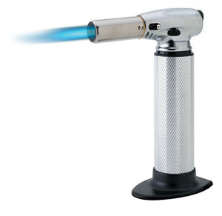
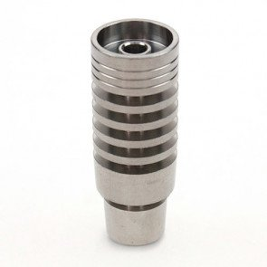
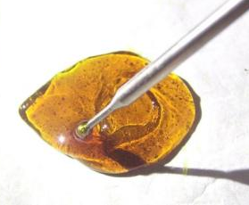
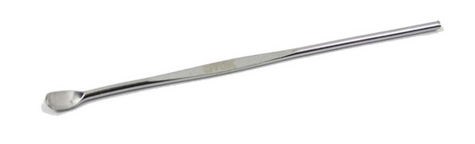
Vaping & Dabbing: Not quite the same
http://googleweed.com/
Notes:
We’re going to divert here briefly to mention dabbing. How many have heard of dabbing? What have you heard about it? It has a reputation of being very dangerous.
So what is it? Well it’s a specific way to flash vaporize BHO. It’s done using this sort of rig/ water pipe pictured to the right. You start by using a blow torch to heat a metal head to 900 degrees. Once it’s hot, you use a tool (often referred to as a nail) to drop a small bit of BHO (often called “dabs”) into the rig. It’s so hot that it immediately vaporizes shooting the vapors down through the pipe, over some water to drop out any heavy impurities and potential cool it a bit, and then you inhale through a mouthpiece on the other side.
https://www.youtube.com/watch?v=EDl3JrHEnZ8

Slide 72
Notes:
https://www.youtube.com/watch?v=EDl3JrHEnZ8

Slide 73
http://googleweed.com/
Notes:
We’re going to divert here briefly to mention dabbing. How many have heard of dabbing? What have you heard about it? It has a reputation of being very dangerous.
So what is it? Well it’s a specific way to flash vaporize BHO. It’s done using this sort of rig/ water pipe pictured to the right. You start by using a blow torch to heat a metal head to 900 degrees. Once it’s hot, you use a tool (often referred to as a nail) to drop a small bit of BHO (often called “dabs”) into the rig. It’s so hot that it immediately vaporizes shooting the vapors down through the pipe, over some water to drop out any heavy impurities and potential cool it a bit, and then you inhale through a mouthpiece on the other side.

Slide 74
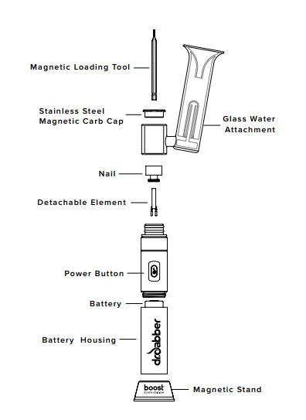
Portable Dab Rig
Dr. Dabber - $160
1st portable, battery-powered rig for essential oils
No torch required
Heats up to 600 degrees F
Do not heat the device more than 3 cycles continuously to avoid bodily harm and injury
Boost eRig truly is the best of both worlds: A portable dabbing experience without any sacrifice.
*This unit is not suitable for dry herbs, only oils and waxes.

Slide 75
Vaping other substances
Evidence is from internet, media, and anecdotal:
Methamphetamine
Cocaine
Heroin
Bath salts
Liquid Synthetic Cannabinoids (Spice, K2)
Notes:
There is not a lot of evidence in the literature showing how these devices might be used for even more substances, but there is information and stories on the internet and through popular press that highlight uses for these substances (read list)

Slide 76
Questions, Comments, Reflections?

Slide 77
Where are we now?
FDA Released new rules on May 5th, 2016
FDA can regulate E-Cigarettes, cigars, hookah tobacco, and pipe tobacco according to the Tobacco Control Act
Nationwide 18 and over restriction
Manufacturing establishments and reporting of ingredients
Premarket review by FDA; All devices since February 2007 must get approval (3-year roll-out)
Health warnings on packages and advertising
Modified risk has to be authorized (“light”, “low”, “mild”)
Notes:
http://www.fda.gov/TobaccoProducts/NewsEvents/ucm499383.htm
http://www.fda.gov/TobaccoProducts/Labeling/RulesRegulationsGuidance/ucm388395.htm

Slide 78
Where are we now?
FDA rules enforcement began August 8, 2016
Influx of new products to the market between May and August
Consumer Product Safety Commission enforcing nationwide child-resistant packing for “liquid nicotine containers” as of July 26, 2016
Child Nicotine Poisoning Prevention Act signed by President Obama 1/28/2016
Notes:
https://finance.yahoo.com/news/e-cigarette-makers-rush-products-110001914.html
http://www.cpsc.gov/en/Regulations-Laws--Standards/Statutes/Poison-Prevention-Packaging-Act/Child-Resistant-and-Senior-Friendly-Packages-packaging-guide/

Slide 79
FDA – Youth E-Cigs prevention
“August 7, 2017 the U.S. Food and Drug Administration announced it would pursue a strategic, new public health education campaign aimed at discouraging the use of e-cigarettes and other electronic nicotine delivery systems (ENDS) by kids.
The agency plans to expand its “The Real Cost” public education campaign to include messaging to teens about the dangers of using these products this fall while developing a full-scale campaign to launch in 2018.”

Slide 80
FDA focus on preventing youth e-cigs use
“Previously announced, the FDA is exploring clear and meaningful measures to make tobacco products less toxic, appealing and addictive with an intense focus on youth.
This could include measures on battery safety, flavors/designs that appeal to youth, child-resistant packaging, and product labeling to prevent accidental child exposure to liquid nicotine.
Seeking public comment on the role that flavors in tobacco products play in attracting youth; and additional restrictions on the sale and promotion of ENDS, (e.g. how products may be sold and advertised), to further reduce youth exposure and access to these products.” August 8, 2017
Notes:
Press room announcement: https://www.fda.gov/NewsEvents/Newsroom/PressAnnouncements/ucm570501.htm

Slide 81
Washington State – RCW 70.345
Vape shops under regulation by Liquor Cannabis Board same as Tobacco Shops
Child-resistant packaging required
Better warning label and information on package
Doubles fines for selling to youth (age maintained at 18)
Increases licenses to ($175) for both tobacco ($93) and vape ($0) and links tobacco and vape licenses in terms of penalties
Tightens internet purchasing requirements
Restricts use of products in public places (indoor areas such as child care facilities, schools, school buses, elevators); requires 50 ft from schools
Although the bill has good elements, it prohibits any local jurisdiction from enacting any point of sale regulations that could be used to reduce tobacco and vapor product use. It preempts local regulation of outdoor use.
Notes:
Find more information on this bill here: http://healthygen.org/sites/default/files/SB6328_Information.pdf?utm_source=Health+Policy+News+You+Can+Use%3A+April+4%2C+2016&utm_campaign=HPN+2016+-+April+4&utm_medium=email
Prohibits any local jurisdiction from enacting any point of sale regulations.
background…this is standard tobacco, and now vaping product industry plans to keep all regulations at the state or federal levels. We need to be clear when talking to folks that while the bill has good elements, it also has lifelong handcuffs that prevent local jurisdictions from developing innovative regulations that could be used to reduce tobacco and vapor product use in the most vulnerable communities.

Slide 82
Where are we now?
State legislation has sought to address…
HB 2144 - A tax was proposed for vapor products
HB 1054 - Tobacco 21 bill would raise the legal sale and distribution age for tobacco and vapor products from 18 to 21 years

Slide 83
Individual and Coalition Actions
Advocate and Educate!
Attend Prevention Policy Day in Olympia – January 15, 2018
Construct and distribute fact sheets on key bills
Arrange visits between community members and local legislators
Participate in “Town Hall” meetings and forums
Testify in person or by writing and submitting a letter
Contact your legislators using WA State’s 1-800-562-6000
Distribute time sensitive legislative alerts
Notes:
For those people who are “public” or “government” employees, there are ways to “educate” so that you don’t risk being accused of lobbying. For example: You can send data and say to “consider” the data as law makers make decisions.

Slide 84
More Individual and Coalition Actions
Have a voice in the community!
Publicize national and local reports
Write Letters to the Editor, call in on radio shows
Use social media
Write articles for your other community involvements (PTAs, faith groups, community blog, etc.)
Encourage student journalists to cover advocacy events and stories
Post on community bulletin boards

Slide 85
Resources
Seattle Children’s - A Parent’s Guide to Preventing Underage Marijuana Use
Start Talking Now webpage and Facebook (Washington Healthy Youth Coalition)
Washington Poison Center Toxic Trend Reports
Public Health Seattle-King County Tobacco Prevention Program
Escape the Vape
Healthy King County Coalition – TMoD
American Lung Association
Foundation for Healthy Generations
Campaign for Tobacco Free Kids
FDA
Notes:
http://www.lung.org/about-us/local-associations/washington.html
https://www.healthykingcounty.org/projects/
https://www.tobaccofreekids.org/
http://www.kingcounty.gov/depts/health/smoking/tobacco-vapor.aspx
https://www.fda.gov/TobaccoProducts/Labeling/RulesRegulationsGuidance/ucm394909.htm
https://www.facebook.com/StartTalkingNowWA/

Slide 86
The Kit
Kit cost: $230
What do you get?
Materials and the container
User guide that describes the items and basic research
Real-time assistance from Arti Patel or Jared O’Connor
Training Materials with the ability to add your logo
Presentation
Notes:
For Prevention WINS Discussion: Are there concerns about having a kit? Any concerns about using it? Storing it? Using on school premises? How should the kits be shared and utilized by Prevention WINS members?

Slide 87
Information Reflection
What topic, idea, or tidbit resonated the most with you?
Is there a topic that you know you’d like to present on? Why?
What are you motivated to do?

Slide 88
You are now trained!
Example Expectations
You will need to collect the following information each time you present
When
Where
Number in attendance (both youth and adults)
Length of presentation
Feedback
Implement a brief survey with the audience

Slide 89
Post-Test
Please put your initials at the top right hand corner

Slide 90
Thank you!
For information on how to order and purchase a kit:
Arti Patel
apatel@wapc.org
206-517-2380
Questions about coalition logistics:
Liz Wilhelm
Liz.wilhelm@seattlechildrens.org
206-987-7612

